Slide 1
40+ Years of
Building Communities
Changing Lives
March 2025

Slide 2
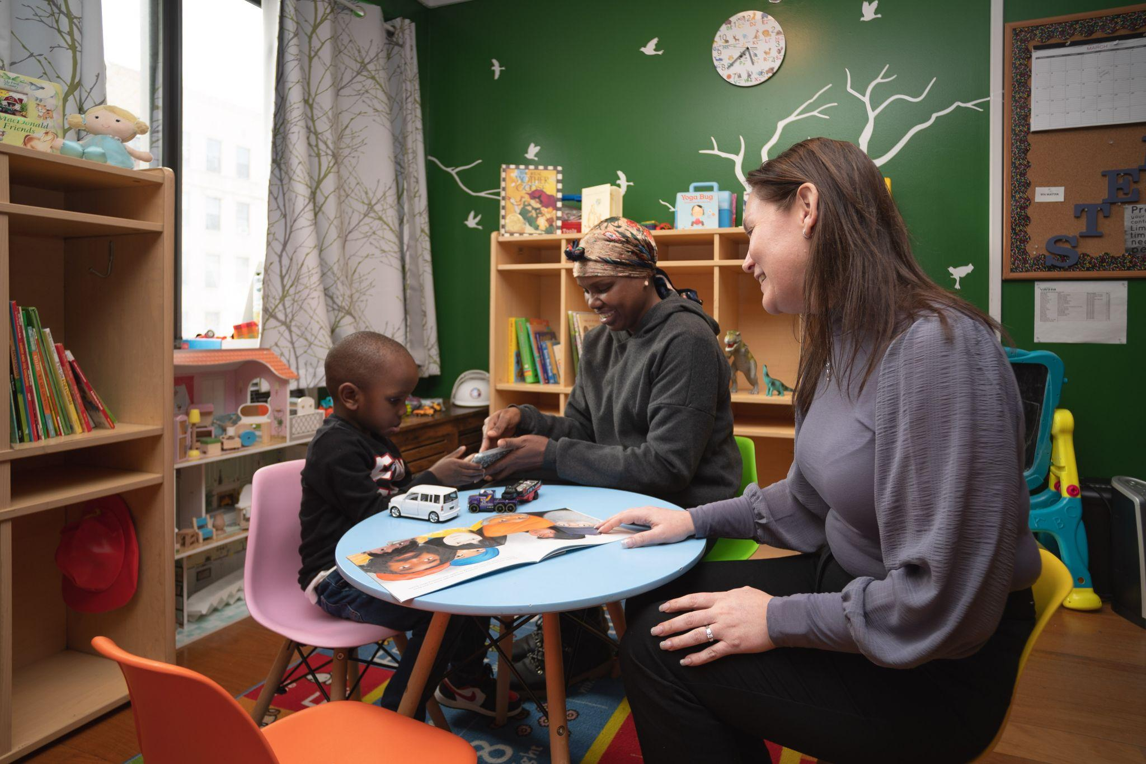
Our Approach
Westhab delivers hope and opportunity and fosters vibrant communities by:
Affordable Housing
Creating high-quality homes that are affordable
Pathways to Permanent Housing
Helping our neighbors get back on their feet
Employment Services
Training for good jobs with pathways to a living wage
Youth Services
Empowering youth
to reach their full potential
2

Slide 3
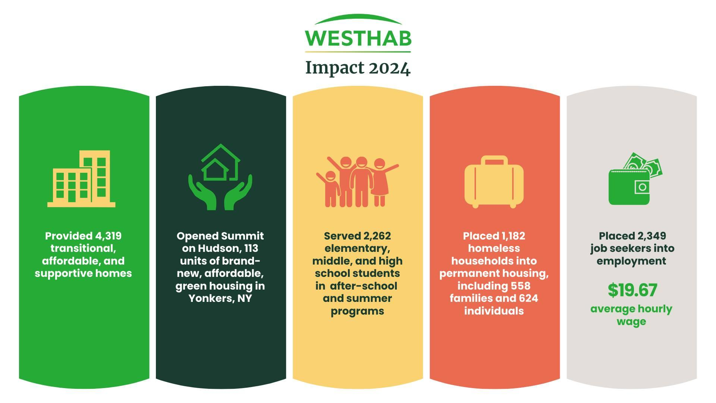
Provided 4,034 transitional, affordable, and supportive homes
Opened two shelters dedicated to serving
the asylum seeker population in NY.
Placed 898 homeless households into permanent housing
3

Slide 4
What You Can Expect
Coyle Street Family Center
4

Slide 5
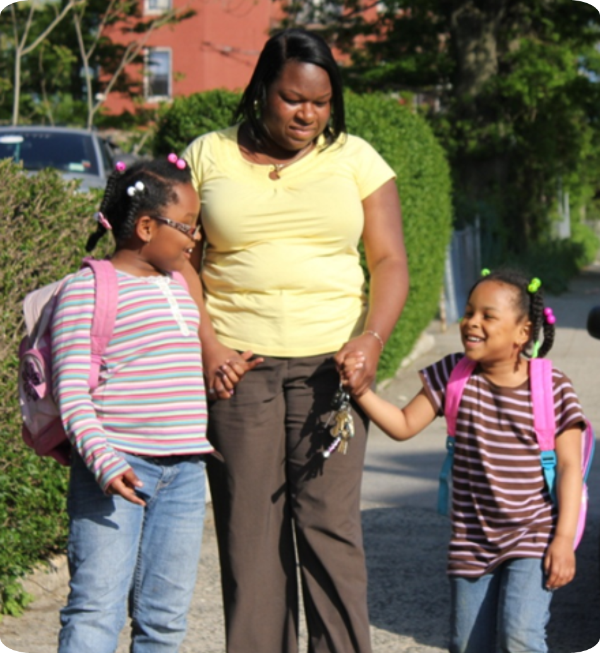
Program Design
100% Families With Children
(No Single Adults. No Unaccompanied Youth.)
175 Individual Apartments, each with kitchens and bathrooms
A rear Playground, on-site service offices and meeting space
24/7/365 Trained, Professional Security Team
5

Slide 6
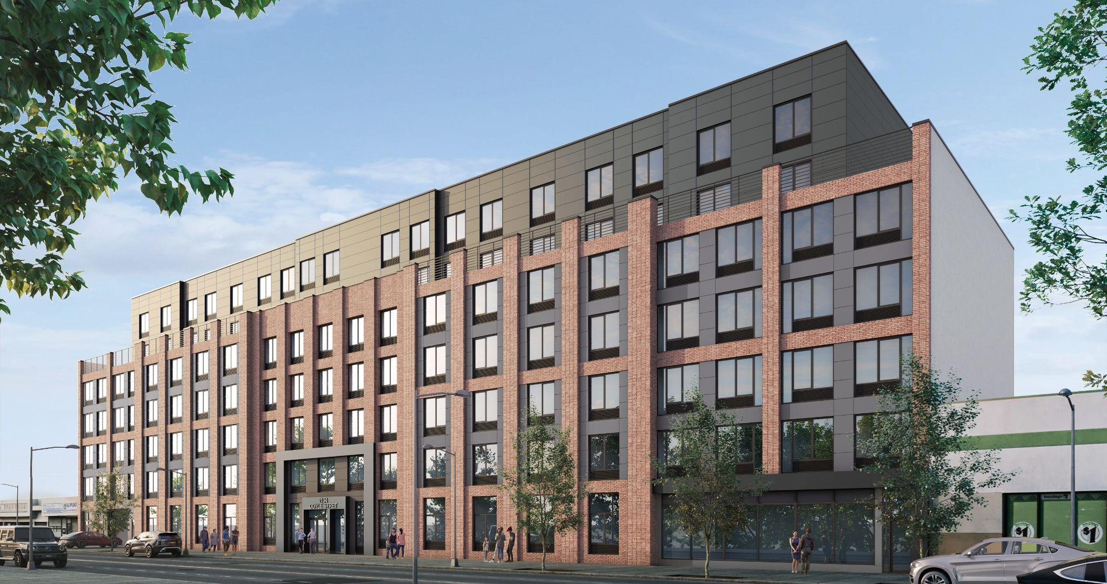
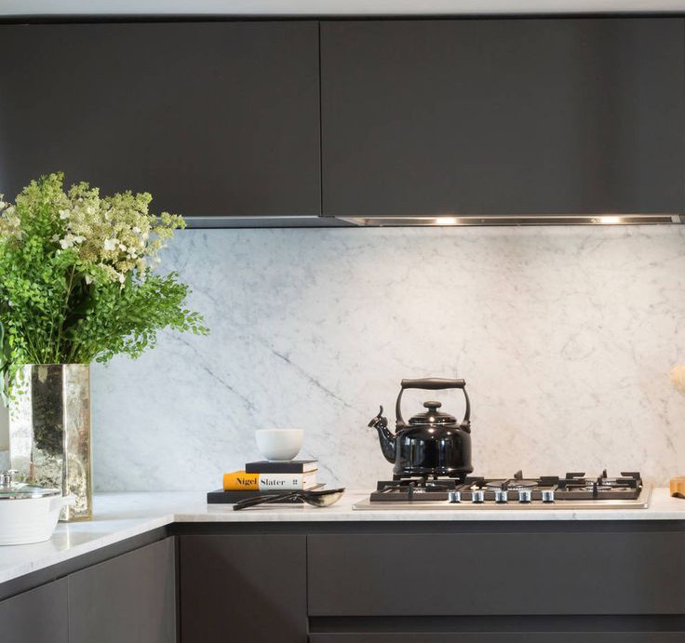
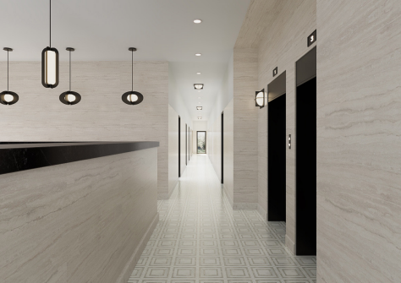
Building Design
New construction, built to the same standard and quality as brand-new affordable housing.
Thoughtful, modern design and extensive landscaping and attractive streetscape.
The potential to convert to permanent affordable housing in the future.
6

Slide 7
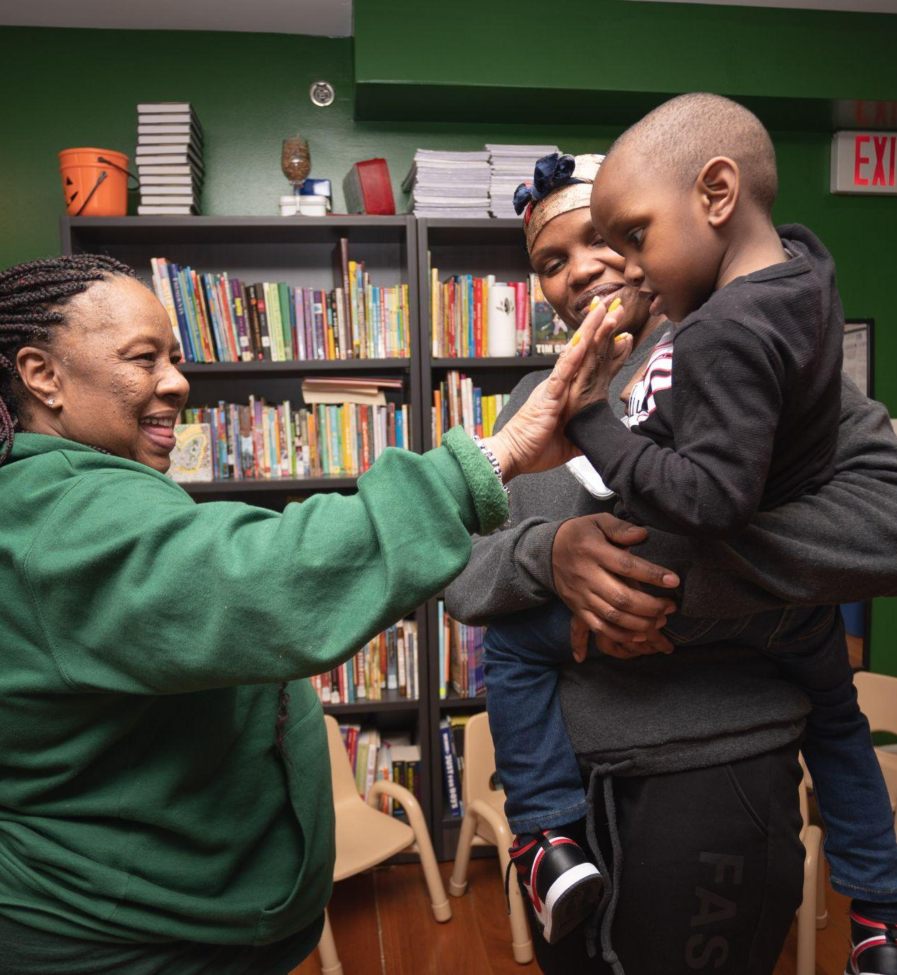
Staffing
Coyle will have a robust team of social services professionals:
Program Director
Case Managers
Housing Specialists
Employment Counselors
Recreation Specialists
24/7/365 Security Team
7

Slide 8
Program
All Families Will Be:
Assigned a case manager.
Referred for medical services.
Actively engaged in finding permanent housing.
Actively engaged in securing employment.
All school-age children will be enrolled in school.
8

Slide 9
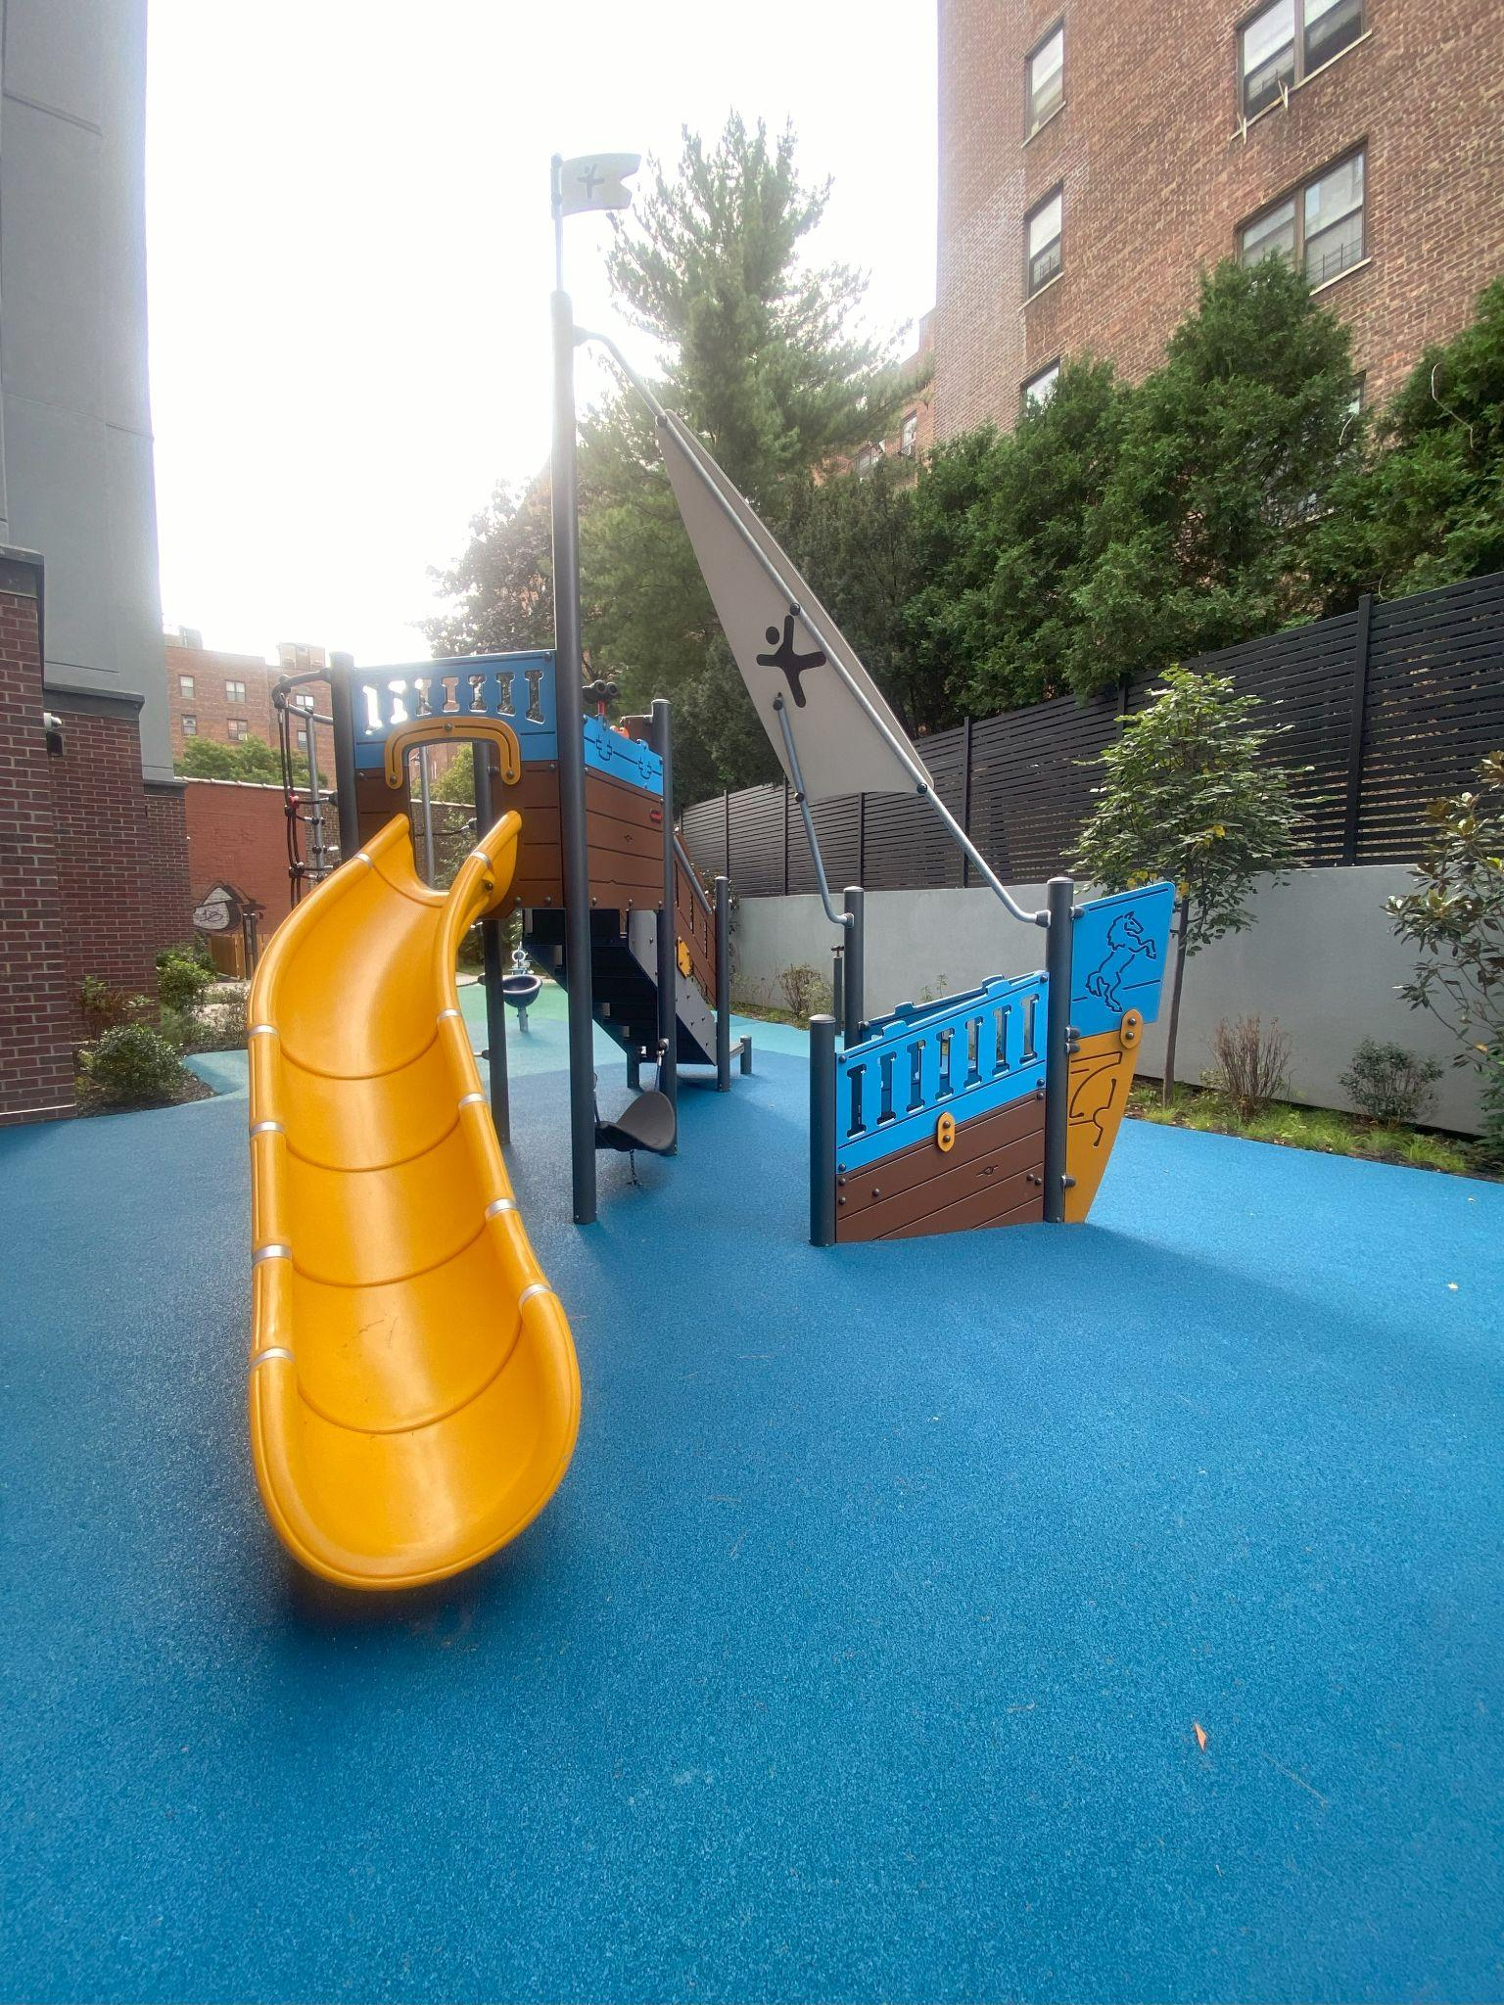
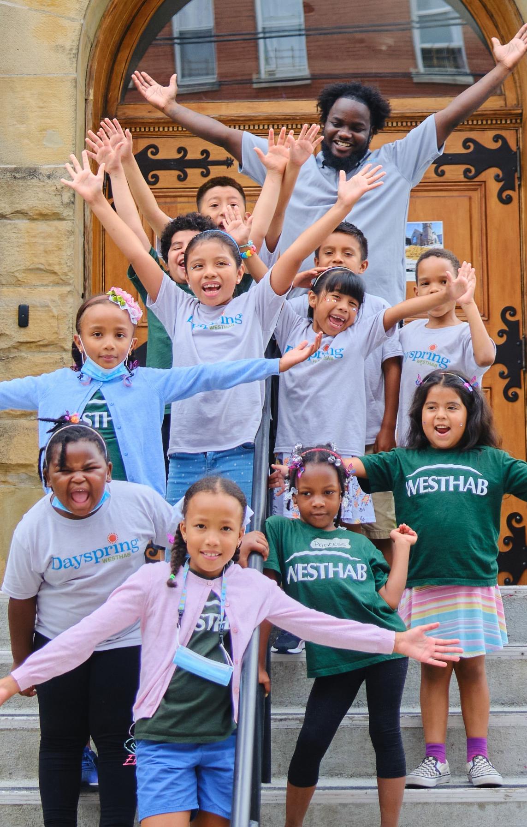
Youth Services
After-school tutoring, enrichment, and recreation for all resident children.
On-site recreation / homework room.
Custom-designed rear playground.
9

Slide 10
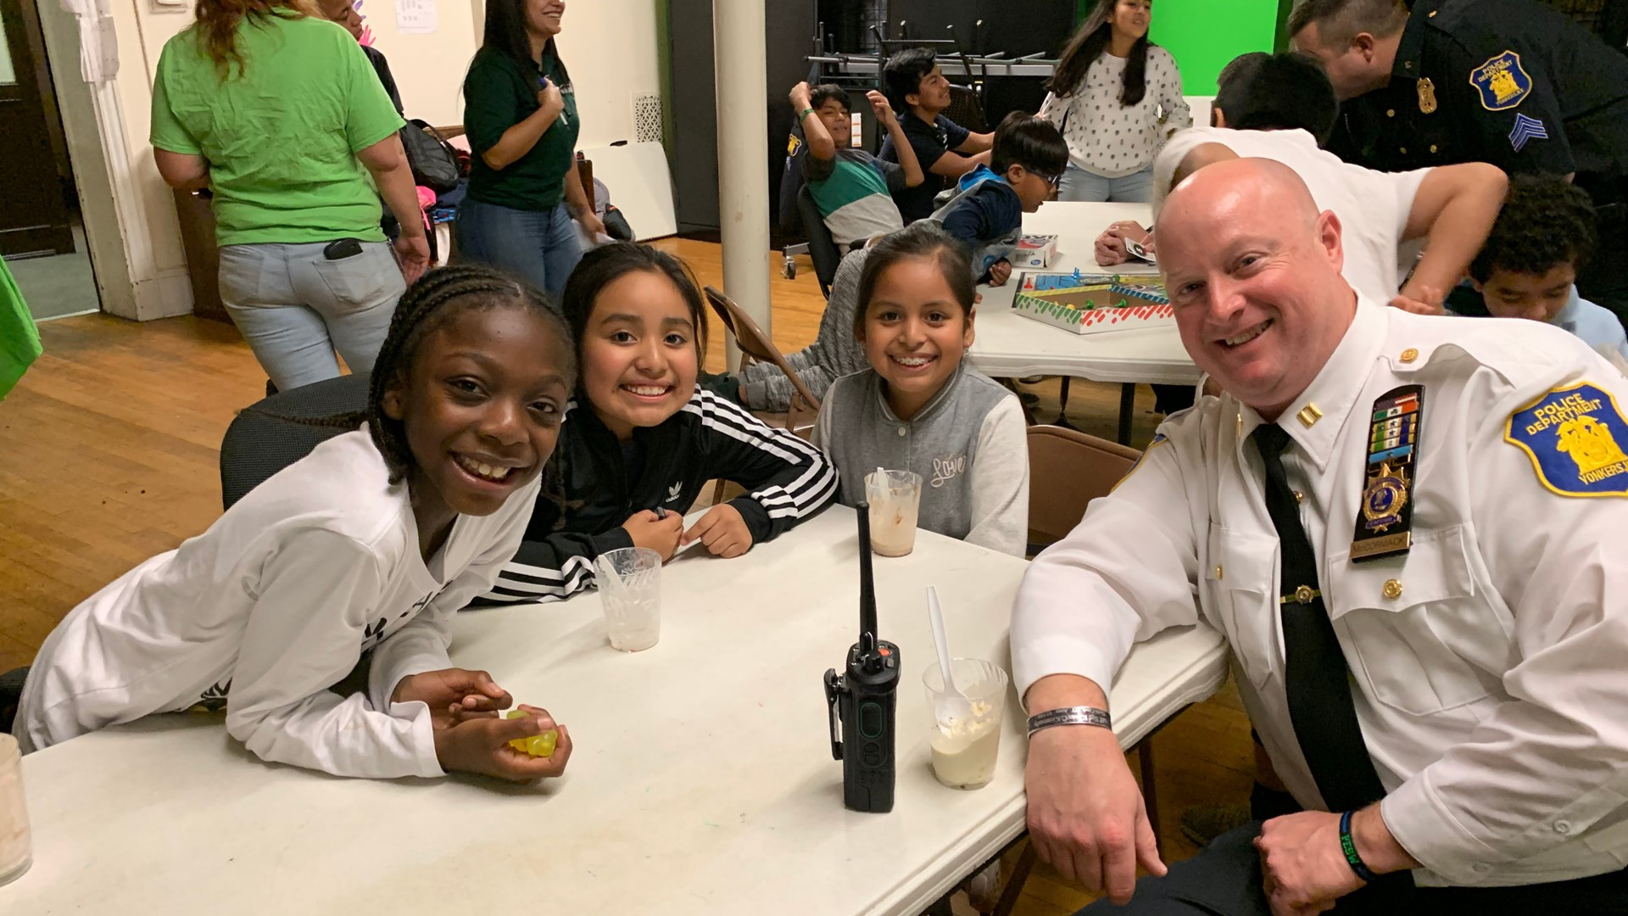
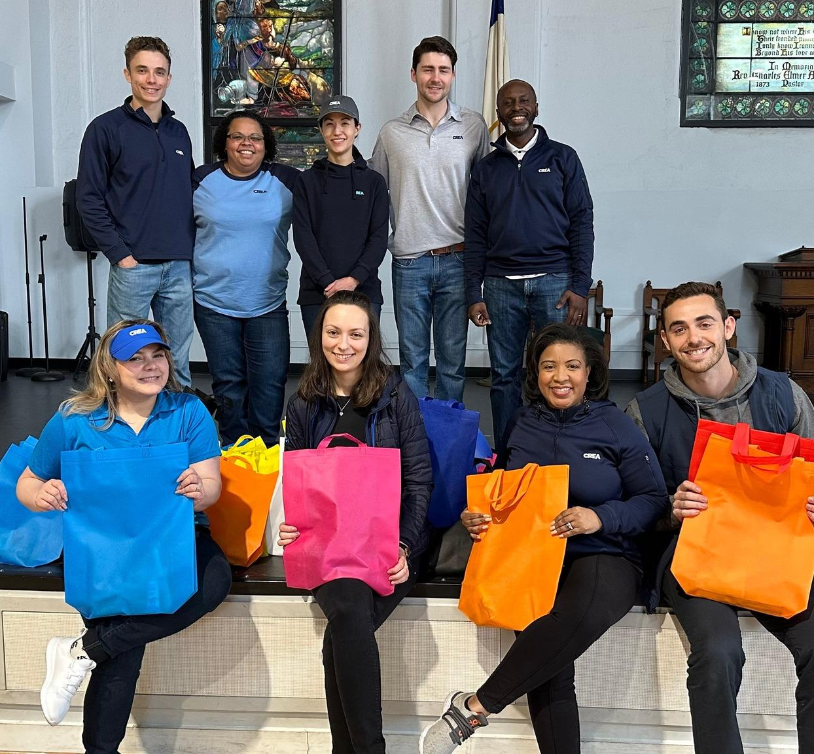
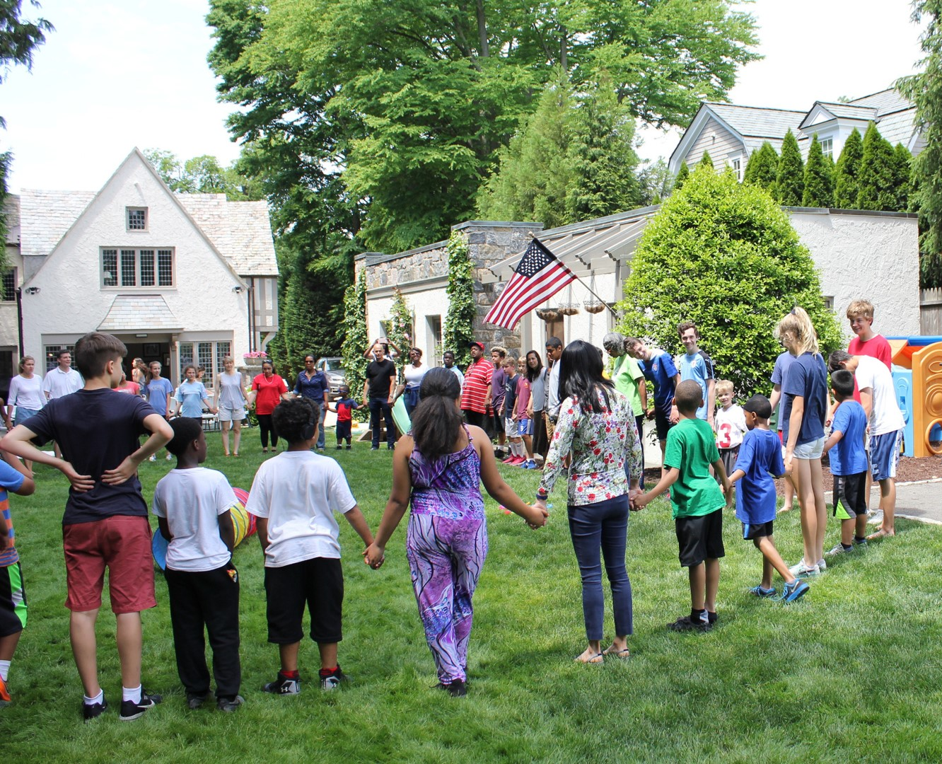
Good Neighbor Policy
Westhab will work with all local residents and community stakeholders to be an active and accountable neighbor.
We will create a local Community Advisory Board that meets regularly.
We will prioritize hiring from the local community.
10

Slide 11
Coyle Street Family Residence
A Pathway To Permanent Housing
Families With Children.
24/7/365 Security.
On-Site Youth Programming.
Modern, Attractive Design.
Accountable, active nonprofit owner / manager committed to our Good Neighbor Policy.

