Slide 1
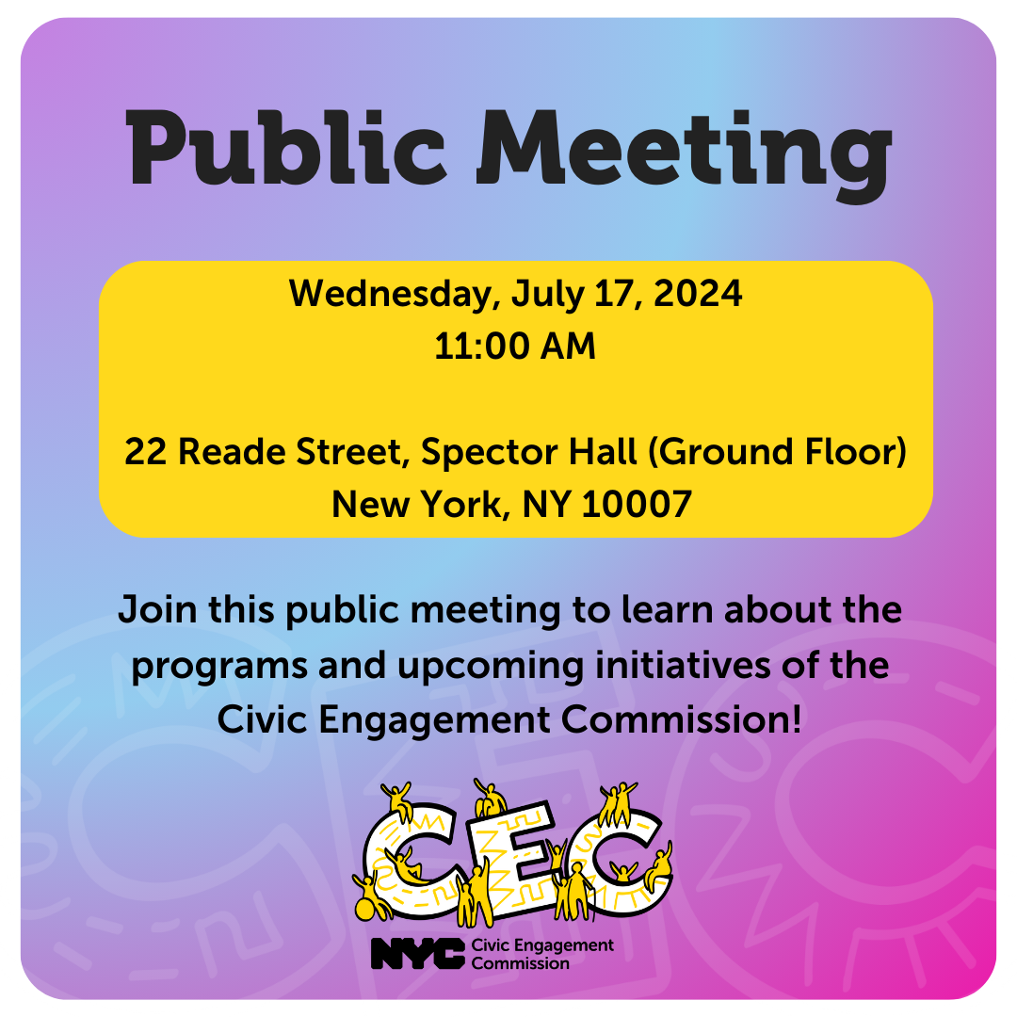
Public Meeting
July 17, 2024
@NYCCEC | nyc.gov/cec

Slide 2
Technology & Housekeeping
To Commissioners:
In-Person Participants:Please mute your microphone when you're not speaking and turn it on when needed
To Online Participants: Please mute your microphone when you're not speaking. Please unmute and let us know when you'd like to offer a comment, since we cannot see you.
To All Participants: ​
Call participants in the order they have registered for public comment prior to meeting, then during today's meeting​
Closed Captioning:​ Closed Captioning will be displayed on the smaller screen​.
​
To In-Person Participants:​
To submit a public comment, please add your name and affiliation to the sign in sheet by the door. We will call on you to speak in order received.​
To Online Participants:​
Closed Captioning:​ Closed Captioning is available online at https://bit.ly/CECCAPTIONS
To submit a public comment, please submit your name, affiliation, and public comment via email to info@civicengagement.nyc.gov or via text to 917-587-9103. We will read comments in order received.

Slide 3
Agenda
Attendance​
Approval of Meeting Minutes from April 24, 2024
Language Access Plan
Budget Update
Program Updates
Participatory Budgeting Program
Cycle 2 Updates
Cycle 1 Phase 4 Implementation Updates
Racial Equity Updates
Poll Site Language Assistance Program
Community Boards
Public Comment

Slide 4
Approval of Meeting Minutes

Slide 5
Language Access Plan

Slide 6
Language Access Implementation Plan (LAIP)
Part of compliance under Local Law 30
Guides the agency’s provision of meaningful language access to information and services
Promotes equitable access to services by
Addressing language barriers
Enabling agencies to better serve culturally and linguistically diverse communities,
Fostering inclusivity within operations

Slide 7
CEC LAIP
1 | Mission and Services | Introduces the CEC and our core mission.
2 | Agency Language Access Policy | Outlines the language access policy of the CEC.
3 | Language Access Needs Assessment | Explains the language access goals for the CEC.
4 | Notice of the right to language access services | How the CEC ensures the public knows about their right to language access services.
5 | Provision of Language Services | Types of language services provided by the CEC
6 | Resource Planning | How the CEC ensures adequate resources to provide language access
7 | Training | Types of training provided for CEC staff
8 | Continuous Improvement Planning | Details how the CEC will continue monitoring and planning language access improvements
9 | Goals and Action planning | Details CEC language access goals
10 | Methodology for Voter Language Assistance Program | Publicly vetted methodology that the Voter Language Assistance Program uses to select poll sites and languages.

Slide 8
CEC LAIP
Utilized 4 Factor Analysis to create LAIP
Factor 1: Number or proportion of LEP persons in the eligible service population
Factor 2: Frequency with which LEP individuals interact with the agency
Factor 3: The importance of benefit, service, information, or encounter to the LEP person
Factor 4: Resources Available
Each program lane integrates interpretation and translation services into planning and implementation
Commission allocates $100,000 (subject to change) for translation and interpretation services as well as $1M annually for voter language assistance

Slide 9
Goals for 2024 - 2026
Develop CEC-wide translation style guide for all program lanes.
Create centralized request portal for language service requests
Expand training for new hires during the onboarding process
Create of Language Access Methodology for the People’s Money
Establish monthly Language Access office hours

Slide 10
Past Achievements
All materials used by the People’s Money for all 4 phases were translated into LL30 languages (Arabic, Bengali, Simplified/Traditional Chinese, French, Haitian Creole, Italian, Korean, Polish, Russian, Spanish, Urdu) plus Yiddish and Italian
Over the phone interpretation made available to all Community Boards
Presented to Community Boards about Language Access
Contracted professional translation/interpretation vendor and over the phone interpretation vendor
Voter Language Assistance Program revamped posters and digital outreach materials

Slide 11
Budget Update

Slide 12
CEC FY 25 Budget
 | ADOPT FY 24 | ADOPT FY 25 | TOTAL REDUCTION
 | $13,515,915 | $12,658,198 | $857,717
 |  | ADOPT FY 25 | Headcount
 | PS | $2,726,758 | 25
 | OTPS | $9,931,440
Highlights
$2,000,000 funded for the TRIE Neighborhood Initiative (not baselined)
FY 23 - $2.4 M FY 24 - $1.8 M
Poll site budget restored
$671 K restored to the PB budget

Slide 13
Program Updates

Slide 15
Process Cycle: Current Status
Fall
Winter
Spring
Upcoming FY
Phase 1: Idea Generation
Phase 2: Project Vetting and Development
Phase 3: Voting
Phase 4: Project Implementation
And Evaluation
Year 1
Year 2
Complete
Complete
Complete
Complete
Complete
Complete
In process
In process

Slide 16
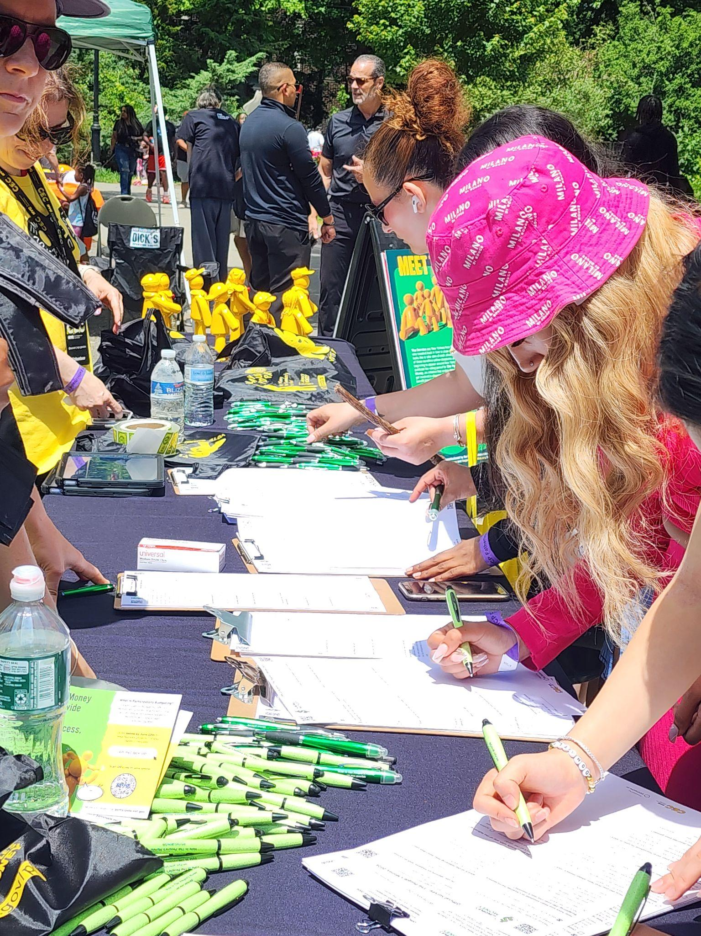
Cycle 2: Voting
The People's Money voting phase ran from ​
May 1 – June 16
​
The Commission funded 88 Community partners, 3 Library Systems, and 2 CUNY campuses carrying out an online and in-person strategy in all five Boroughs and 33 Equity Neighborhoods​
​
Digital Ballots Counted:
31,324 Borough ballots (5,985 more than Cycle 1)
Total Ballots Cast: Still Counting Paper Ballots!​
Announcement coming soon​!

Slide 17
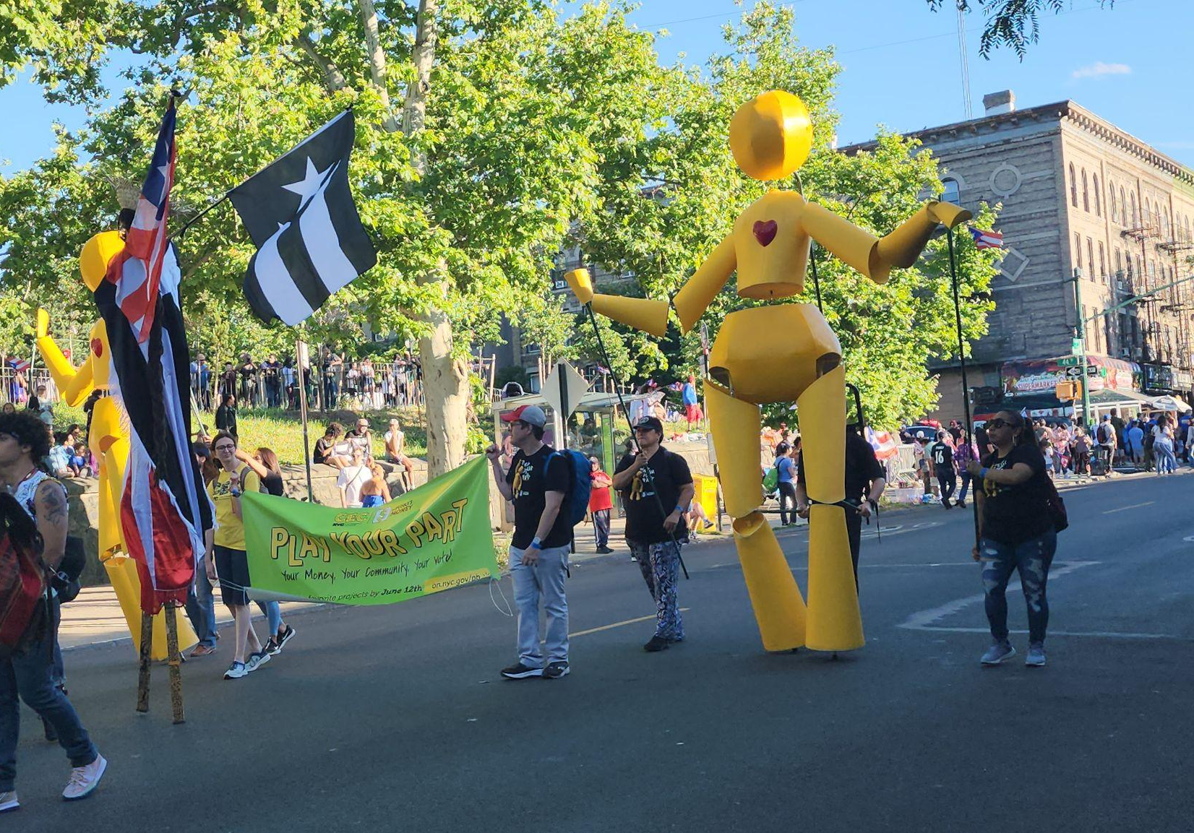
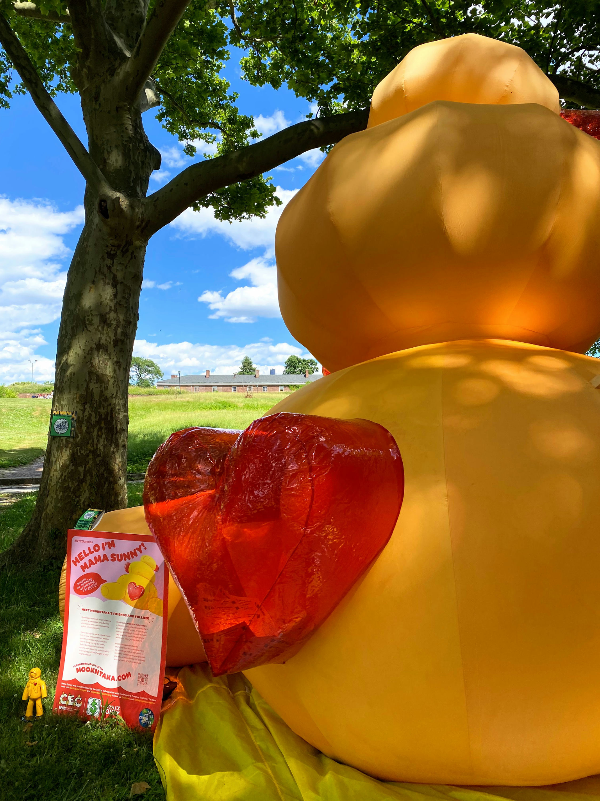
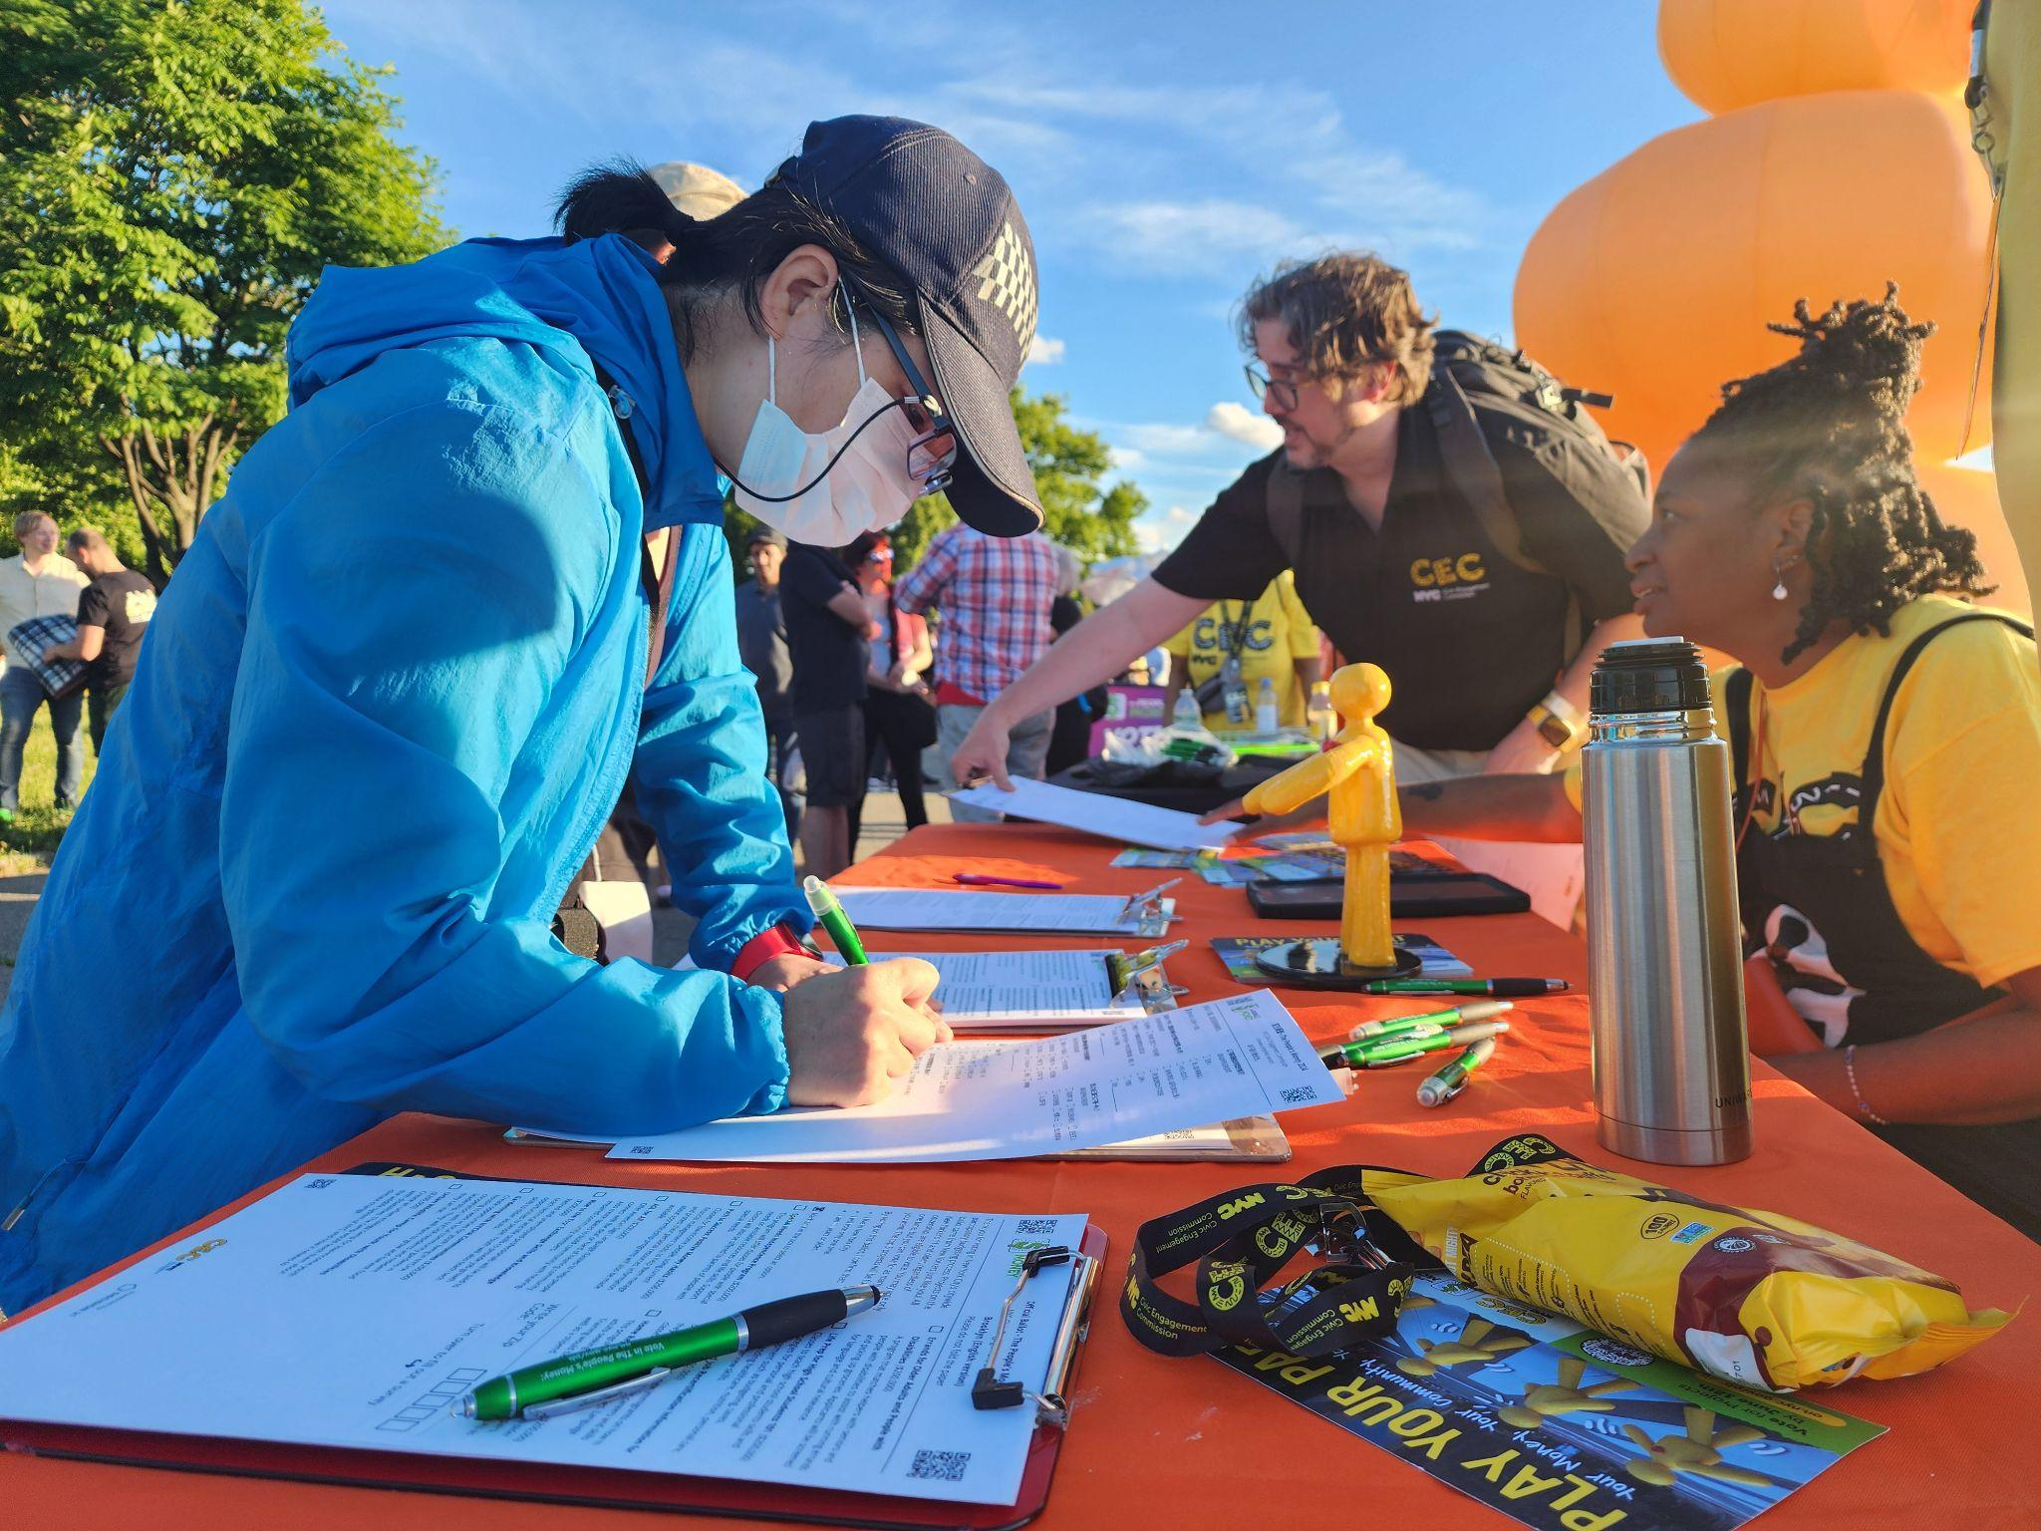
Cycle 2: Flagship Events
The CEC Hosted 5 flagship voting events with the Sunny puppets and Mama Sunny
Bronx Week Parade and Festival
Sunset Park Puerto Rican Day Parade and Festival
Queens Pride Parade and Festival
Staten Island Family Fun Day
Manhattan 9th Avenue Food Festival
As well as activations at
Governors Island
Immigrant Plaza in Manhattan
Union Square Farmers Market
Powerhouse Arts Space in Brooklyn
​

Slide 18
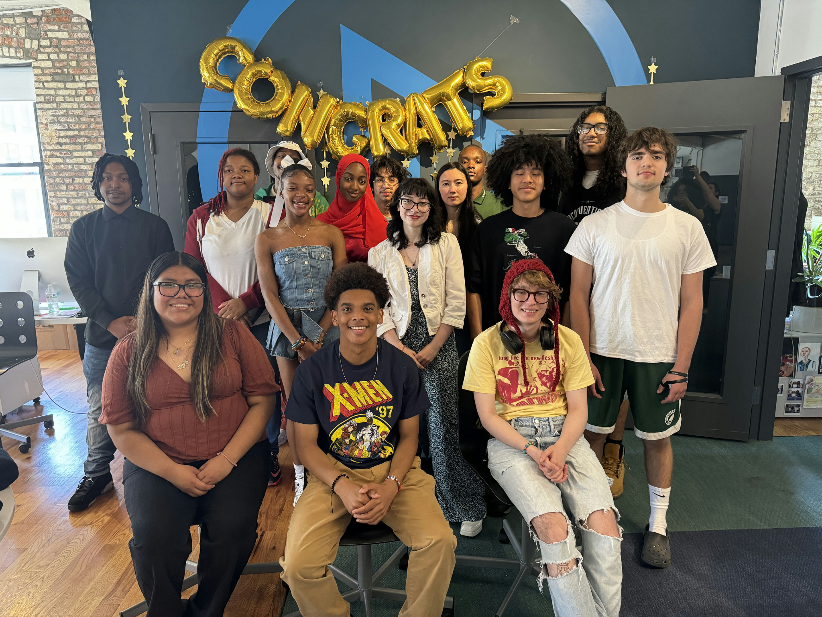
Projects to be Funded
20 Borough Projects
Bronx – 5 @ $174,000​
Brooklyn – 5 @ $200,000​
Manhattan – 4 @ $150,000
Queens – 5 @ $170,000​
Staten Island – 1 @ $180,000​
Total Funding - $3,500,000
​
Notes:
Graduating Class at ReelWorks, Borough Implemented Project in Manhattan from Cycle 1

Slide 19
The People’s Money Project Implementation
Cycle 1: Phase 4

Slide 20
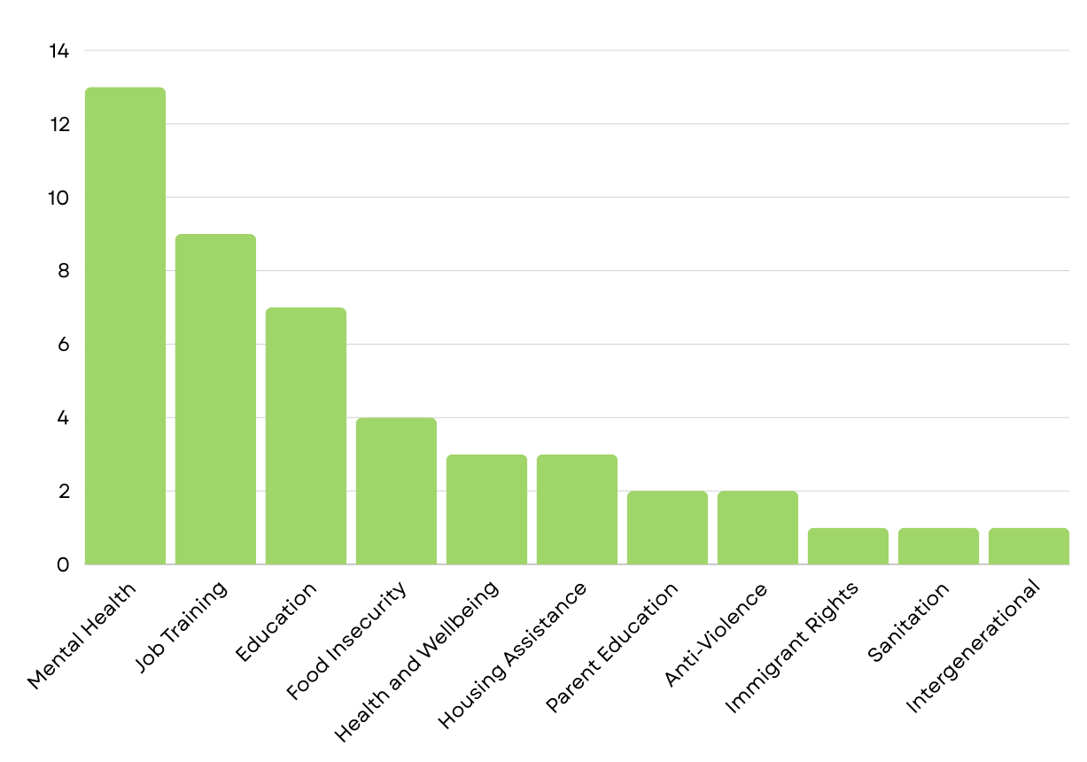
Types of Projects Being Implemented
Total Projects: 46
13 Borough Projects
33 Neighborhood Projects
16 projects’ target pop. is youth and 14 are intergenerational.

Slide 21
Implementing Partners
46 Projects
44 CBO Partners

Slide 22
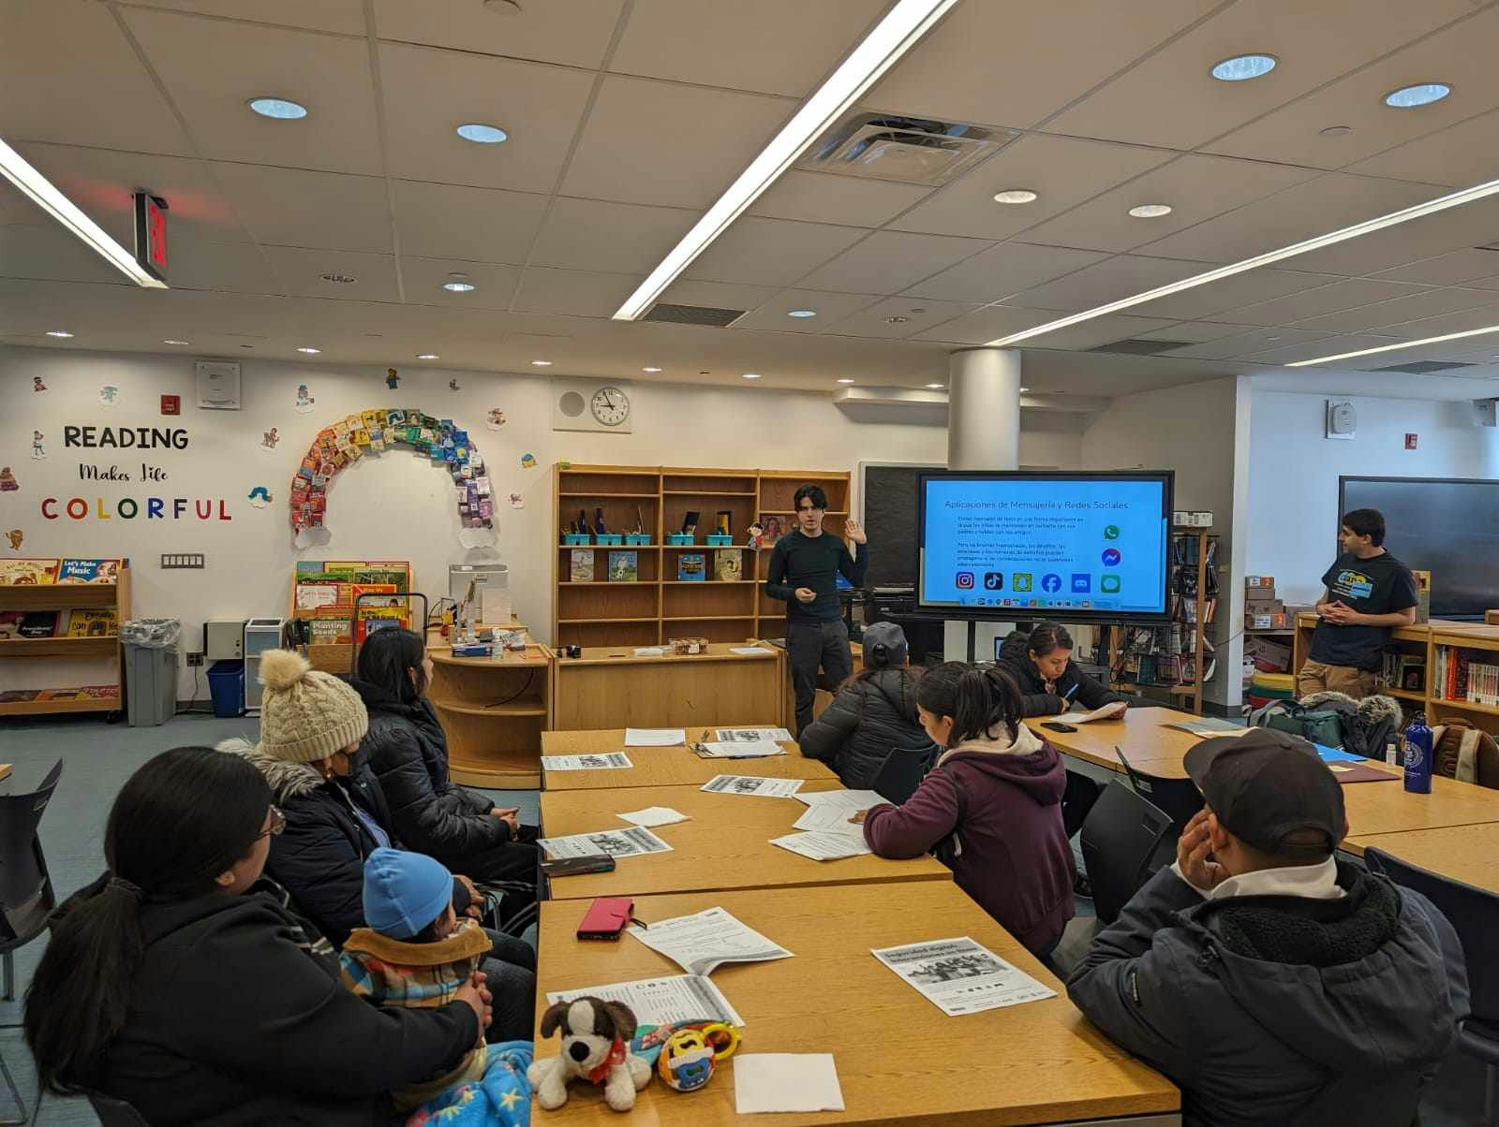
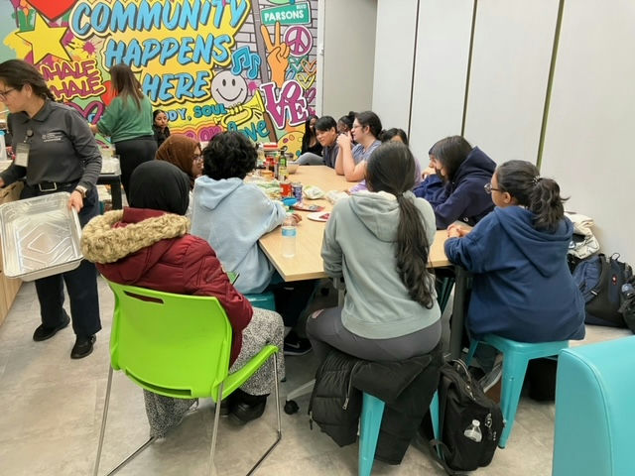
Implementation Updates
Organizations implementing projects in TRIE neighborhoods are submitting final reports to the CEC outlining the project and summarizing its impact on the community.
Borough implementing partners will report on their projects in the Fall.
These reports include an executive summary, introduction, project background, objectives, methodology, key findings, analysis/ interpretation, and recommendations.
We have an Americorp member who is going to be working with us to support the Project Implementation phase!

Slide 23
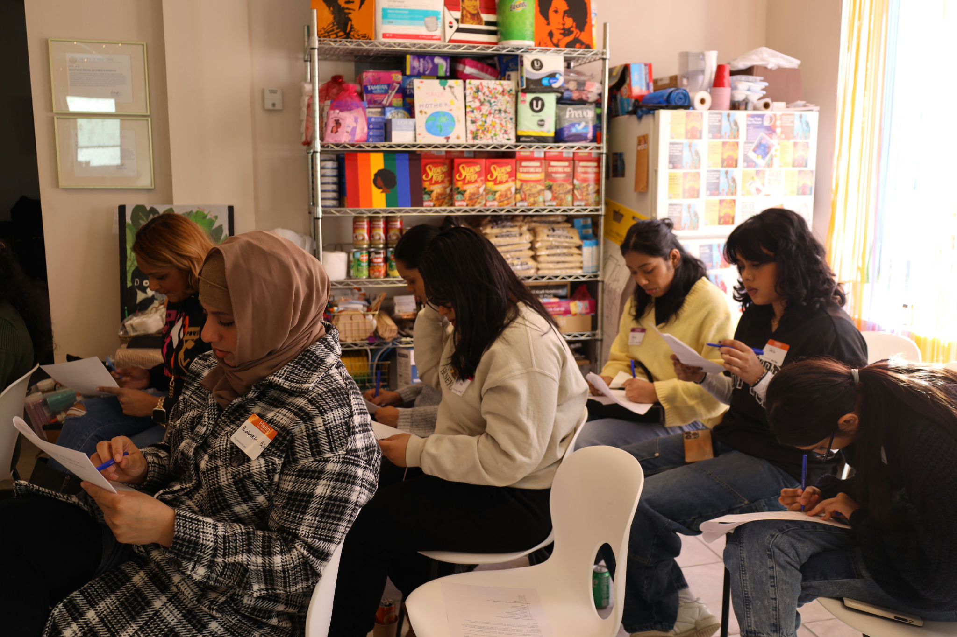
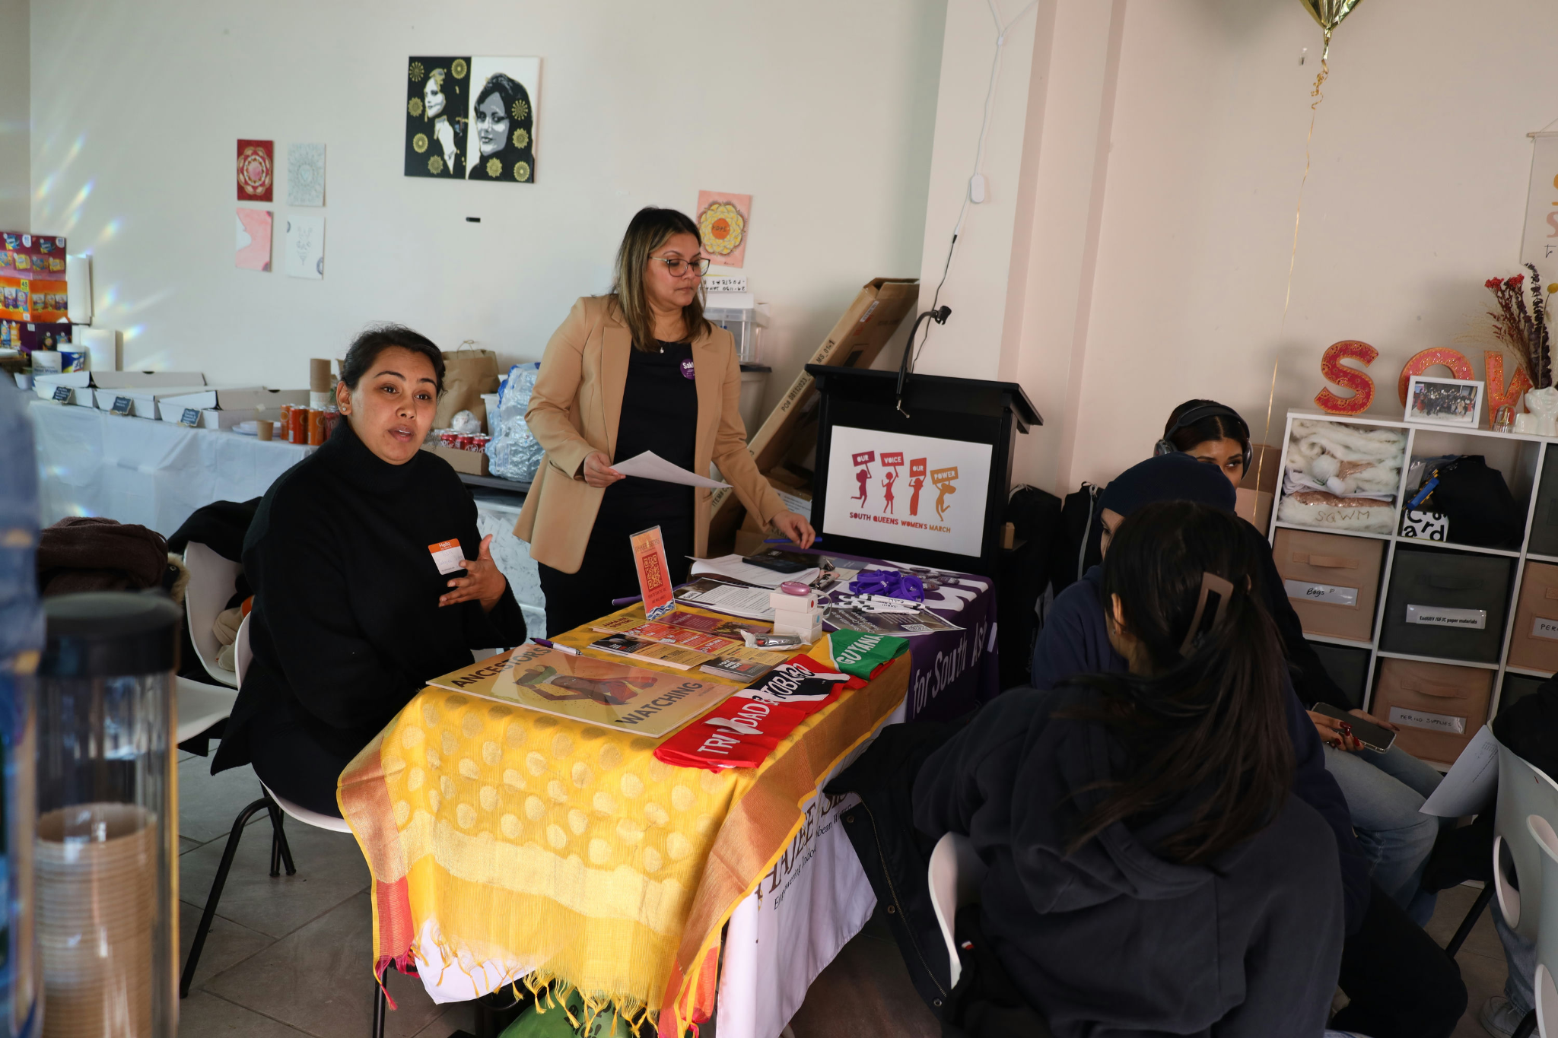
Key Areas of Impact
Mental Health
Awareness and Prevention
Increasing Resiliency
Food Access
Decreasing Food Waste
Culturally Competent Programming
Arts Programming
Creative Wellness
Immigration Resource Access
Increasing Knowledge of Resources
Empowerment
Financial Empowerment
Education
Vocational Skills Training
Employment

Slide 24
Stay Updated
We are planning a showcase of all the projects which will be held late in the Summer/early Fall. We will keep you all posted on this!
To find out more and stay updated on the whole process as well as each of the projects visit participate.nyc.gov.

Slide 25
TRIE Neighborhood Initiative
FY 2023 - FY 2024

Slide 26
2023-2024 TRIE Neighborhood Initiative
112 Coalition Meetings held
131+ Coalition Members engaged
$280,000+ allocated towards coalition-building
42 Civic Engagement Workshops conducted
PB ballots collected from TRIE Neighborhoods are being counted.

Slide 27
Racial Equity Planning

Slide 28
NYC Mayor's Office for Equity and Racial Justice
NYC has started its first-ever, citywide racial equity planning process to address racial inequities. As a part of this process, the NYC Mayor's Office for Equity and Racial Justice (MOERJ) will work across city agencies to set goals, track progress, and make continuous improvements to eliminate racial disparities and promote fairness for all residents.
City agencies have been trained by MOERJ and are beginning work on their agency’s racial equity plan this summer. MOERJ is providing direct support and guidance to agencies throughout the planning process to ensure the production of strong plans.
Timeline:
March-May 2024: Planning process kicks off and drafting of agency plans underway.
June-September 2024: Draft plans reviewed, and Citywide Racial Equity Plan prepared.
October 2024: Preliminary Citywide Racial Equity Plan released and reviewed.
Notes:
Updates:
The charter requires the city to produce a citywide racial equity plan, inclusive of individual agency racial equity plans, on a biennial basis. Per the charter, the city's racial equity plan should encompass: 1) Outcome measures 2) Short and long-term goals 3) Strategies to reduce racial disparities
The Commission on Racial Equity ensures community voice is bought into the process –- proposing community equity priorities and outcome indicators for possible inclusion in the plan.
The MOERJ team has been working diligently to roll out the city's inaugural citywide racial equity plan. We have designed a planning process that is first and foremost focused on structural reform and moving government towards equity and justice in greater unison. To get at the heart of this, our planning process is focused on the core levers of government: budget, staffing, procurement, service delivery, and policymaking, to name a few. This is not a mere compliance exercise, but an opportunity for the city to pursue long-term transformation. Agencies are examining their priorities relative to the foundational values of the charter, assessing disparity data and community equity priorities, and developing short-, mid-term, and long-term goals and strategies that are responsive.
Over the past months, our team has worked on multiple fronts to ensure a successful racial equity planning process. We have briefed senior leaders, identified planning teams across agencies, developed planning tools, and led full-day training workshops. We are providing continuous support to agencies throughout the process through dedicated office hours and 1:1 technical assistance sessions.
Agencies have enthusiastically embraced this process. This fall, we look forward to sharing a preliminary plan with the public and a final plan thereafter. Once the plan is released, our work continues, with MOERJ quickly shifting towards implementation and working closely with agencies to advance critical goals, track progress, and make continuous improvements to eliminate racial disparities and promote fairness for all New Yorkers.

Slide 29
Poll Site Language
Assistance Program

Slide 31
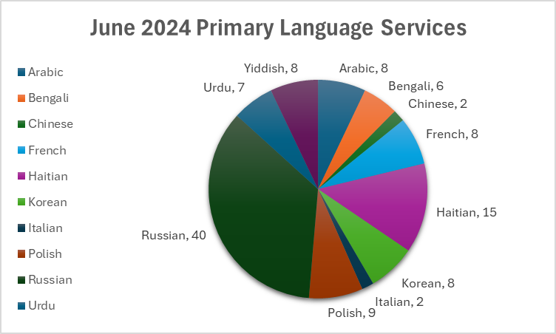
Voter Language Assistance
-113 language services total
-90 Unique Poll Sites - 15 Early Voting, 75 Election Day
-100% of services delivered as planned
Notes:
No primaries on Staten Island.

Slide 32
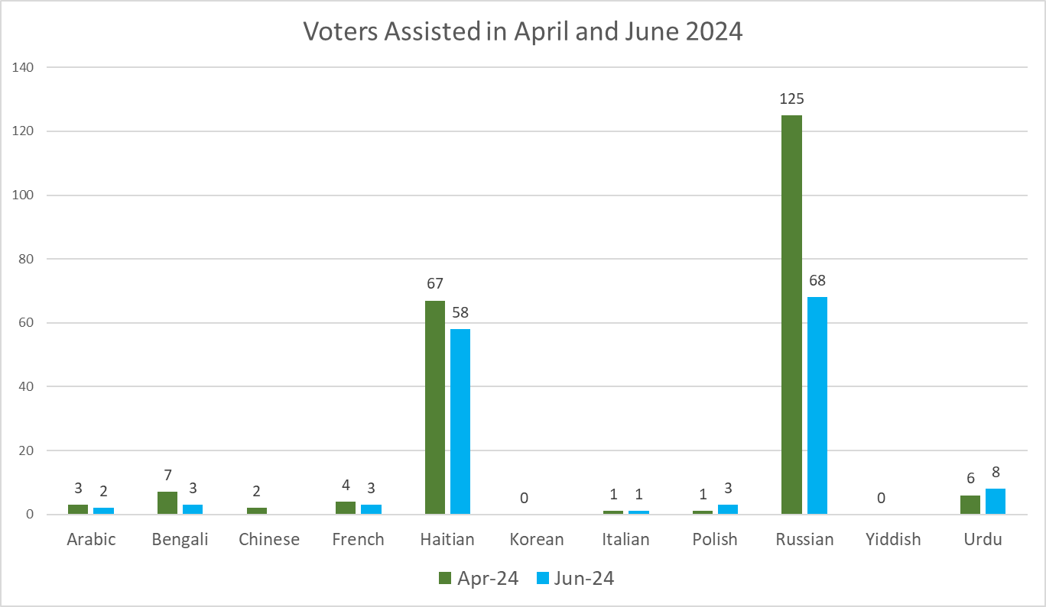
Voter Language Assistance - Utilization of Services in June and April Primaries
Notes:
Total voters in April: 216 Total Voters in June (provisional, pending QA): 146 Korean and Yiddish had no voters assisted in June 2024.

Slide 33
Voter Language Assistance - Outreach & Ads
Outreach conducted with assistance from the LAAC, CEC team members, and interns to reach electeds, partner City agencies, and organizations that work with VLA communities
~$4,000 spent in hyper-targeted ads on Facebook for the June Primary, reaching 100K+ people
Organic social media posts on CEC’s social media accounts raised awareness.
Print and digital informational material was made available in all VLA languages.

Slide 34
2024 Language Assistance Advisory Committee Updates
Conducted outreach for April and June Primaries
Convened monthly
Researched and presented on Korean Speaking Community in NYC
Vetted translation of PB informational materials
Vetted flow of online PB voting process in LL30 languages plus Yiddish and Italian
LAAC members representing Russian and Haitian language communities collected or helped us connect with organizations that collected PB ballots

Slide 35
Language Access for Participatory Budgeting
Provided interpretation for Spanish-speaking participants at May 11th voting phase kick-off event
Provided interpretation for Borough Assembly Committee members as needed
Translated paper and online ballot into 10 LL30 languages, plus Yiddish and Italian
Translated online voting prompts into 10 LL30 languages, plus Yiddish and Italian

Slide 37
Workshop Attendee Survey Results
Satisfaction surveys were sent after select workshops to get feedback from attendees
2023-2024 Season
12 Surveys were sent
529 Received a Survey
119 Responses
22% response rate

Slide 38
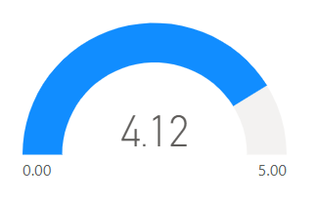
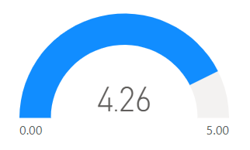
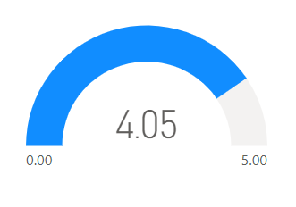
Key Quantitative Results
The attendees were asked to rank the following statements on a scale of 1-5 with 1=Strongly Disagree to 5=Strongly Agree
I found the content informative and relevant to my work on the Community Board
I found the presenter knowledgeable
Overall I found this workshop beneficial to my work on the Community Board
N=94
N=79
N=94
N=94

Slide 39
Please provide any other comments you would like to share about this workshop (113 comments received)
51.3% were Positive Comments
Conflict Resolution: This was a million times better than other training programs I’ve attended in the past. Very human.
Disability Etiquette and Awareness: This training caused me to think differently about how I share information with others. This was a real awakening! Thank you.
Most comments received were positive. CB workshop attendees thanked the CEC and described their satisfaction with our work

Slide 40
Please provide any other comments you would like to share about this workshop (Con’t)
8% were Negative Comments
Disability Etiquette: I didn’t understand most of the presentation. Too complicated!!
Parliamentary Procedure: The presenter was somewhat knowledgeable but not as strong as I would have liked.
Some attendees mentioned that they wanted changes to the format of the presentation, a more informed presenter, or for the presentation to be customized to their interests

Slide 41
Please provide any other comments you would like to share about this workshop (Con’t)
Please provide any other comments you would like to share about this workshop Con’t
40.7% were Technical Comments
Document Accessibility: It would be helpful to announce meetings with ample notice beforehand. The announcement that I received went out in the end of February for meetings that were taking place the following week
Intro to DOB: Please answer questions in the order they were received whether it's in chat or raised hand. If raised hand is given preference, then please state that in the beginning.
Attendees gave a wide array of technical comments on subjects ranging from sharing the slides, times to start, length of presentations, and what video meeting format to use.

Slide 42
Future Training Topics
Housing and Buildings
Meeting Decorum
Affordable housing, tenant’s rights, housing development, summons.
How to handle confrontations that arise in CB meetings; effective meetings
Data Interpretation
Budgeting and Management
Understanding data options in using resources
City budget and how CBs should budget; office management

Slide 43
Looking Ahead

Slide 44
Upcoming Activities
Planning sessions for next year’s PB and TRIE cycle.
Drafting and releasing RFIs for Winning Project Implementation and PB/TRIE Partnerships.
Announcement of winning projects event.
We need your help!
Help recruit applicants once RFIs are released.
Serve as a reader for our RFI evaluations committees.
Attend our announcement event

Slide 45
Public Comment

Slide 46
Thank You!
@NYCCEC | nyc.gov/cec

