Slide 1
Public Meeting
April 24, 2024

Slide 2
Technology & Housekeeping
To Commissioners:
In-Person Participants:Please mute your microphone when you're not speaking and turn it on when needed
To Online Participants: Please mute your microphone when you're not speaking. Feel free to unmute and let us know when you'd like to offer a comment, since we cannot see you.
To All Participants: ​
Call participants in the order they have registered for public comment prior to meeting, then during today's meeting​
Closed Captioning:​ Closed Captioning will be displayed on the smaller screen​
​
To In-Person Participants:​
To submit a public comment, please add your name and affiliation to the sign in sheet by the door. We will call on you to speak in order received.​
To Online Participants:​
To submit a public comment, please submit your name, affiliation, and public comment via email to info@civicengagement.nyc.gov or via text to 917-587-9103. We will read comments in order received.

Slide 3
Agenda
Attendance​
Approval of Meeting Minutes from February 26, 2024
Program Updates
Voter Language Assistance Services from Primary Election
Community Boards
PB GOTV phase
Sustainability of PB Projects and updates
Public Comment

Slide 4
Approval of Meeting Minutes

Slide 5
Program Updates

Slide 7
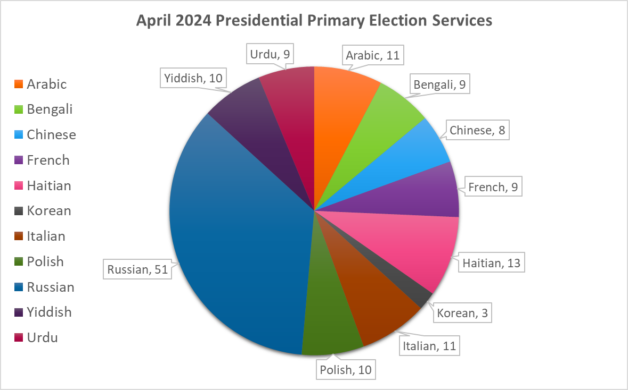
Voter Language Assistance Presidential Primary Election
144 language services
110 unique poll sites
30 Early Voting + 80 Election Day
100% of services delivered as planned
Notes:
total 144 language services, 109 unique poll sites (30 EV + 80 ED); 100% of services delivered as planned

Slide 8
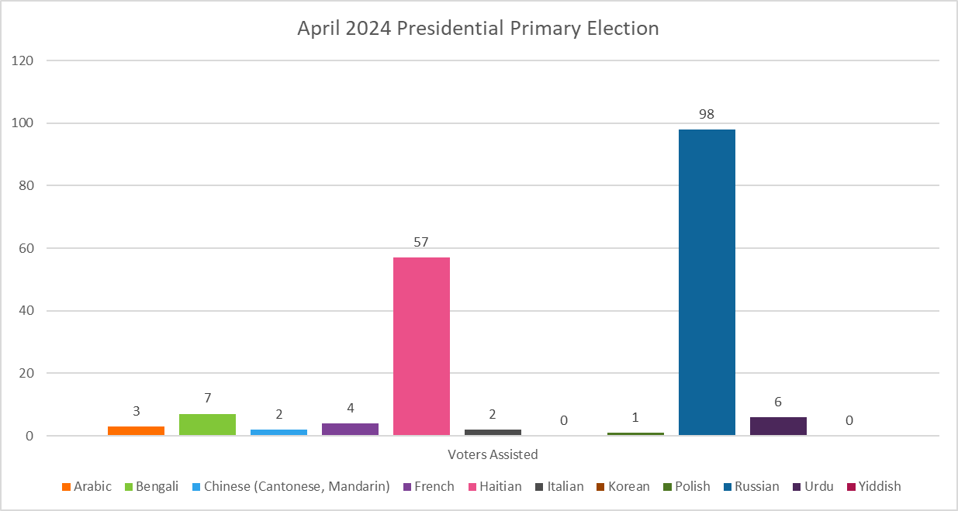
Presidential Primary Election Utilization - Preliminary Data
Total Voters Assisted: 180

Slide 9
Voter Language Assistance Program – Language Assistance Advisory Committee
Haitian Language Forum on Voter Rights held on March 26th in Flatbush in partnership with LAAC member representing the Haitian speaking community.
Chair and ED Dr. Sarah Sayeed and NYC Chief Democracy Officer Kathleen Daniel addressed participants.
Presentation held in Haitian Creole with interpretation.
Notes:
Total of 551 voter assisted

Slide 10
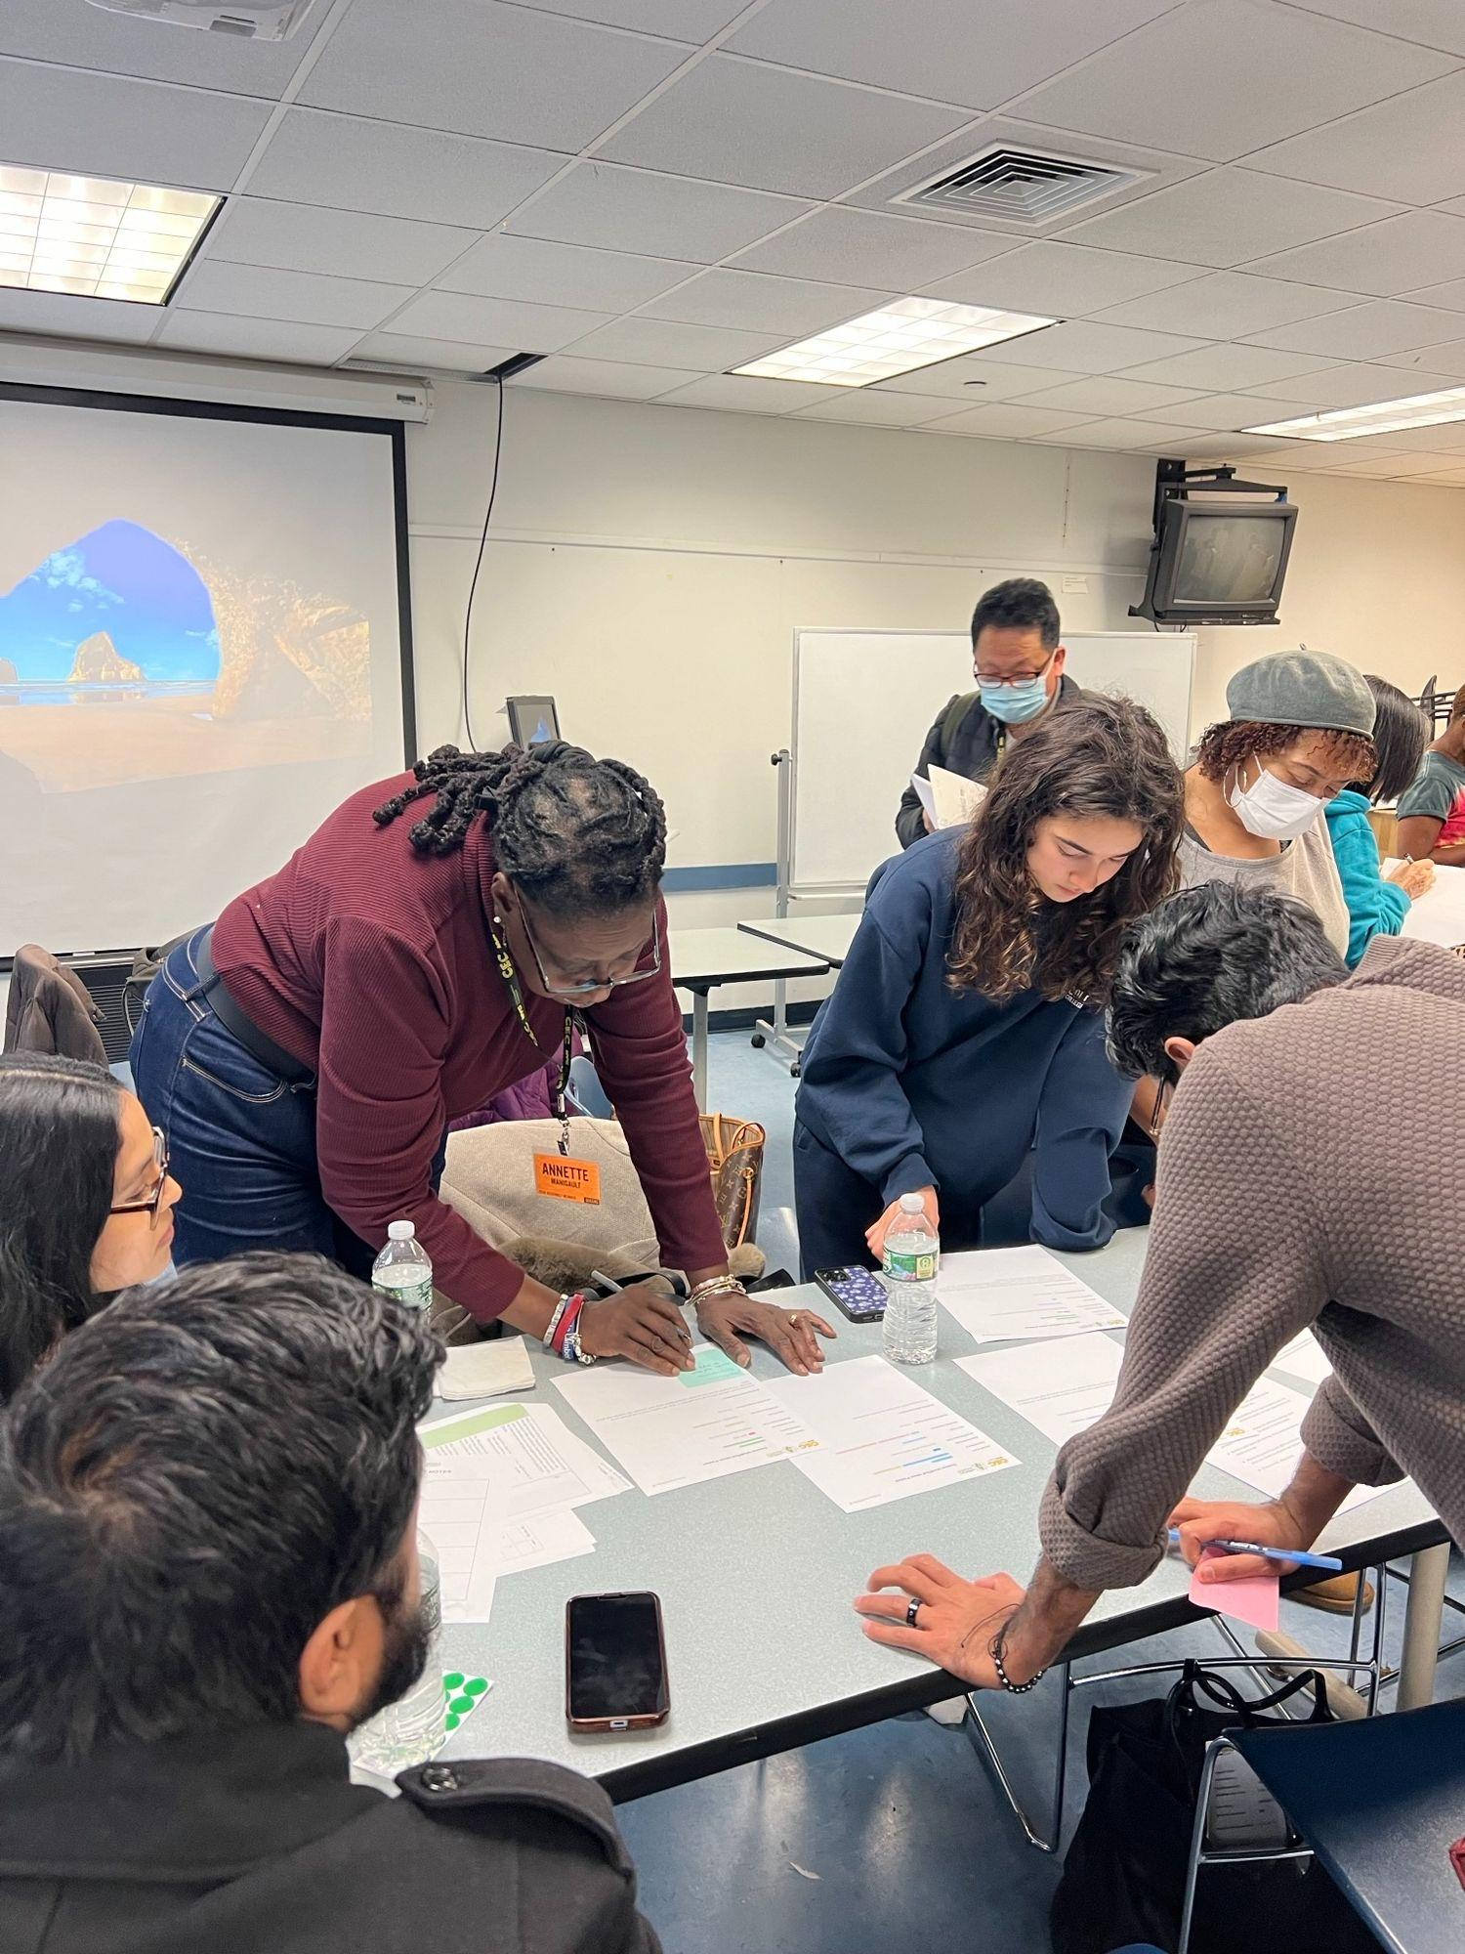
Language Access – The People's Money Borough Assembly Committees
Consecutive interpretation services were provided according to committee member needs (Spanish and Arabic)
Assembly members were able to fully participate in idea development regardless of language spoken
Notes:
Total of 551 voter assisted

Slide 12
Community Boards
Dept of Housing Preservation and Development (Final confirmed series for Spring 2024
Affordable Housing 4/09
61 registered, 34 attended
Fair Housing 4/11
55 registered, 23 attended
Affordable Housing 4/16
55 registered, 18 attended
Fair Housing 4/18
54 registered, 8 attended
We will be issuing certificates to people who have attended five or more workshops in Spring 2024
Possible workshops to come: Independent Budget Office Executive Budget Review, The People’s Money and You

Slide 13
Community Boards
The CEC has begun collaborating with the Future of Community Boards Working Group and the Center for Urban Pedagogy on a panel discussion in July regarding the upcoming term limits.
Tentative discussion points:
Guiding question: “What are you most concerned about losing with the upcoming implementation of term limits?”
Other questions and opportunities for discussion:
○ Central staff for community boards
○ Opportunities for mutual support
○ Vision for how Community Boards could be in the future

Slide 15
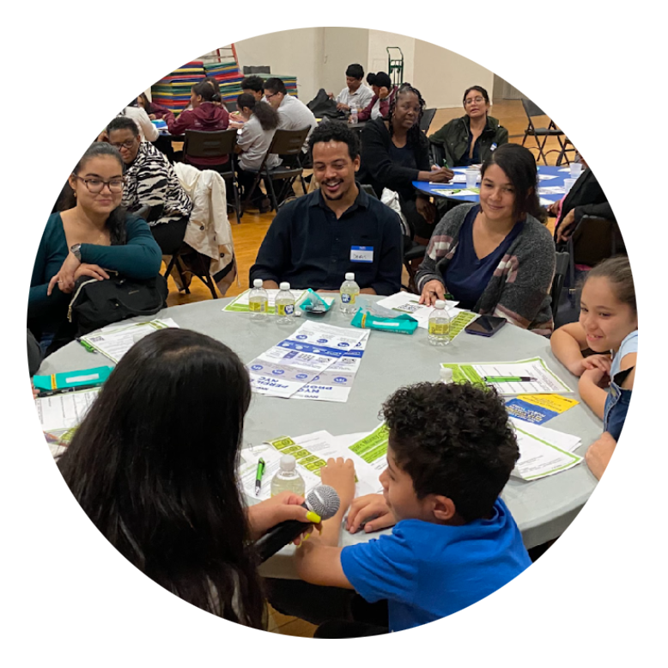
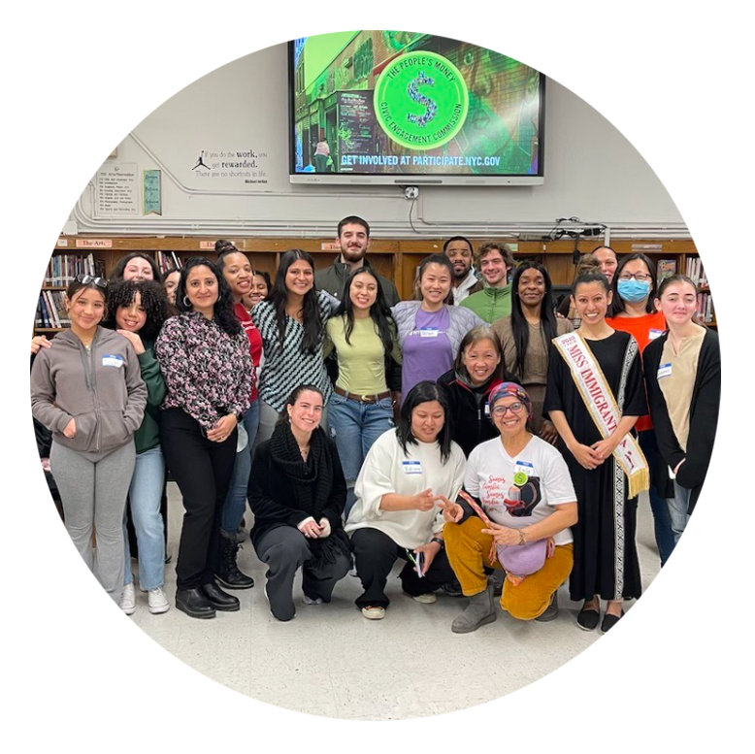
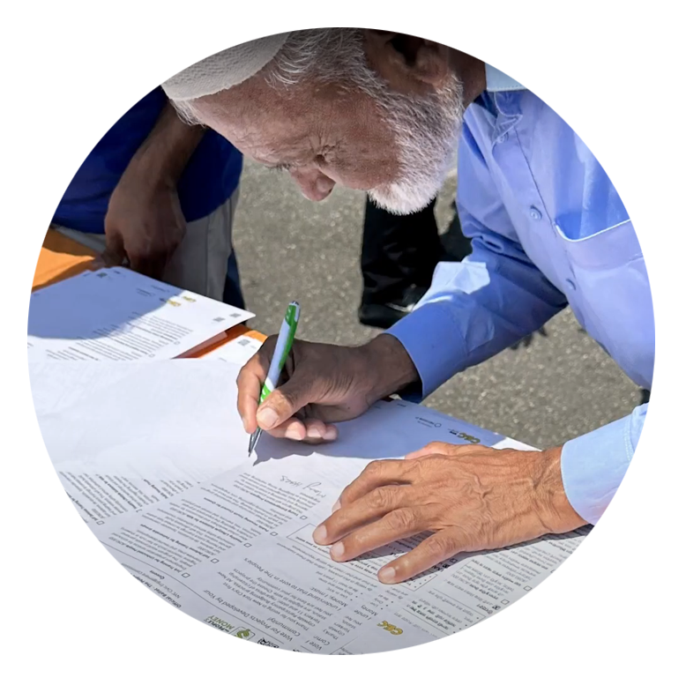
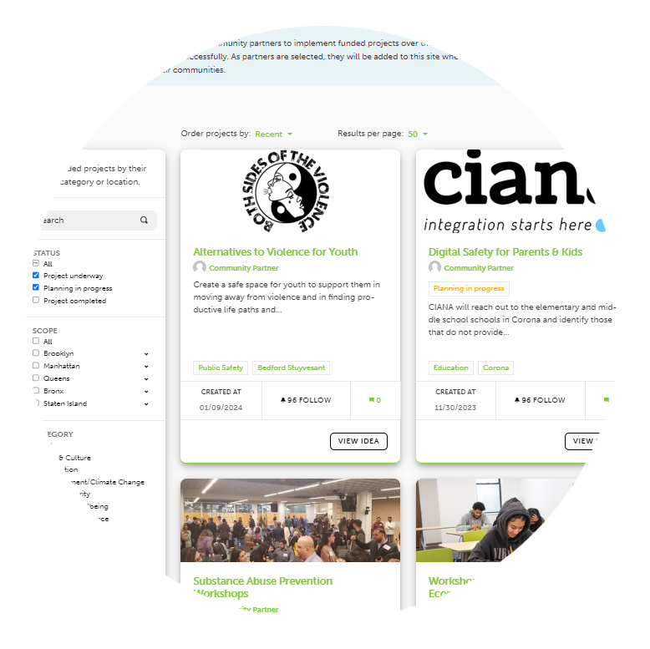
Phases of “The People’s Money”
participate.nyc.gov
1
2
3
4
Idea Generation
(Fall)
Project Vetting + Development
(Winter)
Vote!
(Summer)
Implementation
(Year-round)
Residents submit ideas for how to spend a part of the city’s budget
25 residents of each borough decide together which projects go on the ballot
Residents 11+ years old vote on projects they want to see in their Borough
Follow the winning projects to see what’s happening in your borough
Notes:
Script:
“Lastly, you can also participate in various phases of ‘The People’s Money’!”
Phase 1: Idea Generation
“During the first phase you can volunteer less than 2-hours of your time and attend an idea generation session where you, along with other community residents like yourself, discuss and submit ideas on how you think the budget should be spent.”
Phase 2: Borough Assembly Process
“You can also apply to be a Borough Assembly member if you are interested in getting to know others residents in your borough, and to learn more about the key issues and ideas that your fellow residents are asking the process to address Borough assemblies meet during the winter to look through the ideas and decide which ideas should go on the ballot. Most members walk away with new perspectives and new friends!”
Phase 3: Voting
“Then the voting begins! This year the vote will take place from May 1st through June 12th.”
“If you’re interested in getting out the vote for PB with us [TRIE Partner], please indicate your interest on the sign-in sheet before you leave today’s workshop.”
Phase 4: Project Implementation
“After the vote, winning projects are announced. You can follow the winning projects in your borough or neighborhood by going to participate.nyc.gov.”
“You’ll have an opportunity to sign up and volunteer with the CEC at the end of this workshop after filling out the exit survey.”

Slide 16
Vote Phase Timeline
Voting will start May 1, however we’d love to invite all partners to our Kickoff event on May 11. We will also have 5 Flagship events!
Date: Saturday, May 11 2:30 - 5:00 PM
2:30 – 3:30 Exhibition of Cycle 1 Projects and Reception
3:30 – 5:00 Recognition of Partners, Volunteers, and Champions
Location: Brooklyn Academy of Music (BAM) Fishman Theater
RSVP: Here!

Slide 17
Flagship Events
We will also have 5 Flagship events!
May 18 – Hudson River Submerge Festival
May 19 – Bronx Week Festival and Parade
June 2 – Queens Pride Parade
June 8 – Staten Island Family Fun Day
June 9 – Puerto Rican Day Parade

Slide 18
The Ballots

Slide 19
Project Allocations 2024
Borough | Funding per Project | # of Projects on the Ballot | # of Projects Funded
Brooklyn | $200,000 | 10 | 5
Bronx | $174,000 | 10 | 5
Queens | $170,000 | 10 | 5
Manhattan | $150,000 | 10 | 4
Staten Island | $180,000 | 6 | 1
Total | $3,500,000 | 46 | 20
*tentative based on Mayor’s Executive plan

Slide 20
Voting Eligibility and Rules
Residents can only vote one time, but for as many projects as they like on their ballot.
Residents have to live in New York City.
Residents have to be 11 years or older.

Slide 21
Voting Methods & Languages
As with last year there are 2 ways to vote.
Online
Paper Ballot
Online voting and paper ballots are offered in 14 languages.
English, Spanish, Arabic, Bengali, Chinese (traditional and simplified), French, Haitian Creole, Italian, Korean, Polish, Russian, Urdu, Yiddish

Slide 22
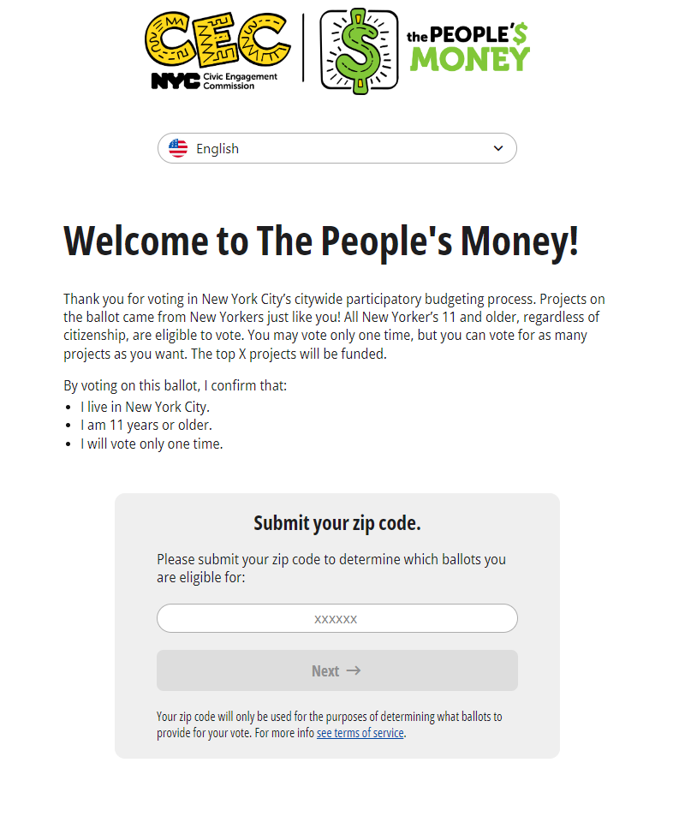
Online Ballot
Voting Link: on.nyc.gov/pb
Voter must enter an email or phone number that they have access to, in order to receive a code to get into the voting portal.
All our partners have a unique code that people can enter so we can keep track of who is getting how many votes.
Survey comes at the end

Slide 23
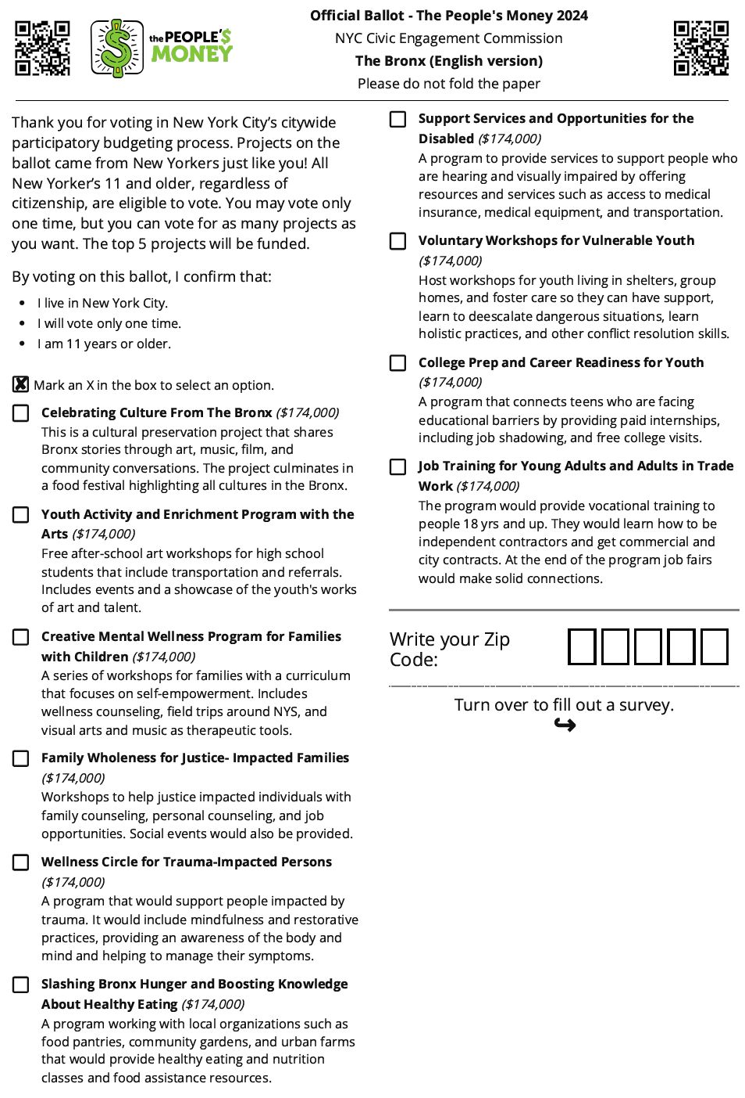
Bronx Ballot
Listed: 10 Projects
Funded: 5 Projects

Slide 24
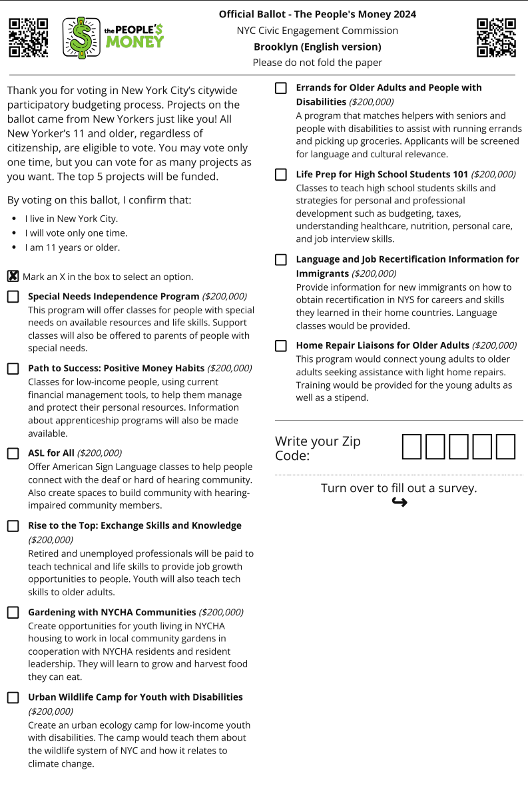
Brooklyn Ballot
Listed: 10 Projects
Funded: 5 Projects

Slide 25
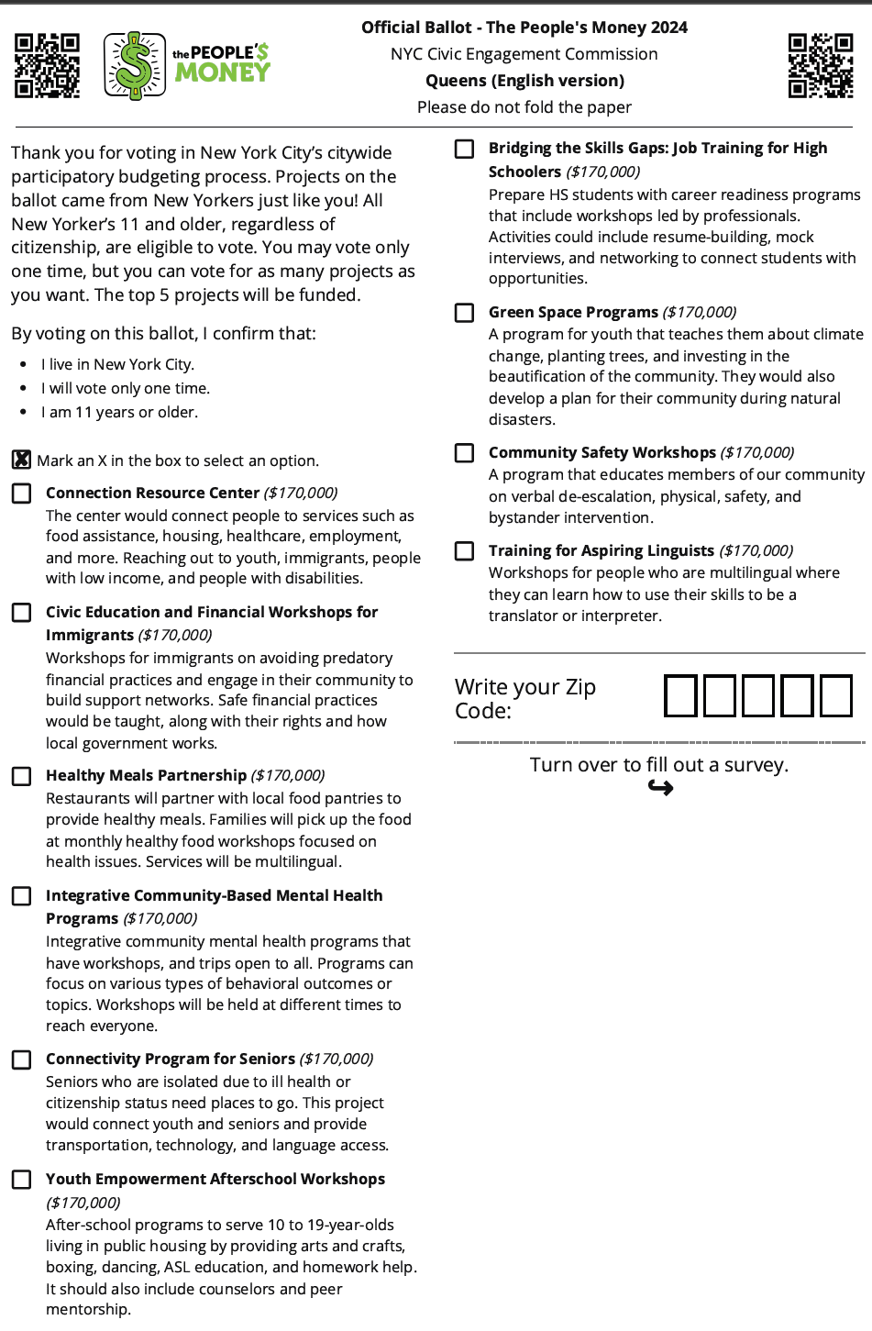
Queens Ballot
Listed: 10 Projects
Funded: 5 Projects

Slide 26
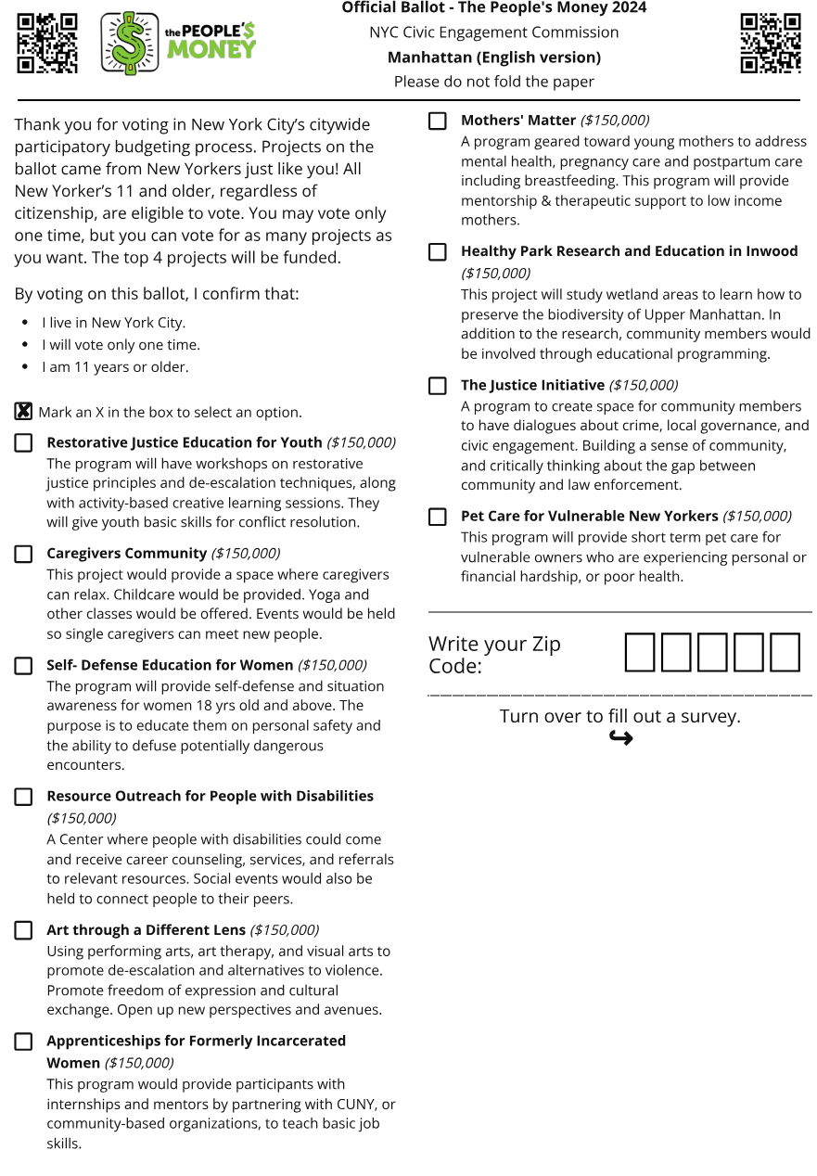
Manhattan Ballot
Listed: 10 Projects
Funded: 4 Projects

Slide 27
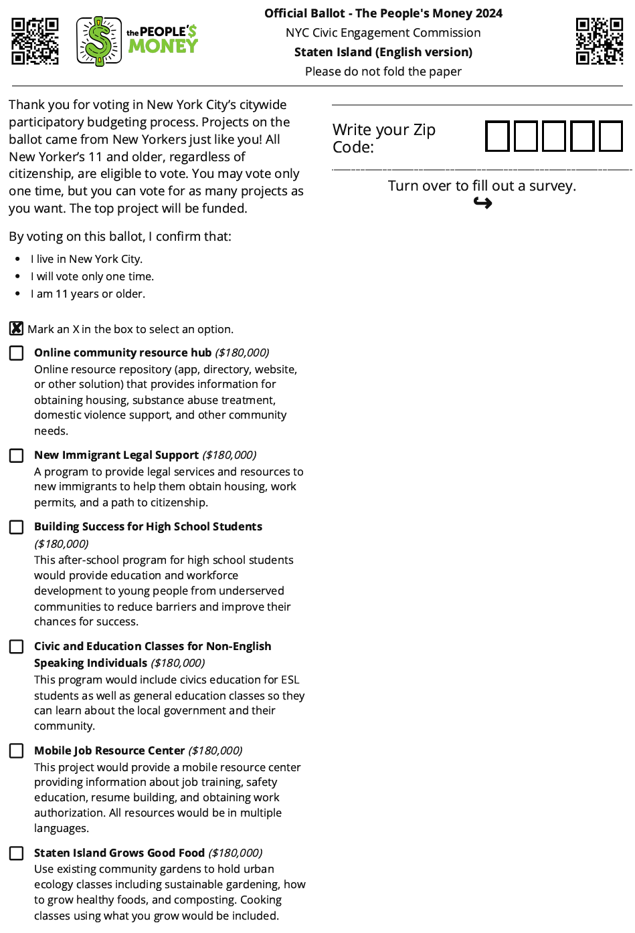
Staten Island
Ballot
Listed: 6 Projects
Funded: 1 Project

Slide 28
Community Partners - 85
Types of Partnerships:
TRIE - 30
PB - 52
Digital - 3
View here by borough breakdown!

Slide 29
The Sunnies!

Slide 30
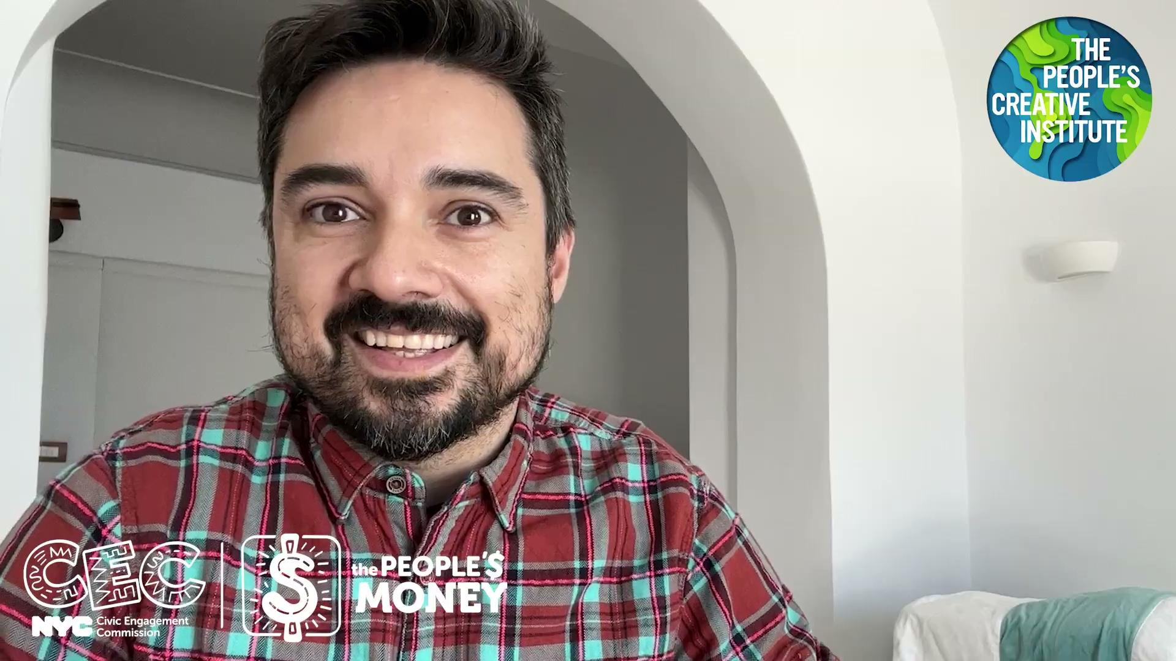
A Message from Yazmany Arboleda

Slide 31
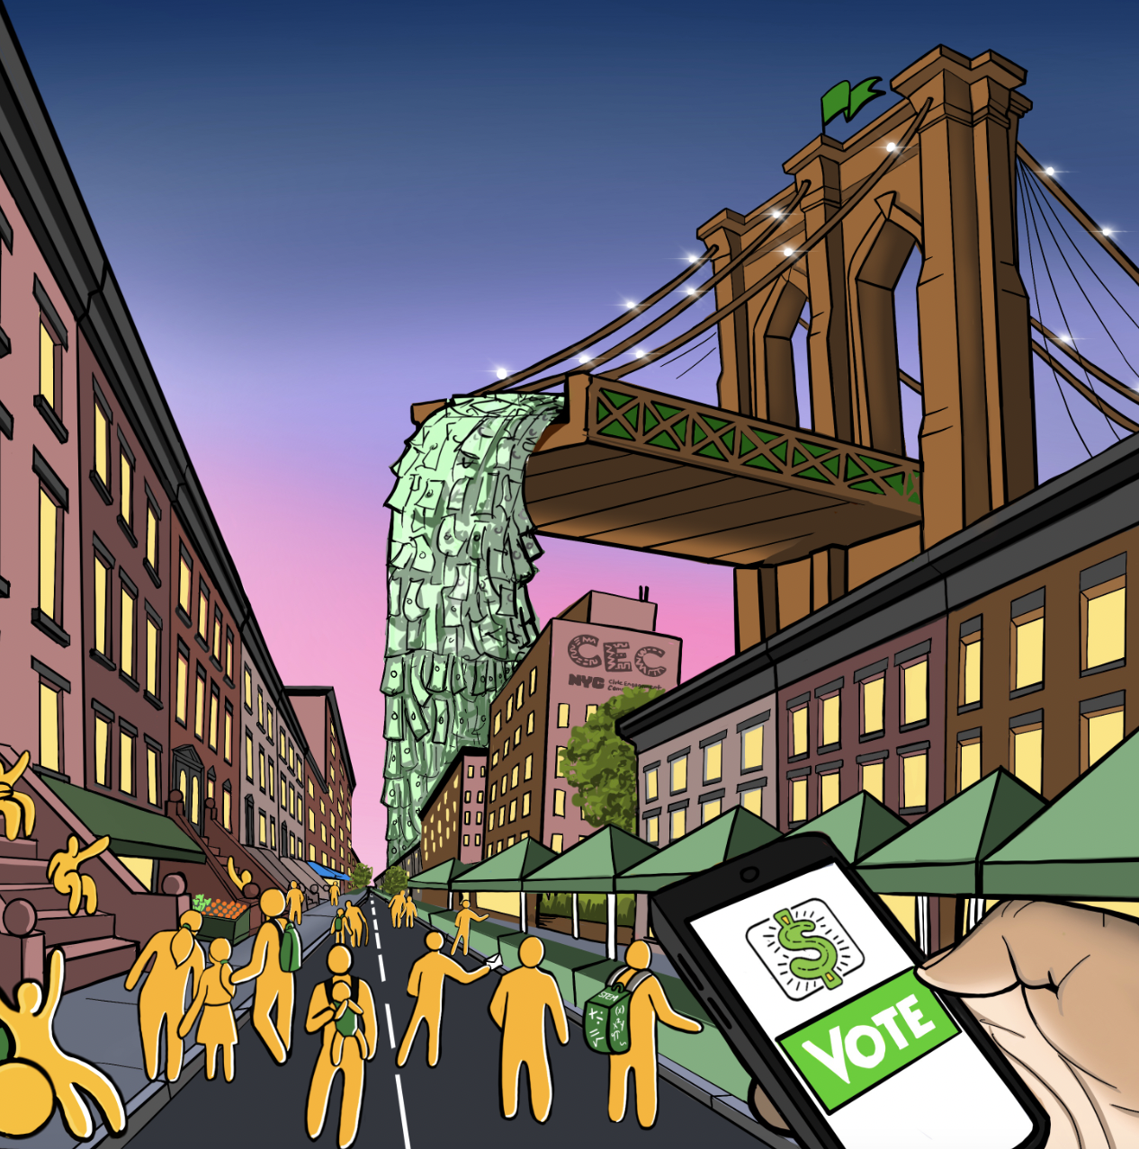
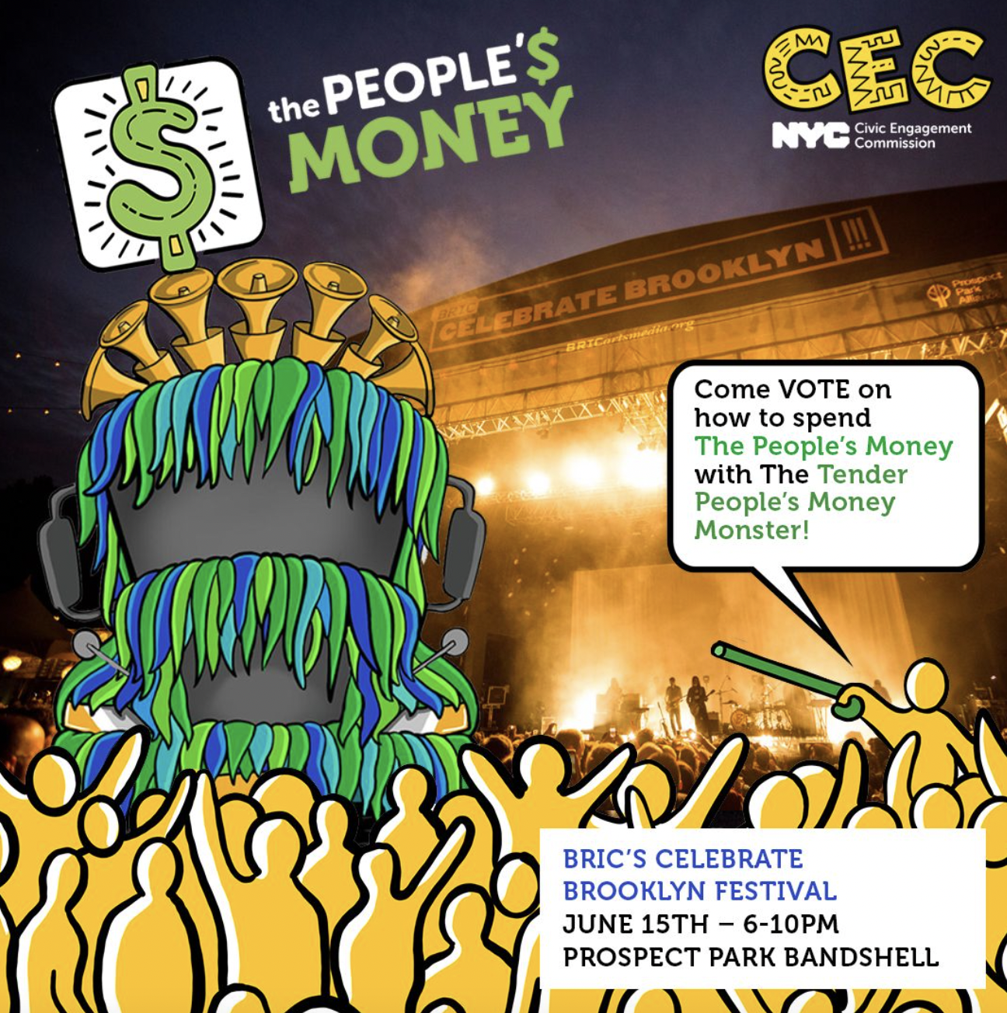
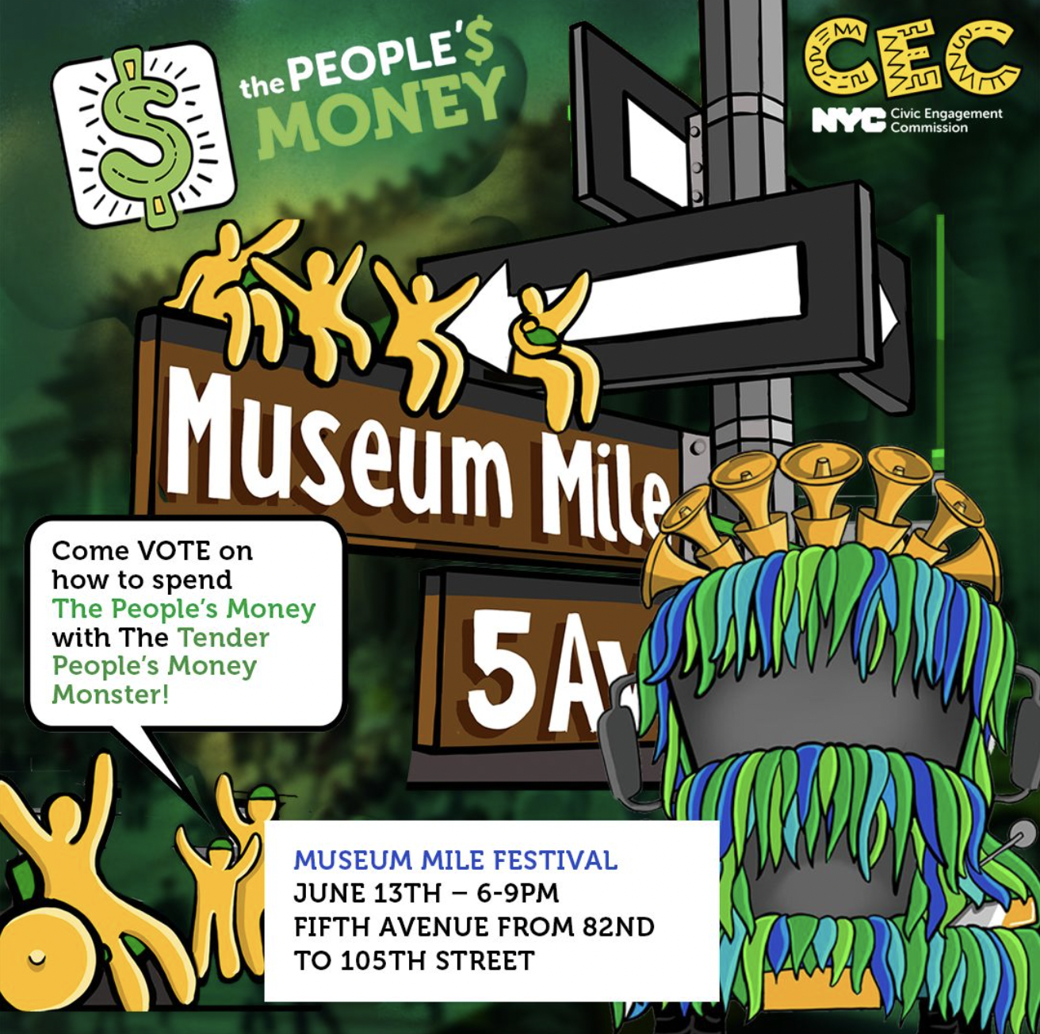
Inspiration
Building upon last year’s campaign designed by the CEC artist collective, these two dimensional Optimistic Yellow People are now becoming three dimensional.

Slide 32
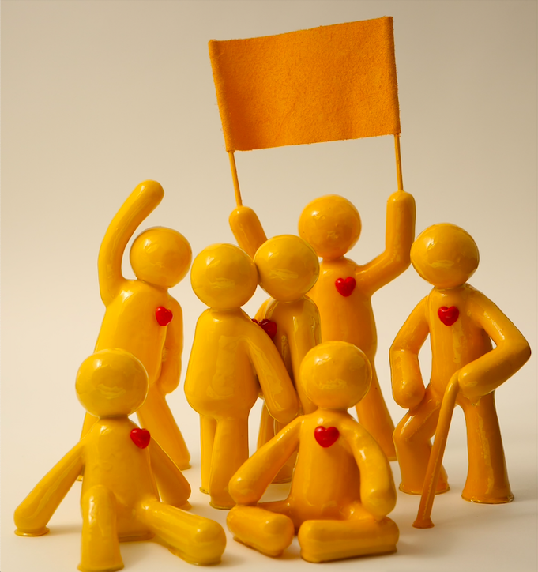
The Sunnies
These little yellow figurines represent New Yorkers from the future who traveled through time to show us what it looks like to take care of each other. Because they they lead with an optimistic heart that shines bright wherever they go they are called The Sunnies.
The Sunnies embody what a thriving democracy looks like. The campaign aims to inspire New Yorkers to imagine a more optimistic and participatory democracy. During the voting period, Sunnies will appear throughout the city at parks, plazas, cultural institutions, and offices.

Slide 33
Your Very Own Sunny
Each CEC partner will receive their own Sunny at the Kickoff to display!
Your Sunny comes with a QR code tent card that leads people to the voting platform.

Slide 34
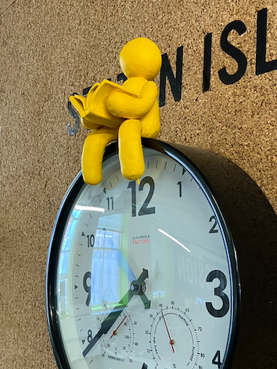
What to do with your Sunny
Sunnies love to be seen and photographed! Place your Sunny somewhere fun, introduce your Sunny to your favorite people and places, post photos of your Sunny to spread the word about the PB process.

Slide 35
CEC Commissioners & Vote Phase
Attend launch event
Host a Sunny!
Introduce CEC staff to relationships to support PB vote
Relational organizing- plan and follow through (list a minimum of 25 contacts that you’ll personally reach out to via phone call, text, or email)
PLAY is your partner code!

Slide 36
Sustainability of PB Projects

Slide 37
Sustainability Updates
Concern: expense process funds projects that are short term, need to consider how to continue successful projects
Working with Acting Chief Engagement Officer Crystal Price to promote awareness of PB projects with Deputy Mayors and agencies
CEC convened a few Commissioners in a subcommittee to further discuss
Steps include focusing on monitoring & evaluation for proof of concept
Capacity building for our implementing partners for M & E
Considering ways to tell the story of their and our success
Introduce implementing partners to funding from philanthropy or government

Slide 38
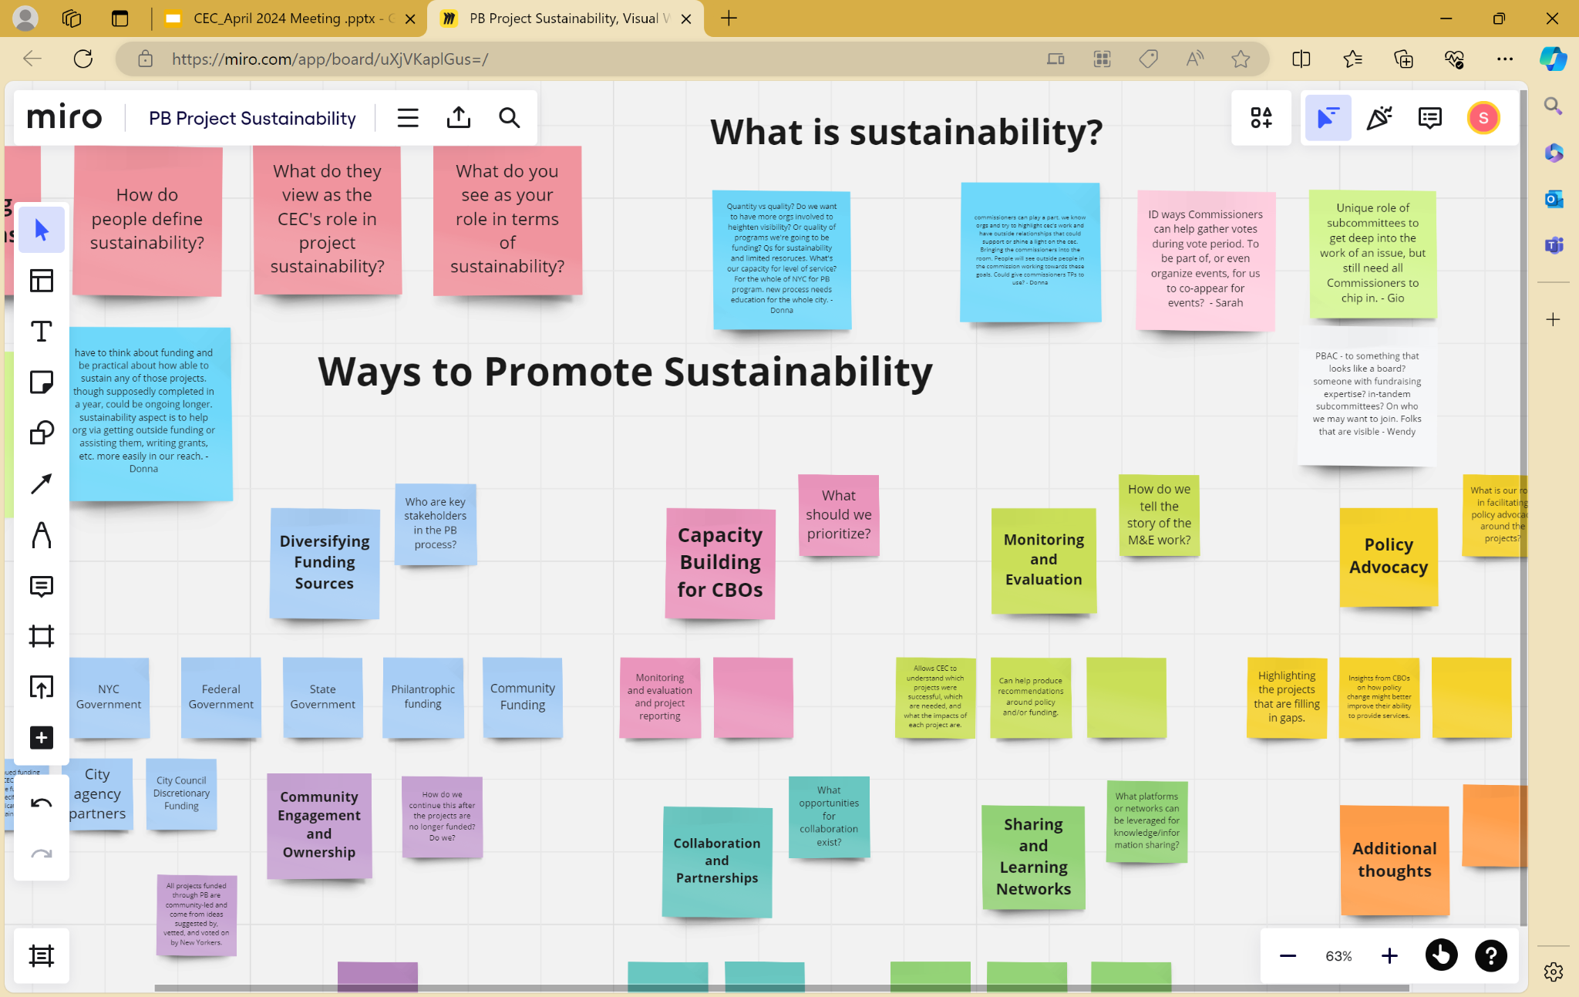
PB Project Sustainability, Visual Workspace for Innovation (miro.com)

Slide 39
Sustainability Subcommittee Updates
Donna, Gio, Amy- key takeaways from discussion
Need to differentiate: sustainable PB process from sustainable PB projects
Importance of cycle 1 “proof of concept”
What criteria would make for a sustainable PB process?
What role do Commissioners recommend for CEC to take on for both the PB process and PB projects?
Prioritizing between them
Priorities within each

Slide 40
Congratulations to Commissioners on 5 Year Milestone!

Slide 41
Public Comment

