Slide 1
Financial Education for Worker Cooperative Members
Topic 4: Creating a Profitable Business

Slide 2
Financial Education for Worker Cooperative Members
Introduction
This curriculum was created as part of a project between the New York City Department of Consumer Affairs Office of Financial Empowerment and Make the Road New York, with the support of Citi Community Development to integrate financial empowerment tools and training into the cooperative development process.
It consists of 5 two-hour-long workshops:
Topic 1: Basic Money Management & Budgeting
Topic 2: Banking & Basic Financial Transactions
Topic 3: Credit
Topic 4: Creating a Profitable Business
Topic 5: Basic Financial Statements
Notes:
The goals are threefold:
To support and strengthen the financial health of individual members of workers cooperatives and to empower them to make the best possible financial decisions for themselves and ultimately their families
To ensure that the cooperative businesses are maximizing asset building and financial empowerment opportunities for their members, and
To develop individual-level and cooperative-level financial empowerment and asset building tools and practices for the broader New York City cooperative community

Slide 3
Financial Education for Worker Cooperative Members
Sample Start-up Budget
Company name
Startup Budget
Start Up Costs
Purchase of Inventory
Renovation
Rent Deposits
Marketing
Office Equipment
Furniture & Fixtures
Working Capital
Auto Equipment
Other Equipment
Start-up Insurance
Fixed Monthly Expenses x (3-6) months (recommended)
Start-up Legal & Accounting Fees
Training & Education
Sales-related Startup Expenses
Franchising Fees
Licenses & Permits
Office Supplies
Total_ | $ -

Slide 4
Financial Education for Worker Cooperative Members
Questions to Think About
How do we know if the business is profitable?
How do we calculate the profit?
What do we do with the profit?
How is a member’s share of the profit calculated?
What does a profit mean for the owners of the cooperative?

Slide 5
Financial Education for Worker Cooperative Members
Creating a profitable business:
Two levels of profitability Level 1: Does the product / service make a profit? Level 2: Does the business make a profit?
Income Statement:
Revenues (Total sales of goods and services = units x price)
- Direct costs (Materials, packaging, labor, transportation, etc.)
= Gross Profit [LEVEL 1]
- Indirect costs (Rent, utilities, administration, advertising, etc.)
= Net Profit or loss [LEVEL 2]

Slide 6
Financial Education for Worker Cooperative Members
Creating a profitable business:
Level 1: Does the product / service make a profit?
Does the price of the product or service cover the direct costs and allow for a profit?
Direct costs: (examples)
Materials
Packaging
Labor
Distribution/logistics
Rentals

Slide 7
Financial Education for Worker Cooperative Members
Creating a profitable business:
Level 2: Does the business make a profit? If selling the product / service generates a profit, how many products / services will you need to sell to cover the business’s indirect expenses?
Step 1: First, figure out the total indirect expenses by month.
Indirect expenses are expenses a business must meet on a regular basis, regardless of sales volume.
Examples:
Personnel Administrative expenses Accounting/bookkeeping Insurance Marketing Webhosting Subscriptions | Travel Training/Certifications Rent Utilities Maintenance Storage Trash disposal

Slide 8
Financial Education for Worker Cooperative Members
Example Indirect Expenses in the Income
INCOME STATEMENT | Mo 1
TOTAL REVENUE | $ -
TOTAL DIRECT COSTS | $ -
GROSS PROFIT | $ -
INDIRECT COSTS
Officers' Salaries
Staff Salaries
Employee Withholdings
Employee Benefits
Liability Insurance
Telephone
Marketing / Advertising
Travel
Office Supplies
Legal Fees
Accounting Fees
Rent
Internet/Web Costs
Utilities
Amortization
Other Expenses
TOTAL INDIRECT EXPENSES | $ -
PROFIT / (LOSS) | $ -

Slide 9
Financial Education for Worker Cooperative Members
Creating a profitable business:
Step 2: Next, divide the total indirect expenses per month by the profit per product / service.
Break-Even Analysis | Total Monthly Indirect Expenses _________________ | = | # of products / services the business must sell to cover Indirect Expenses per month
 | Profit per product / service
Remember! The business is only making a profit if it is selling more than its break-even # in units.

Slide 10
Financial Education for Worker Cooperative Members
Tie-in to Personal Household Budget
A business can provide:
Client: My business is profitable.
Counselor: Is the business able to cover all of its costs and pay you a salary that covers the value of the time that you give to it?
Client: Not yet.
Counselor: Then your business is not yet profitable.
Supplemental income
Replacement income

Slide 11
Financial Education for Worker Cooperative Members
Internal Capital Accounts
A record called an internal capital account is created for each member to track:
How much a member paid for a share in the cooperative
How much of a profit was distributed to the member
How much of the profit was reinvested in the business and reserved to pay taxes

Slide 12
Financial Education for Worker Cooperative Members
What’s in an Individual Internal Capital Account?
Your membership share fee
2 PARTS
Some profits from co-op business
More on this in a minute.
Notes:
The internal capital account is an account within the coop that is assigned to you.
SO it is individual, in that is about one member.
It is internal, in that it is within the coop. You can think of it as having two parts. The first is your membership share, the second Is a place to keep some of the profits from the coop business.
We’re going to look at the membership share first, then talk about the profit part.

Slide 13
Financial Education for Worker Cooperative Members
Membership Share
When you join the co-op, you become a member by buying a membership share. When you leave, this amount is returned to you. It does not increase or decrease in value.
Share could be $5 or $5,000 depending on the co-op
Each member is entitled to one vote in the co-op.
Notes:
When you work for a coop you are an employee. You may have the option of becoming a coop member and to do so, you have to buy a membership share of the coop.
A membership share does not increase or decrease in value like a share in a standard corporation.
This allows new members to join a successful co-op easily.
If the membership shares increased in value with the success of the company, talented workers without enough money could not become members easily.
In some coops, the share is very small, in others it is much higher. Sometimes people pay all of the membership share fee at once, other times they pay it in installments.
The holder of a membership share is entitled to one vote.
A membership share also gives the holder rights to an internal capital account and to a share of the profits.

Slide 14
Financial Education for Worker Cooperative Members
Membership Share is in Your Capital Account
Member share: All members own only 1 share
Notes:
Review: Each member has one share. This is in each individual internal capital account.

Slide 15
Financial Education for Worker Cooperative Members
Excellent News: Your coop made a profit
Now what?
Pay out cash to members?
Keep (retain) some of the profits to reinvest in the co-op?
Notes:
Now let’s turn to profits.
Excellent news, the coop is going great, there’s a profit.
NOW WHAT?
There are two choices. Pay out cash to members or keep some of that money to reinvest in the coop.
But WAIT: first we need to talk about what we mean by profit.

Slide 16
Financial Education for Worker Cooperative Members
What is a Profit? In this Case, ”Net Income”
Customers: $75,000
Revenue earned from customers buying your goods or services
Rent:
(1,000)
}
Expenses/Costs that went into providing services or goods to customers
Wages:
(20,000)
Supplies:
(10,000)
Net Income: $43,800
Net Income =
Revenue - Expenses
Notes:
We aren’t going to get into too many accounting terms, but we need to understand how the coop will calculate profit for the purposes of distributing it.
In this case, profit means “net income,” which is simply the amount brought in from customers, from the activities of the business.
If you sell donuts, it’s how much money you brought in from the sale of donuts. If you fix cars, it’s how much money you brought in from mechanics doing their work.
Other thing such as taxes and depreciation are involved in net income, but for now, we want to focus on this simple definition.
IMPORTANT: Net income does not include cash that comes into the company from loans or member fees. For example, if the member fee is $100 and 5 new members bought shares this year, that $500 is NOT part of revenue. That money did NOT come from customers and does not get reflected in net income.
Describing profit as net income makes sense for this reason: we want to know how much we’re making from the activities of the actual business, say selling donuts. 5 new members joining has nothing to do with selling donuts, so we don’t want it to be part of us thinking about the profit that the BUSINESS activities are leading to.

Slide 17
Financial Education for Worker Cooperative Members
What Happens in a Traditional company when there is a profit?
APPLE COMPANY
Retain $200 in company (can be used for equipment, buildings, etc.)
Profit=$300
APPLE Employees: Receive no shares of profits, only their wages
APPLE CEO/Board
APPLE Shareholders
(own APPLE stock)
Pay out $100 to shareholders in dividends
If 4 shareholders total, each owning 1 share, each receives $25
Notes:
Ok, so we now know that we earned a profit. Great.
How do we decide what to do with it?
(Teacher note: this would be good to act out with students, get them out of their chairs, moving around, with signs: CEO, APPLE COMPANY, APPLE SHAREHOLDERS, APPLE EMPLOYEES) Use large boards/signs with money amounts on them so they can see how the money flows.
If a company decides to pay out some of the profits, it goes to shareholders. The CEO and company board make the decision about how much to pay out and how much to reinvest in the company.
So if you owned 10 share of Apple stock, and the Apple CEO and Board decides to pay out a $1dividend or share of profits/share, you get $10.
Let’s say a $300 profit was made by Apple. The CEO/board take that $300 and decide they will pay out $100 in dividends (to shareholders).
$200 is given to “APPLE COMPANY,”
$100 is given to shareholders, 4 of them in this example
Each of the shareholders gets ¼, or $25 each. Assume they each owned 1 share.
In a traditional corporation, workers are simply paid wages and that’s it. If there is a profit, they don’t get any of it. RED BOX.
In a coop, it’s different.
Let’s look at how it’s different.

Slide 18
Financial Education for Worker Cooperative Members
What Happens in a Co-op hen there is a profit?
Coop Business
Retain $200 in company (equipment, buildings, etc.)
Employees who are not co-op members do not receive share of profits
Profit=$300
Co-op Board
Coop Members/
Shareholders
Pay out $100 to Co-op members
Division of $100 is
based on labor hours, not shares.
Notes:
Now let’s turn to a Coop.
Teacher Note: Act this out with students as well: COOP Board, Coop business, Coop members, and coop employees.
So now a $300 profit.
The coop board, which has representation from the members/workers, decides how to divide the profits.
They decide $200 reinvestment in the coop business
And $100 to be paid out to the coop members in cash.
Division of $100 is based on labor hours, not shares. Our next slide will explain what we mean by labor hours.
A note: if an employee is not a member, they do not receive a share of profits.

Slide 19
Financial Education for Worker Cooperative Members
How does the co-op determine dividends?
Division of dividends: usually based on number of hours(labor hours) members worked in past year.
Total hours worked by all members at co-op last year = 50
2h
1h
5h
3h
4h
Member share:
All members own only 1 share
($5/share)
Jane worked 4 hours, so Jane gets 4/50, or 8% of dividends
Notes:
(NOTE TO TEACHER: Can act this out with group)
IN a traditional company, you buy shares. In the coop, you buy one share, your member share.
Everyone has that one share. One vote. Notice, everyone paid $5 for their share.
Now, put that aside. (click through slide)
Each year, the coop adds up how many hours members worked. In this case 50 total hours.
Now, Jane worked 4 of these total hours, so she is entitled to 8% of the dividends or patronage dividend.
NOTICE: this is very different than in a traditional company where shareholders buy shares, could be 1 or 100 shares.
Remember: Each member always owns ONE member share. But each year, hours worked will determine dividend percentage for each member.
So if the whole coop worked 50 hours again next year, but Jane worked 5 hours, she would get 10% of dividends FOR THAT YEAR.

Slide 20
Financial Education for Worker Cooperative Members
First Decision:
How much to pay out to members, how much to keep in co-op?
Coop Business
Retain $200 in company
Profit=$300
Co-op Board
Coop Members/
Shareholders
Pay out $100 to co-op members.
This money is paid out in cash to co-op members. In our example, Jane gets $8, or 8% of the $100. Jane pays taxes on this $8.
Notes:
A little review. We’ve made a profit, great.
Ok, so now the coop board has decided they are going to pay out $100 to members and keep $200 in the coop for investment.
First, let’s look at what happens to the $100 we’ve decided to pay out in dividends.
We are paying out $100, so we would calculate each members’ share based on their hours and then pay this out.
In Jane’s case, she is entitled to 8% of $100 or $8.00
Jane will also pay taxes on this $8.00

Slide 21
Financial Education for Worker Cooperative Members
Second Decision:
How does money retained by co-op gets used?
INTERNAL CAPITAL ACCOUNT
Co-op Business
$200 retained
Collective Account
Individual Accounts
$150
$50
Corporate taxes (15%)=$22.50
Jane still gets 8% dividend, or $4 of the $50.
Total in Collective
Account = $127.50
Notes:
The coop board has determined that it is going to retain, or keep, $200 of the $300 profit in the business. Now the coop has some more decisions to make.
That money is retained in what’s called “INTERNAL CAPITAL ACCOUNT.”
One way to think of this is as an account that the company can go to when it needs money to buy equipment, new computers, a building.
If you sell donut and are planning to expand in the next year, you would want to retain some earnings in the internal capital account to pay for new mixers, ovens, and delivery trucks.
So back to this account. The board has decided to keep $200 in the coop.
A coop has the ability to then decide to divide that internal account between “collective account” and “individual accounts”.
And let’s assume that the coop decides they will divide the $200 between these accounts with $150 in collective and $50 in individual accounts.
First we look at taxes on the collective account, which at 15%, leaves $127.50 in the collective account. That’s settled.
On the individual account side, the same logic used to pay out the cash dividends is in play here. Remember, Jane worked 4 hours of the company’s total 50 hours. This was 8%.
So if Jane receive 8% of cash dividend, she also receives 8% of this internal dividend. In this case, 8% of $50 is $4.

Slide 22
Financial Education for Worker Cooperative Members
What does Jane actually receive?
First we determine patronage based on hours. Jane gets 8%.
In co-ops, this total amount ($150) is called a “patronage dividend.” Note: not all patronage dividends are paid out in cash to members.
Total Patronage paid out to members:
$100 in cash + $50 in internal accounts = $150 of profits to members
(started with $300 profit)
Jane gets 8% of total patronage dividend (12/150= 8%)
$8 in cash + $4 in internal account = $12 Total
4h
Jane will receive $8 in cash and a written allocation notice for the $4.
$8
$4
Notes:
First, each employees patronage percentage is determined. Remember, Jane worked 4 out of the total member hours of 50, so she gets 8%.
Now, total patronage that is going to members is the cash that is being paid out, PLUS the amount being put into their internal capital account.
This is important: That account is in your name, in Jane’s name. It is not cash paid out to you, but it is considered your investment.
In Jane’s case, she gets $8 in cash and $4 is put into her internal capital account.
At the end of each year, the coop should provide members with statements that show their balances in their individual accounts, much like one receives an end of year statement for a retirement account.
In coops, the total of cash paid out and allocation into an individual internal account is called a “Patronage dividend.” This is important for tax reasons. We will explain in a minute.

Slide 23
Financial Education for Worker Cooperative Members
Review of what co-op did with profits
How much to pay out to members, how much to keep in co-op?
Co-op Board
Co-op Business
Co-op Members
$300 profit
=
$150
+
$50
+
$100
$150 in internal collective account
Pay $50 into individual internal accounts
Pay out $100 in cash to members
Patronage dividend
Notes:
For now, it is important to understand that the coop started with $300 in profits, then made a decision about how to divide it.
$150

Slide 24
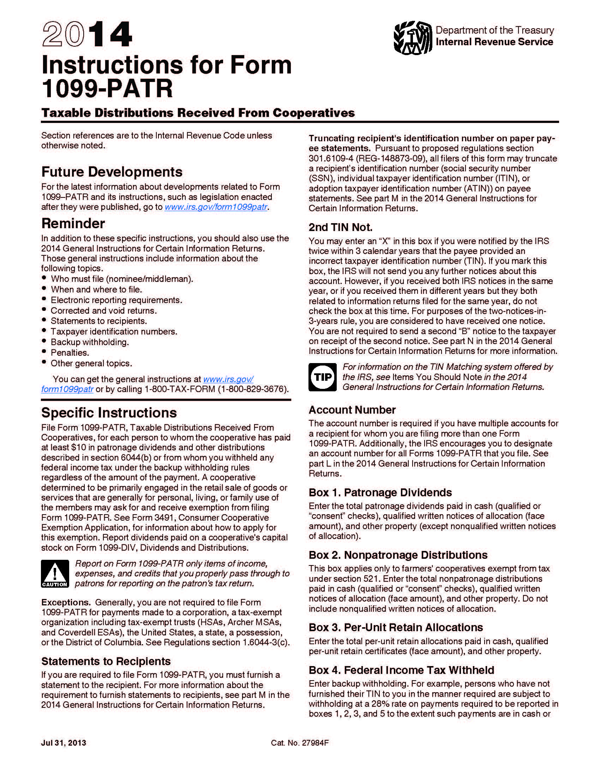
Financial Education for Worker Cooperative Members
What does Jane pay in taxes?
Members pay taxes on patronage dividend – both the cash and the written notices of allocation.
Jane pays taxes on $12, the $8 in cash she receives AND the $4 put in her internal capital account.
Notes:
Please note: Jane receives at least enough in cash dividend to cover the taxes she owes on internal account amount, so there is never an expectation that come up with cash to pay taxes on this amount.

Slide 25
Financial Education for Worker Cooperative Members
Why is this a good deal for the co-op and for Jane?
The co-op The co-op benefits by paying less in taxes than a conventional firm would pay. This means that the extra money saved on taxes can be reinvested in the co-op, hopefully leading to more profits. The co-op can also use the funds in the internal accounts for investment, which is less expensive than if they needed to borrow it from an outside bank or investor.
Jane
If the co-op does better, Jane does better.
Investment in the firm is important.
Jane’s individual internal capital account acts like a savings or retirement account (for example, a Roth IRA). When she withdraws funds, she does not pay taxes on it. So instead of investing the stock market, Jane is investing in her own workplace.
When does Jane receive a payout? The co-op decides on payout schedules and balances the needs of the co-op with the needs of the members.
Notes:
The coop benefits because of the way corporations are taxed. This is beyond the scope of this lesson, but that’s why coops set up this kind of internal capital account.
Jane benefits because if the firm does better, Jane does better. This arrangement allows the firm to have to more cash (because of taxes) at a lower cost---they do not have to go to an outside bank or investor and pay them interest.
This internal capital account is a lot like a saving or retirement account. Many people have IRAs, Individual retirement accounts. They pay taxes on their money when they earn it, then put it into an IRA and it earns tax free returns over time. You can’t take it out without penalty. When you do take it out, you don’t pay taxes on it. This is similar.
Let’s look at an example

Slide 26
Financial Education for Worker Cooperative Members
Internal Capital Account Balance
Notes:
In the beginning of the coop’s life, there will likely be losses. We can see that in Year 1-3.
Then there may be some other dips, we see in years 12-14,
but overall, the returns build up in Jane’s account.
If the coop is doing well, Jane is doing well and so is her internal capital account.

Slide 27
Financial Education for Worker Cooperative Members
Summary
Profitability has two levels: gross profit and net profit
Members of a cooperative pay for a membership share of the cooperative
Profits of a cooperative can be distributed to the members and/or retained in the business
Members’ shares, distributed profits and retained profits are tracked in an internal capital account
© June 2017. New York City Department of Consumer Affairs. All rights reserved.

