Slide 1
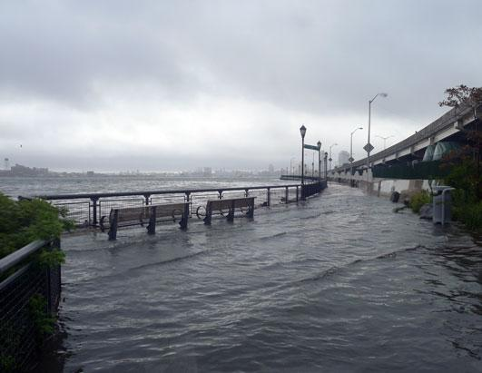
Tabletop exercise
Date
Time
Company/Organization
Disclaimer: These customizable exercise templates were created for the use of private sector organizations by New York City Emergency Management (NYCEM). NYCEM is not responsible for any changes made to exercise materials by participating organizations. The scenarios presented are fictional, and NYCEM cannot guarantee that the City agency actions depicted here will be the City’s response for similar incidents. For more information about the resources NYC Emergency Management has available, please visit us at NYC.gov/emergencymanagement or email us at publicprivate@oem.nyc.gov.

Slide 2
Ground Rules
Don’t fight the scenario! It is a tool to guide the discussion.
This exercise will be held in an open, low-stress, no-fault environment. Varying viewpoints, even disagreements, are expected.
Respond to the scenario using your knowledge of your organization’s current plans and capabilities.
Decisions are not precedent-setting and may not reflect your organization’s final position on a given issue. This exercise is an opportunity to discuss and present multiple options and possible solutions.
Issue identification is not as valuable as suggestions and recommended actions that could improve response efforts. Problem-solving efforts should be the focus.
The Parking Lot: A place to note ideas that can be discussed at a later time.

Slide 3
Background
Thursday, August 29, 5:45PM
The summer has been extremely hot, but the forecast for the coming weekend looks excellent, with pleasant temperatures promised through Labor Day on Monday. Several of the organization’s employees are taking advantage of the long weekend to travel out of town.
The company’s Chief Operating Officer (COO), who will be in South Carolina until Wednesday, checks the forecast before leaving for the airport:
“The weather looks clear all along the East Coast. Tropical Storm Chester has just strengthened into a Category 1 hurricane about 400 miles east of the Bahamas, but that’s far away.”

Slide 4

Swift Changes
Friday, August 30, 10:00am
Today’s forecasts and projections show Hurricane Chester, now a Category 2 storm, heading for the South Carolina coast and then weakening significantly as it heads north over land. New York City could face heavy rain and high surf on Tuesday.
Considerations:
Where does your organization get information from?
What actions, if any, will be taken at this point?

Slide 5
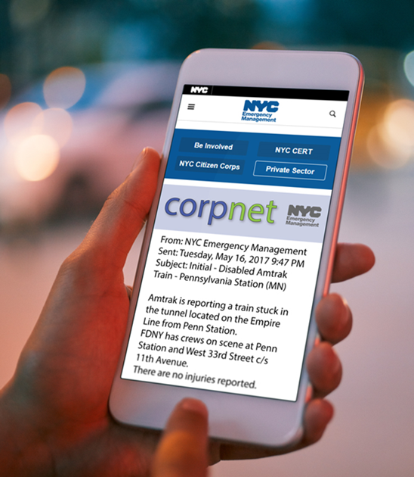
CorpNet Update
Friday, August 30, 11:30am
Correspondence from WATCH COMMAND:
**UPDATE** HURRICANE CHESTER IS NOW A CATEGORY 2 STORM
THIS SYSTEM CURRENTLY POSES
NO IMMEDIATE THREAT TO
NEW YORK CITY.
NYCEM WILL CONTINUE TO
MONITOR THE STATUS AND
PROGRESS OF HURRICANE CHESTER.
LOCATION...18.3N 65.0W
ABOUT 400 MI... 643.7 KM E OF THE BAHAMAS
MAXIMUM SUSTAINED WINDS...96 MPH...154 KM/H
PRESENT MOVEMENT...NE OR 315 DEGREES AT 13 MPH...20 KM/H
MINIMUM CENTRAL PRESSURE...997 MB...29.44 INCHES

Slide 6
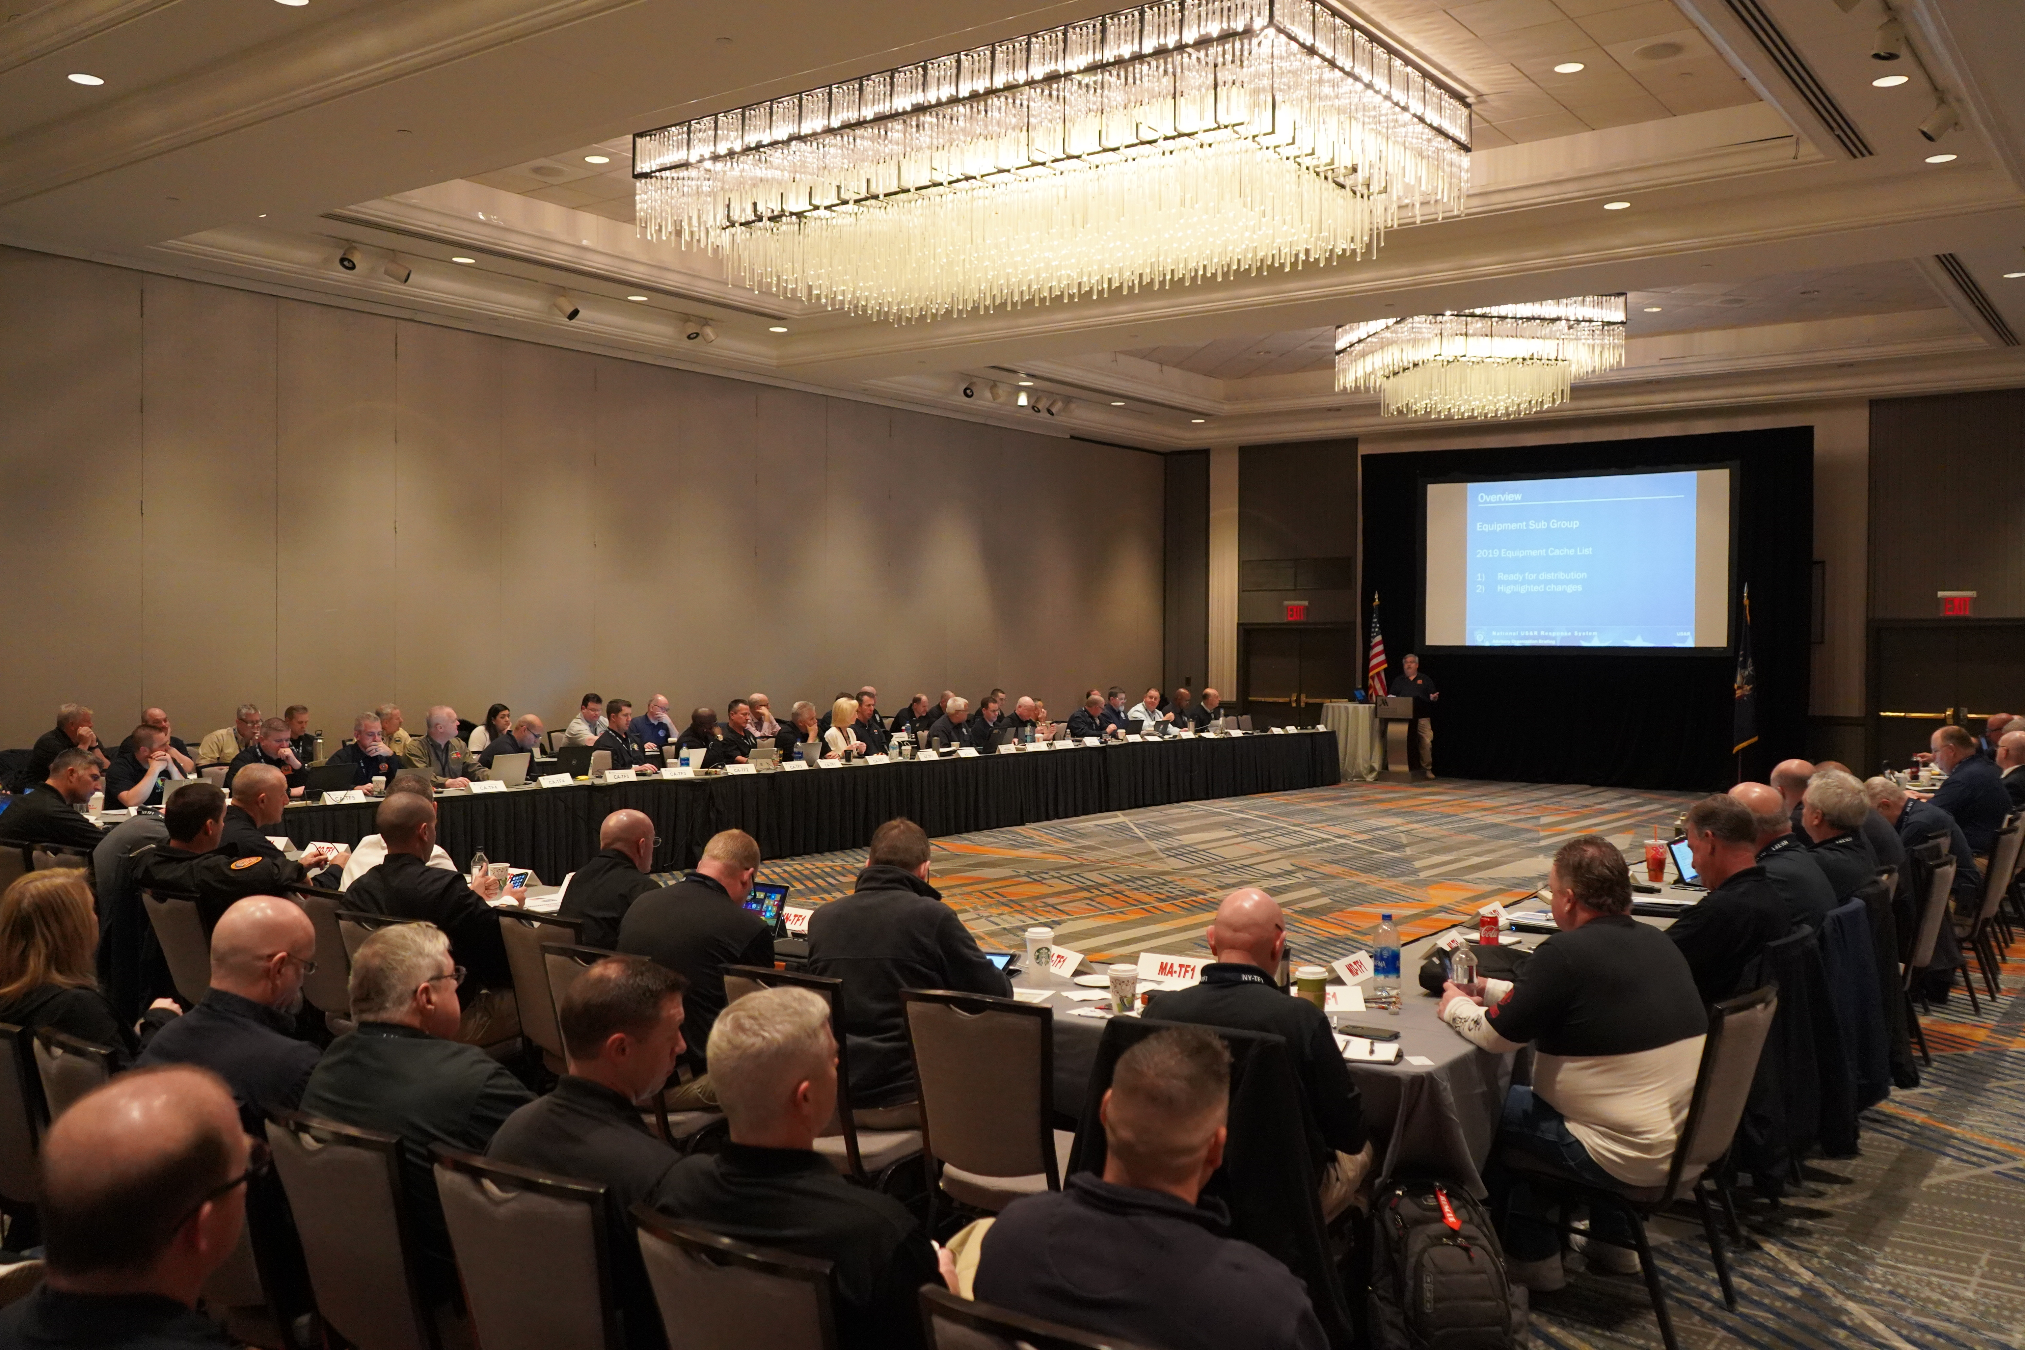
Operational Concerns
Friday, August 30, 6:30PM
A call comes in from the business operations manager, stating that a large shipment of supplies is due to arrive at the office Tuesday afternoon.
The office administrator reminds the group that the annual client conference is supposed to kick-off Wednesday morning.
Considerations:
Who is on the crisis management or response team? Does such a team exist?

Slide 7
Saturday

Slide 8
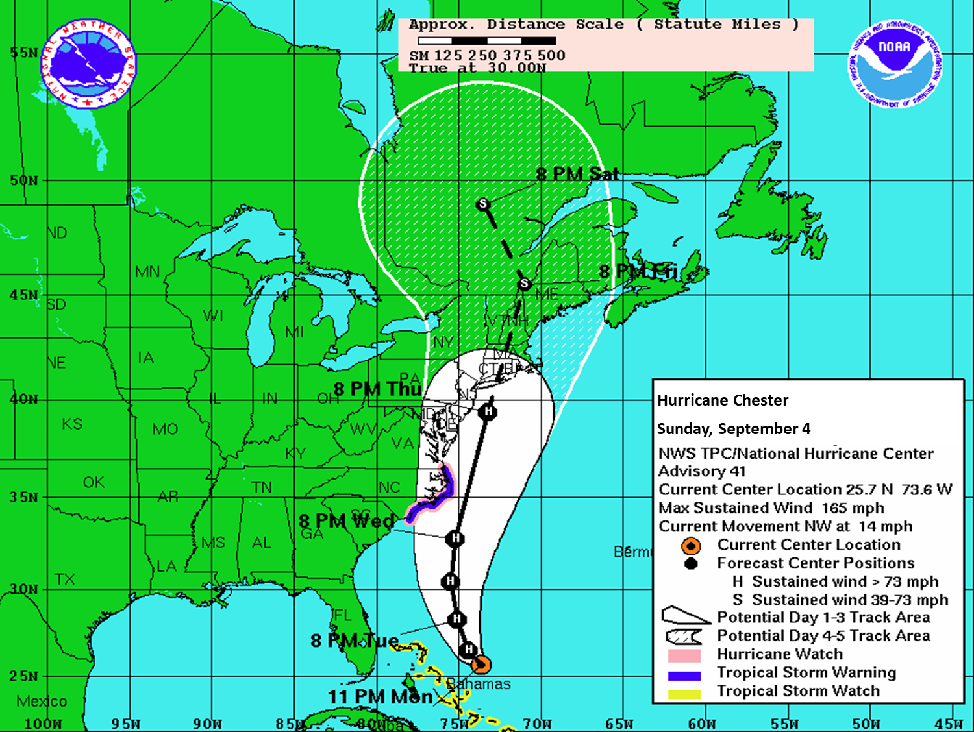
Projections Change
Saturday, August 31, 9:15AM
The National Weather Service (NWS) has now indicated that Hurricane Chester is expected to make landfall in North Carolina as a Category 2 storm and will then likely head north-northeast back into the Atlantic and up the East Coast.
The meteorologist warns that unusually warm ocean temperatures could keep the hurricane at Category 2 strength when it lands in New York City with a north trajectory.
8PM Thu
8PM Wed
8PM Tue
Saturday, August 31
8PM Mon
110
8PM Sun
8 PM Sat
11 PM Fri

Slide 9
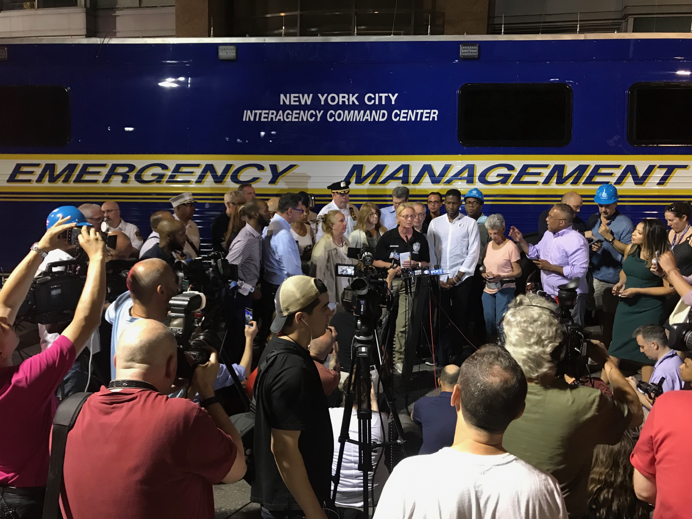
NYC Press Conference
Saturday, August 31, 11:00AM
NYCEM Emergency Operations Center is activated.
NYC is considering issuing an evacuation order for Zones 1 and 2. The City is also urging New Yorkers to stay with friends and family if possible but will open shelters if an evacuation order is issued.
The City has been working with hospitals and long-term care providers to relocate their patients and residents.
The NWS has issued an official Hurricane Watch for the NYC area.

Slide 10

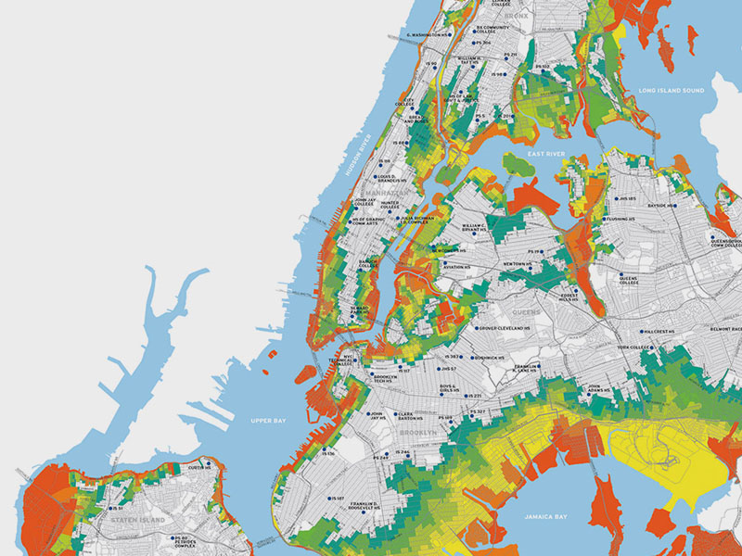
Evacuation: Know Your Zone
Are any of the organization’s facilities located in either Evacuation Zone 1 or 2?
Do any employees live in a NYC, NJ, or Long Island evacuation zone?
HINT: www.nyc.gov/knowyourzone

Slide 11
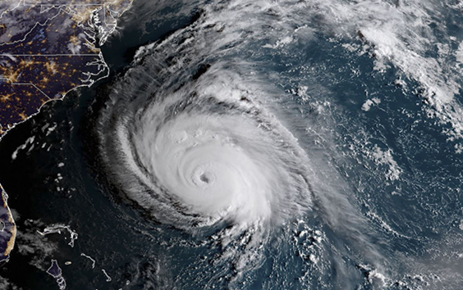
The Next Sandy?
Saturday, August 31, 6:00PM
Local media has picked up the Hurricane Chester story. Commentators are asking whether it will be the next Sandy. Several co-workers have e-mailed asking whether they should plan to come in to work on Tuesday or Wednesday.
The NWS has issued an official Hurricane Warning for New York City and Long Island. The hurricane is expected to make landfall at 8:00 PM, Tuesday and is projected to have a major impact on Brooklyn, southern Queens, and Nassau County.

Slide 12
sunday

Slide 13
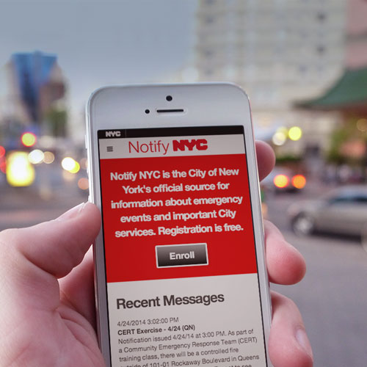
Executive Order
Sunday, September 1, 10:00AM
The Mayor has now ordered a mandatory evacuation of Zones 1 and 2.
Schools will not open on Tuesday or Wednesday.
The Mayor warns that non-essential City services, including public transportation, will shut down at 2 PM Tuesday, when tropical storm-force winds will make operations unsafe.

Slide 14


Are you ready?
Is your home in an evacuation zone? Where will you evacuate to?
Do you have an emergency plan for family members and pets?
Do you have a Go-Bag?
All New Yorkers should sign up for NotifyNYC to receive up-to-date emergency alerts directly from NYCEM’s 24/7 Watch Command.

Slide 15
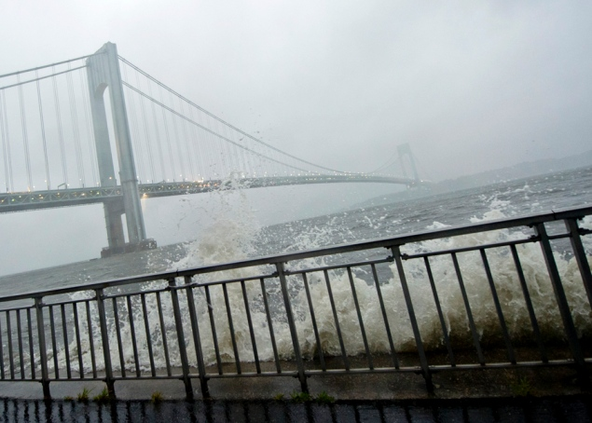
Are We Ready for This?
Monday, September 2, 8:30AM
The COO calls from South Carolina: “Are we ready for this storm? I know folks are out of town for Labor Day, but can you gather some people together to make sure our organization can make it through Chester intact? I don’t mean just facilities… Come to think of it, did we ever secure an alternate work site?”
The company’s vendor emails back: the shipment of supplies is postponed until further notice.
Considerations:
Are there lines of succession and back-ups designated for important positions?
Does the organization have an alternate work site? How quickly can it be functional for the organization’s needs?

Slide 16
Hurricane chester makes landfall
Tuesday, September 3, 8:00PM
Hurricane Chester makes landfall in New York City, bringing sustained winds of up to 110 mph and a storm surge of 13.0-16.6 feet.
According to the National Hurricane Center,
  “some roofing material, door, and window damage of buildings will occur. …A number of glass windows in high rise buildings will be dislodged and become airborne. Loose outdoor items will become projectiles, causing additional damage [and injury]. …Numerous large branches will break. Many trees will be uprooted or snapped. Extensive damage to power lines and poles will likely result in widespread power outages that could last a few to several days.”

Slide 17
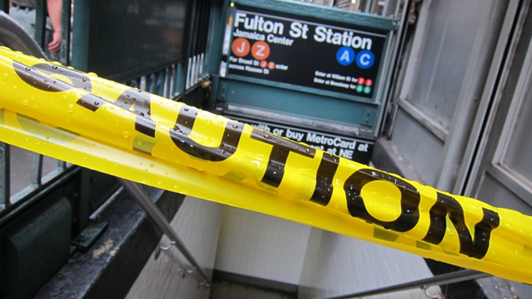
The Immediate Aftermath
Wednesday, September 4, 8:00AM
Hurricane Chester has passed and left a large amount of damage in its wake.
The storm surge has devastated areas of southern Brooklyn and Queens, trees and signs are down all over the city, and Lower Manhattan and Midtown are a mess of broken glass and debris.
Due to flooding, parts of the Belt Pkwy and FDR Drive are closed until further notice.
Considerations:
What critical operations will need to get back up and running as soon as the storm passes?
What operations can be postponed or canceled for a time?

Slide 18
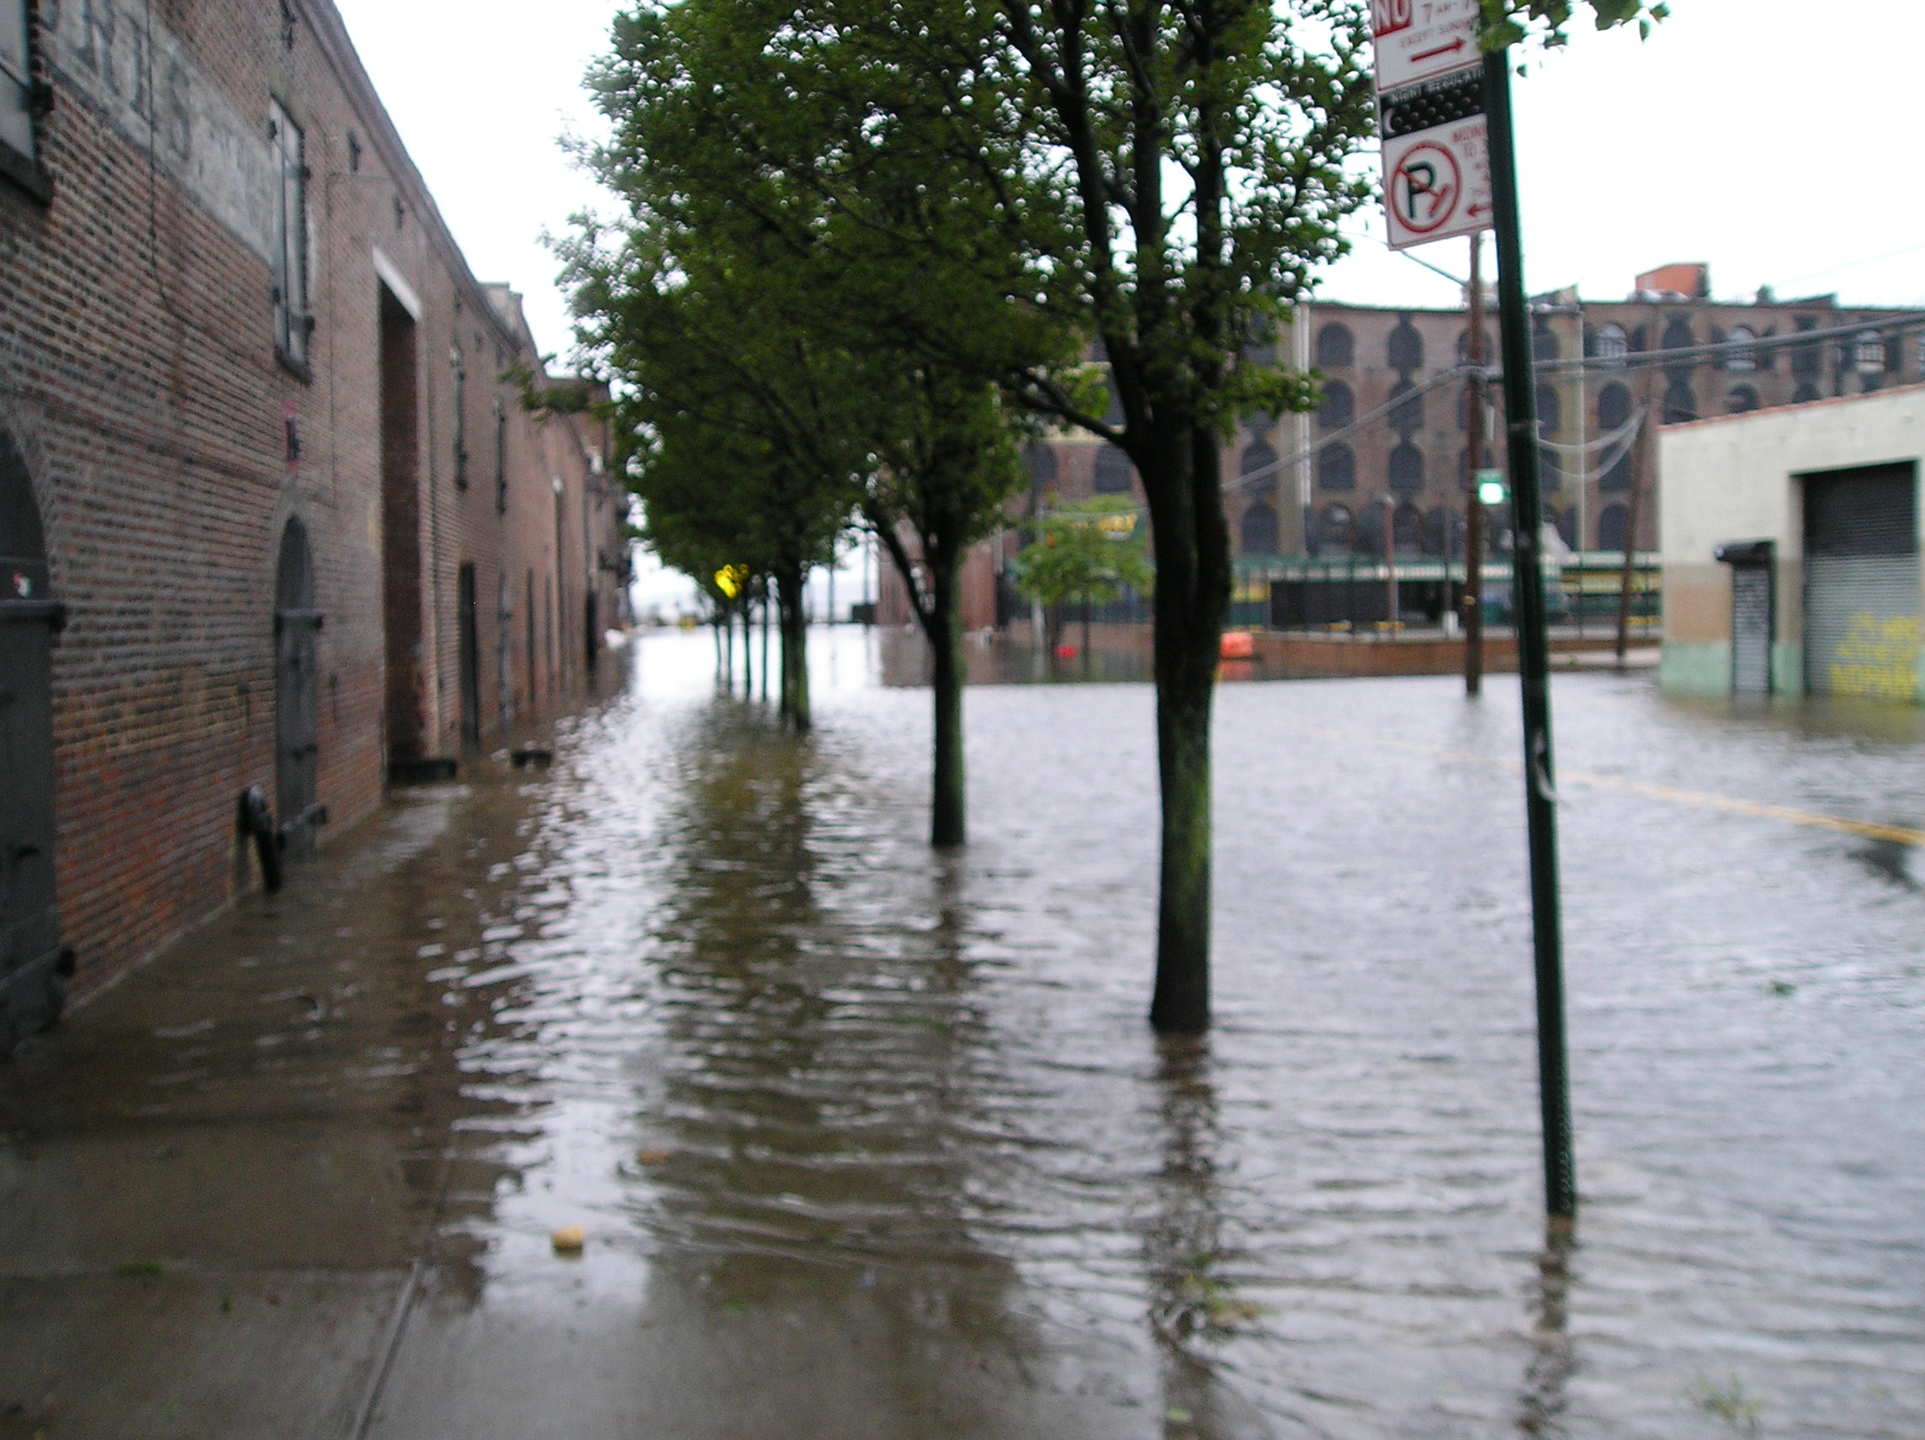
Damage Assessment
Wednesday, September 4, 10:00AM
City agencies are conducting damage assessments and determining how long it will take to re-open major roadways, bridges, and public transportation systems.
The Mayor announces that schools—many of which are currently serving as shelters—will not open until Monday, September 9th.
Considerations:
Are employees required to come to work at this point?
If not, will they be using vacation time? Sick time?

Slide 19
Moving Forward
For exercise purposes, this marks the end of the immediate response to the coastal storm event. As response transitions to recovery, your organization may have to consider issues such as employee contact, damage assessment, continuity operations, and the insurance adjustment process.
The recovery phase will be the subject of a forthcoming scenario in NYC Emergency Management’s Tabletop Exercise Toolkit.
For more information about the resources that NYC Emergency Management has available for organizations, please visit us at NYC.gov/emergencymanagement or email us at publicprivate@oem.nyc.gov.

Slide 20
Thank you

