Slide 1
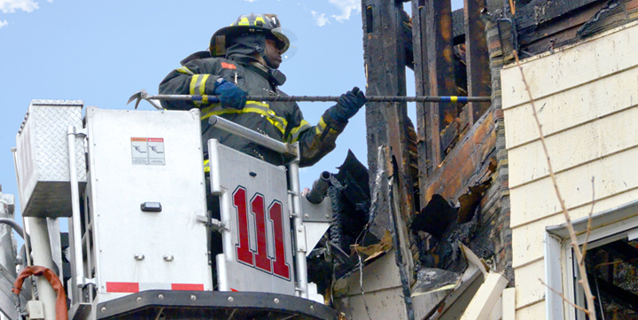
Tabletop exercise
[Date]
[Time]
[Company/Organization]
Disclaimer: These customizable exercise templates were created for the use of private sector organizations by New York City Emergency Management (NYCEM). NYCEM is not responsible for any changes made to exercise materials by participating organizations. The scenarios presented are fictional, and NYCEM cannot guarantee that the City agency actions depicted here will be the City’s response for similar incidents. For more information about the resources NYC Emergency Management have available, please visit us at NYC.gov/emergencymanagement or email us at strategicpartnerships@oem.nyc.gov.

Slide 2
Ground Rules
Don’t fight the scenario! It is a tool to guide the discussion.
This exercise will be held in an open, low-stress, no-fault environment. Varying viewpoints, even disagreements, are expected.
Respond to the scenario using your knowledge of your organization’s current plans and capabilities.
Decisions are not precedent setting and may not reflect your organization’s final position on a given issue. This exercise is an opportunity to discuss and present multiple options and possible solutions.
Issue identification is not as valuable as suggestions and recommended actions that could improve response efforts. Problem-solving efforts should be the focus.
The Parking Lot: A place to note ideas that can be discussed at a later time.

Slide 3
Background
Thursday Morning, 11:30 AM
It is a sunny Thursday morning in New York City, and business activities for the week are in full swing. Most employees working in the office today have already arrived. Several employees are working remotely.
One of the employees, Jason, announces that something smells weird and gets up from his desk to investigate. With the attention of his desk neighbors, he walks over to the server room where he sees wisps of smoke coming out.

Slide 4
Alarms Go Off!
Thursday Morning, 11:30 AM
Jason reaches the server room and notices the smoke is slowly increasing in volume. He steps away from the room and instructs one of his colleagues to call 911.The whole office quickly becomes aware of the situation happening in the server room.
Suddenly, smoke alarms start blaring overhead as dark smoke begins to billow out of the server room!

Slide 5
Initial Reactions
Thursday Morning, 11:30 AM
Employee reactions:
    What’s going on?
    Am I in danger?
    How do I leave quickly and safely?
Your reactions:
    All of the above, and…
      How do you answer these initial questions/concerns?
      How do I ensure all employees exit safely?

Slide 6
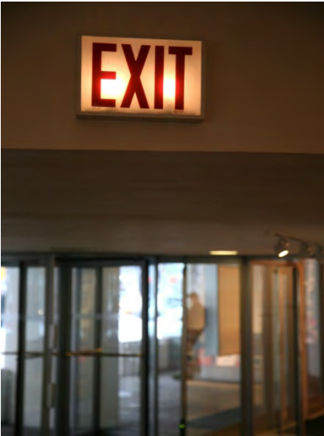
What Now?
Thursday Morning, 11:35 AM
The Fire Safety Manager for the building announces that everyone must evacuate the building following the exit signs and meet at the predesignated meeting place.
Considerations
Do employees know where to meet?
How is management prepared to deal with panic or confusion?

Slide 7
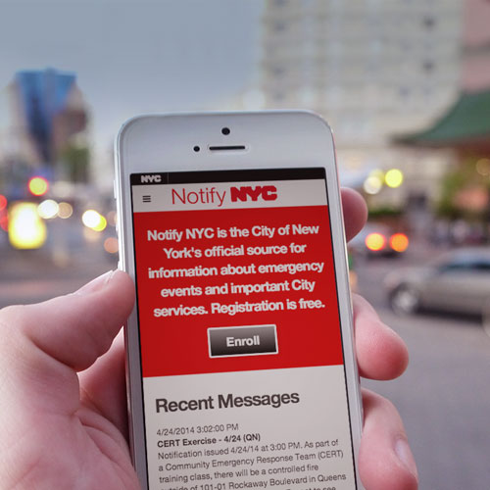
Arriving on Scene
Thursday Morning, 11:35 AM
Employees are evacuating the building and waiting across the street.
You hear the sound of several sirens outside. NYPD, FDNY, and FDNY-EMS are on scene. NYC Emergency Management is enroute.
Notify NYC sends out a message informing people to avoid the area due to fire and police activity.

Slide 8
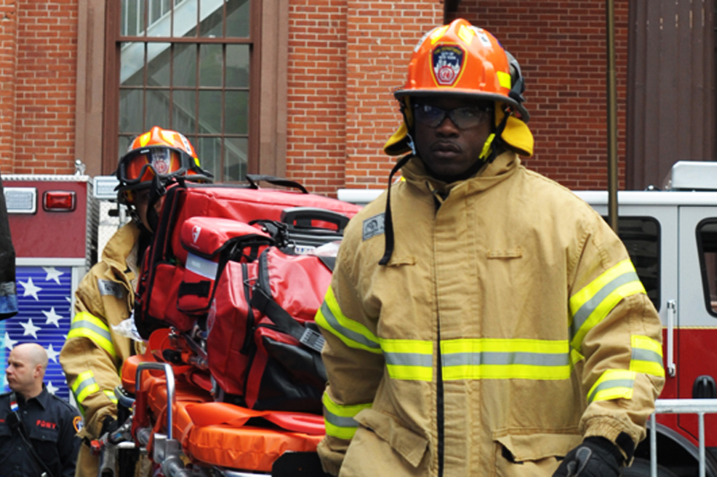
Are you ready?
Be PREPARED for a possible fire.
Leave immediately at signs of fire.
Stay close to the ground to avoid smoke.
Call 911 as soon as you are safe.
Stop, drop and roll if clothes catch on fire.
Do NOT go back for any forgotten items.
Do NOT take the elevator.

Slide 9
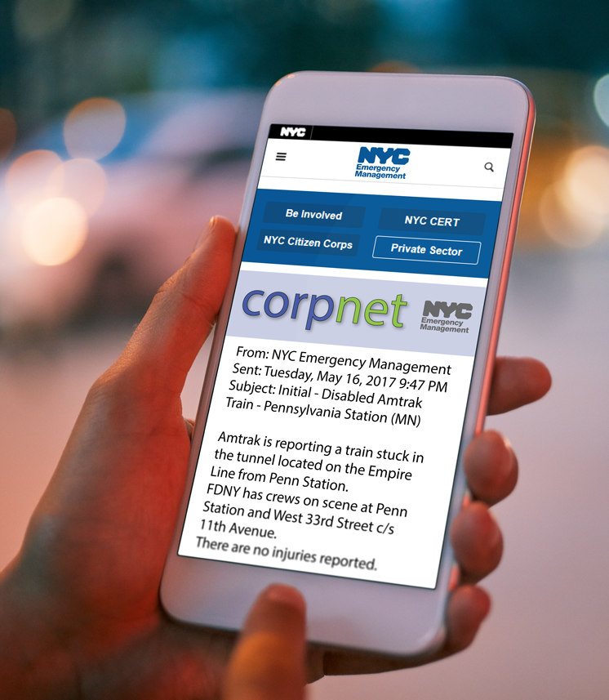
The City’s Response Continues
Thursday Afternoon, 12:30 PM
A CorpNet message is sent out with the following information:
FDNY is on scene completing evacuation procedures and extinguishing a fire in a commercial high-rise building.
Department of Buildings (DOB) has been requested to assess structural impacts.

Slide 10
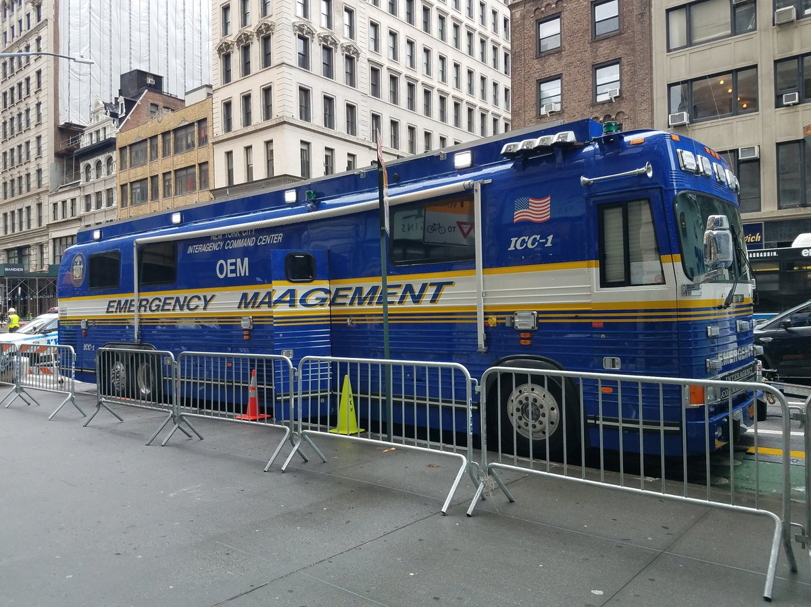
What’s Happening Outside
Thursday Afternoon, 1:00 PM
FDNY has extinguished the fire originating in the server room. All hardware in the room is beyond repair along with desks nearby.
DOB is assessing structural impacts.
NYC Emergency Management is facilitating an initial interagency meeting.
Considerations
How is your organization prepared to respond to this?
How will employees away from the office be notified?

Slide 11
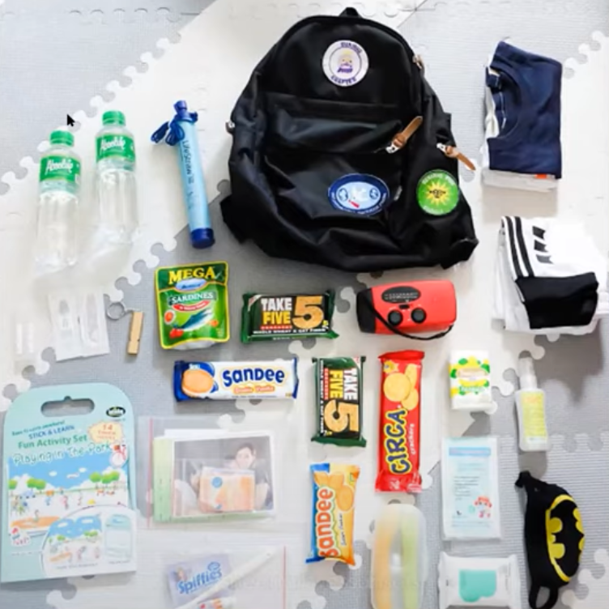
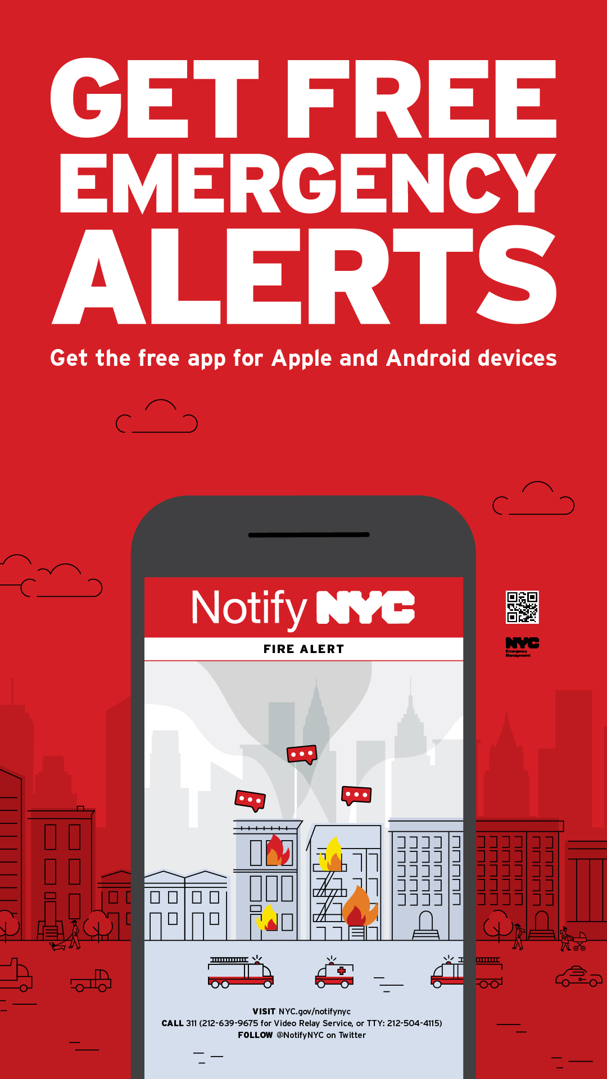
Are YOU Prepared?
Be PREPARED to leave at a moment’s notice.
Keep a Go Bag in an easy to reach location.
Customize your Go Bag for an office setting by including:
  A portable phone charger
  Extra pair of clothes and shoes
All New Yorkers should sign up for NotifyNYC to receive up-to-date emergency alerts via www.nyc.gov/notifynyc or follow@notifynyc.

Slide 12
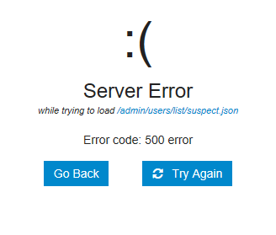
Office Updates
Thursday Afternoon, 2:00 PM
A fire marshal informs you that it is still not safe to enter the building and that it may be several hours before entry is allowed, but thankfully damage to the building is not critical.
Employees working from home notify you that they cannot access the virtual desktop and are limited in their capacity to perform their roles.
Considerations
How will your organization maintain continuity of operations?
What are on-site employees expected to do at this moment?
What is the messaging to employees working from home?

Slide 13
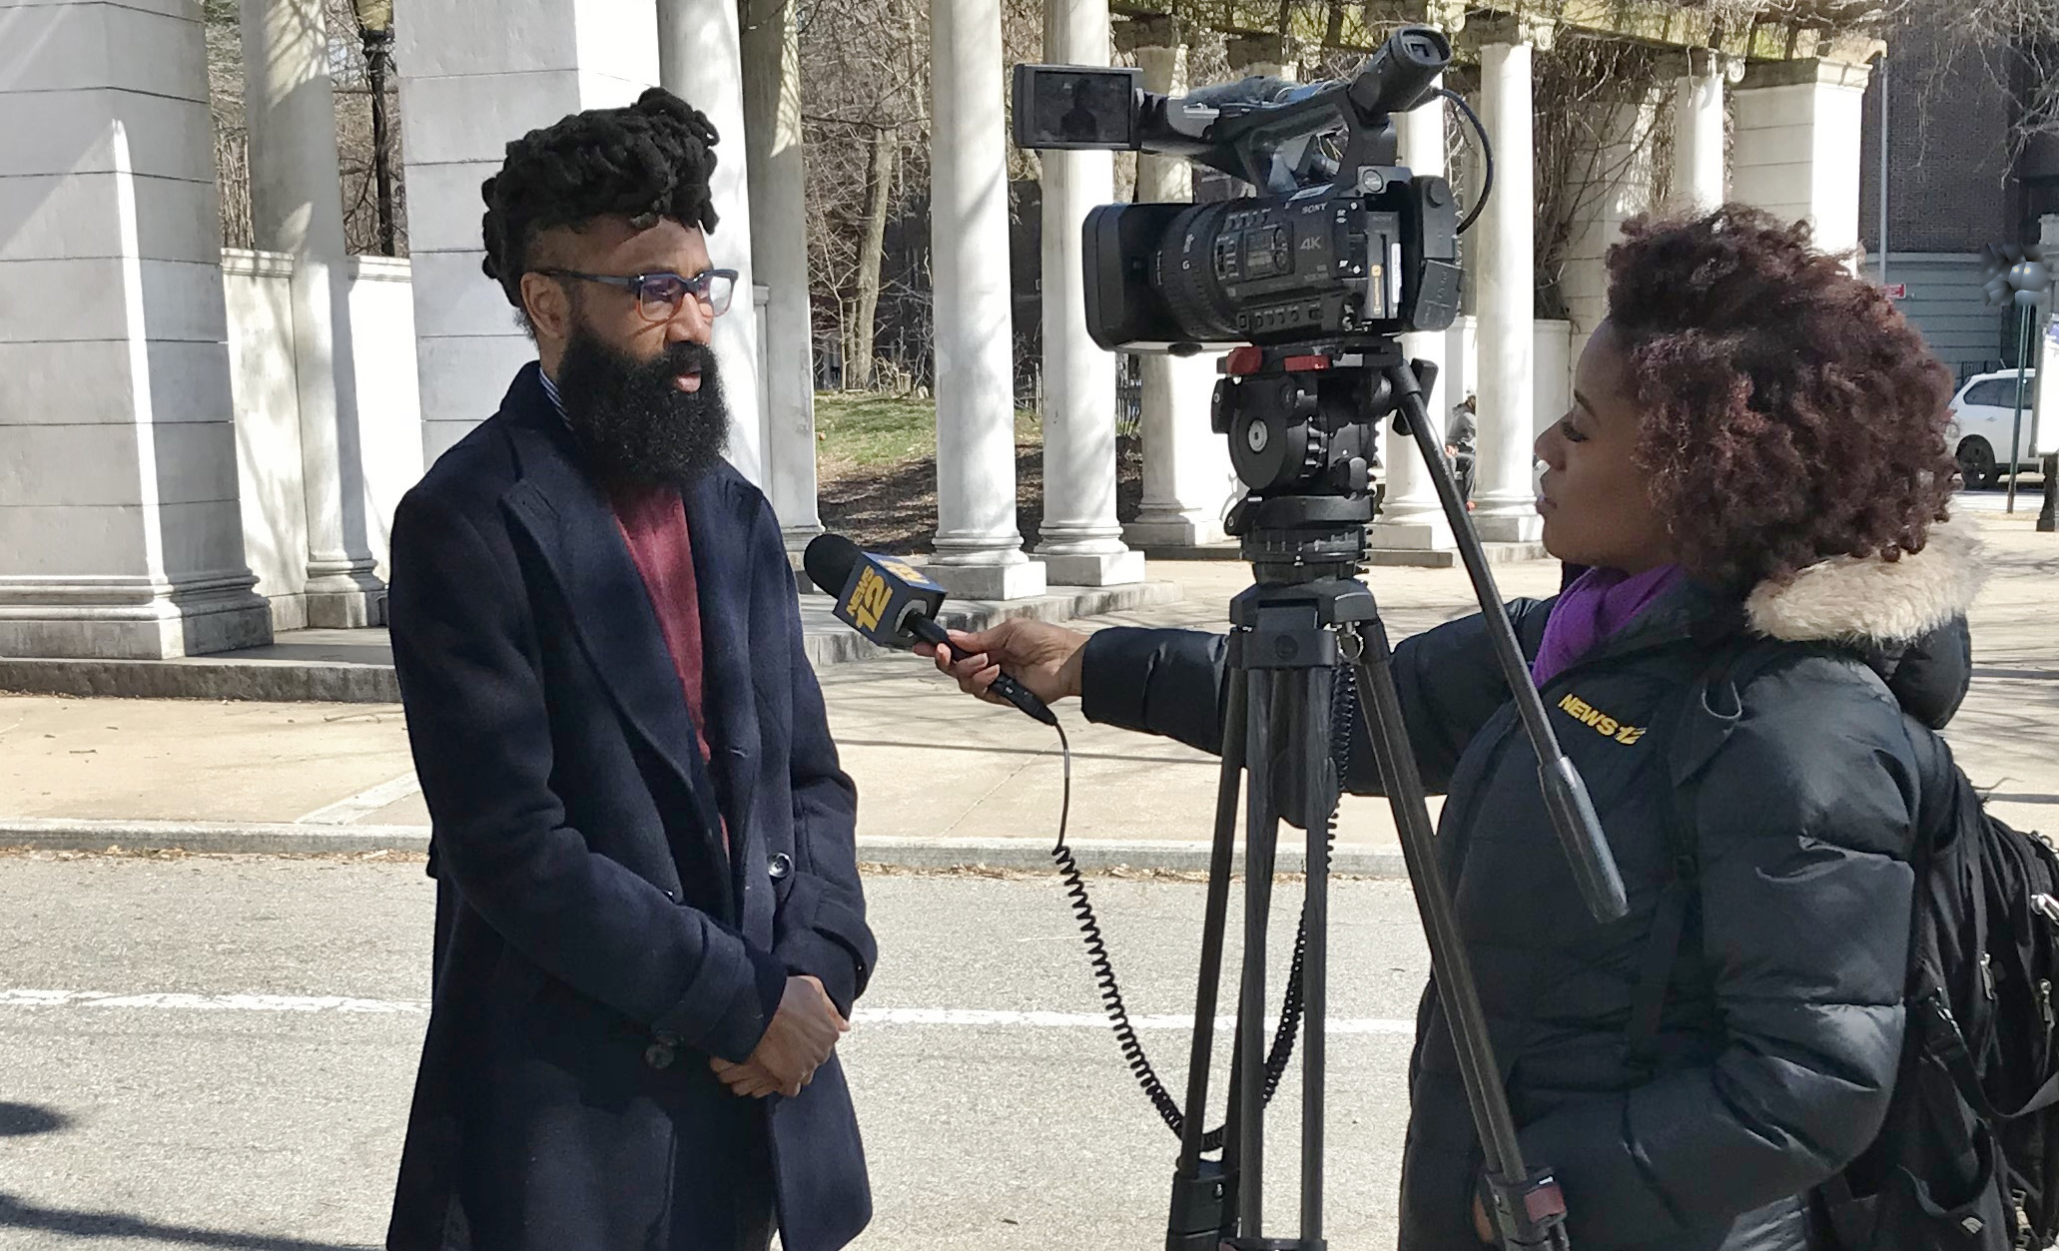
Mounting Issues
Thursday Afternoon, 2:15 PM
Employees are becoming aware of the repercussions of a destroyed server room. They are speculating among themselves about what their duties will be in the immediate and long-term future. – “What will this mean for our jobs?”
Remote workers have also contacted management looking for guidance on how to proceed. The Chief Technology Officer is meeting with their team to determine impacts moving forward.
Several television crews have arrived, and they are asking the employees questions.
Considerations
How is your organization prepared to respond to all these impacts?

Slide 14
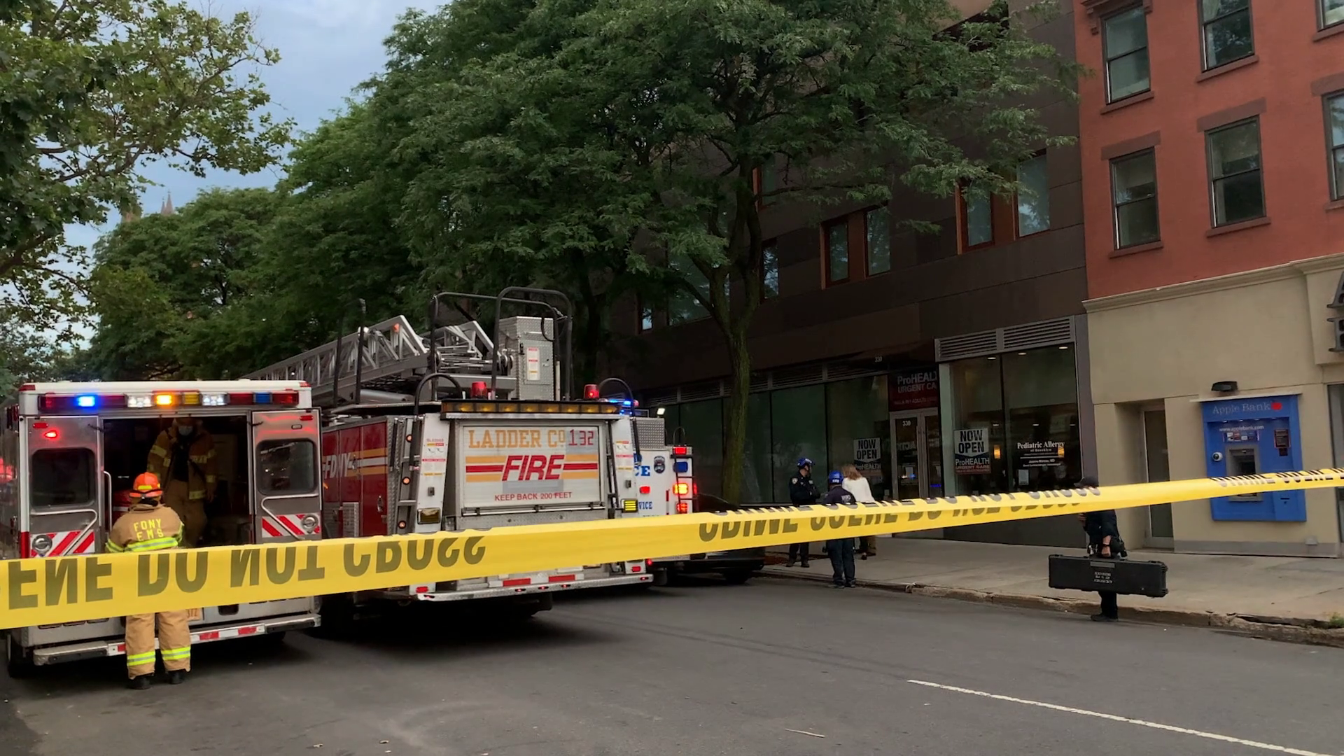
Assessing the Damage
Friday Morning, 10:30 AM
DOB has announced no structural impacts to the building, and FDNY has permitted limited access to the building. You inspect the office and are relieved to find that the damage is mostly in the server room.
It becomes clear to you that your organization cannot go on with business as usual for several days at least. You will likely have to find a new space to work while repairs are underway, and set up new servers to enable remote work.
Considerations
What is your organization’s plan for continuity of operations?
How will employees be kept informed about this incident?

Slide 15
Moving Forward
For exercise purposes, this marks the end of the immediate response to the fire incident. As response transitions to recovery, your organization may have to consider issues such as client contact, damage assessment, continuity operations, and the insurance adjustment process.
This recovery phase will be the subject of a forthcoming scenario in NYC Emergency Management’s Tabletop Exercise Toolkit.
For more information about the resources that NYC Emergency Management has available for organizations, please visit us at NYC.gov/emergencymanagement or email us at strategicpartnerships@oem.nyc.gov.

Slide 16
Thank you

