Slide 1
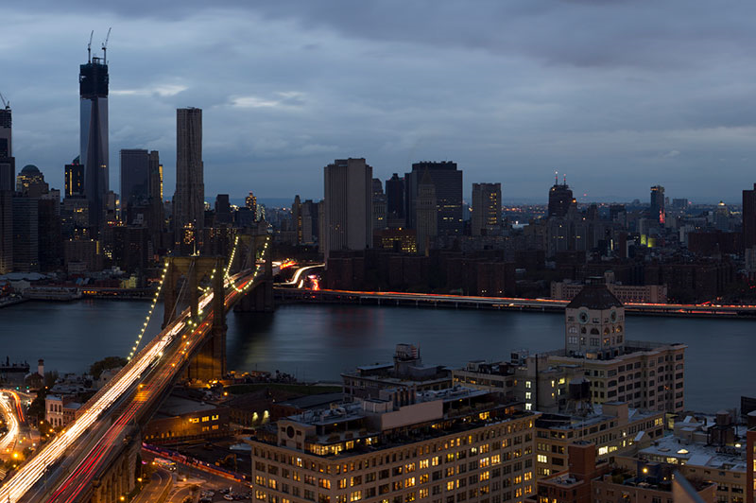
Tabletop exercise
Date
Time
Company/Organization
Disclaimer: These customizable exercise templates were created for the use of private sector organizations by New York City Emergency Management (NYCEM). NYCEM is not responsible for any changes made to exercise materials by participating organizations. The scenarios presented are fictional, and NYCEM cannot guarantee that the City agency actions depicted here will be the City’s response for similar incidents. For more information about the resources NYC Emergency Management has available, please visit us at NYC.gov/emergencymanagement or email us at publicprivate@oem.nyc.gov.

Slide 2
Ground Rules
Don’t fight the scenario! It is a tool to guide the discussion.
This exercise will be held in an open, low-stress, no-fault environment. Varying viewpoints, even disagreements, are expected.
Respond to the scenario using your knowledge of your organization’s current plans and capabilities.
Decisions are not precedent-setting and may not reflect your organization’s final position on a given issue. This exercise is an opportunity to discuss and present multiple options and possible solutions.
Issue identification is not as valuable as suggestions and recommended actions that could improve response efforts. Problem-solving efforts should be the focus.
The Parking Lot: A place to note ideas that can be discussed at a later time.

Slide 3
Background
Monday, June 30, 7:30 AM
Upon arrival to the office this morning, the electricity seems to be out with the exception of some emergency lighting in the halls…
Brian, the building engineer, says that the building is experiencing a loss of power and it’s not yet clear what the cause is. However, the building is currently running on backup generator power.
Sherry arrives at the office and states that other buildings on the block appear dark and seem to be without power too.

Slide 4
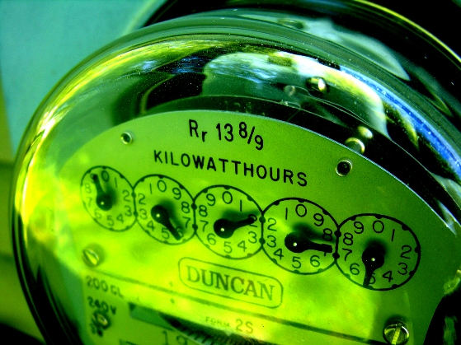
Power Disruption
Monday, June 30, 8:00 AM
Consolidated Edison (Con Edison) confirms that they are currently experiencing a massive grid outage primarily affecting the west side of Manhattan. The cause of power failure is unknown at this time and remains to be under investigation.
Considerations:
Does the organization rely on backup power?
How long can the organization be without power before critical functions are affected?
With interrupted phone line service, what are the concerns regarding communication capabilities?

Slide 5
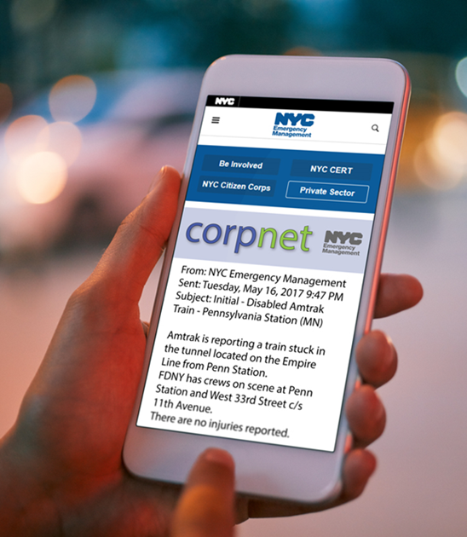
CorpNet Notification
Monday, June 30, 8:30 AM
New York City Emergency Management (NYCEM) messaging
includes the following CorpNet notification:
(NYCEM ALL CALL)
FDNY operations are ongoing.
Con Edison reports a manhole fire occurred at the above location and impacted a transmission line. This has caused a power outage to the west side of Manhattan impacting approximately 38,000 customers including Lincoln Center, St. Luke’s-Roosevelt Hospital Center, and Columbus Circle.
MTA reports there is no disruption to train service, however, there are no operational lights at the stations.
Port Authority reports power went out at Penn Station and was immediately restored. There are no reports of train disruptions at this time.
There are no reports of evacuations or injuries at this time.
NYCEM is on scene. NYCEM will activate the EOC.

Slide 6
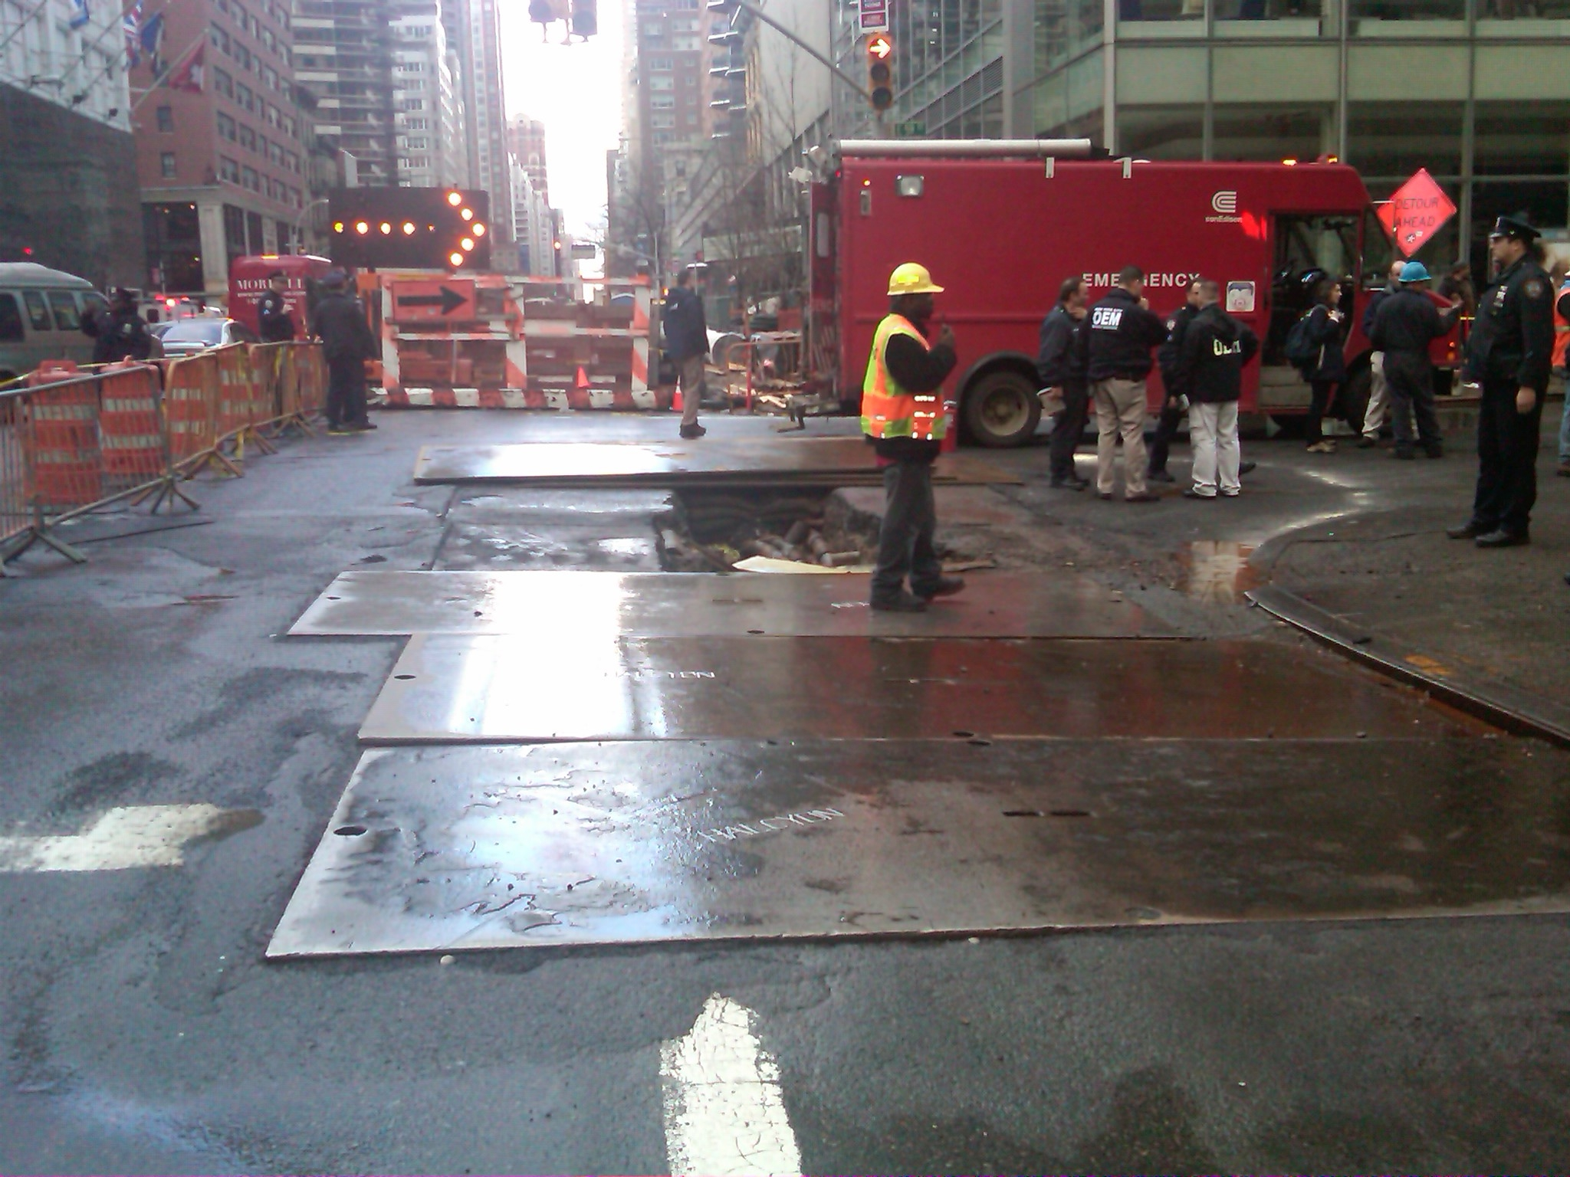
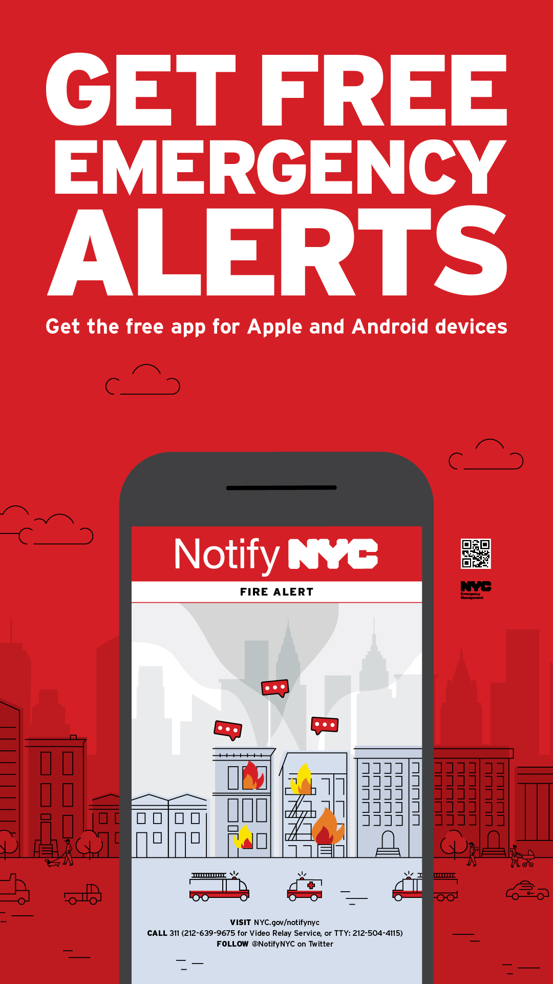
Are you ready?
PREPARE for a possible power outage:
Charge cell phone batteries, gather supplies like flashlights and extra batteries.
Limit the use of energy-intensive equipment such as washers, dryers, and air conditioners. Turn off lights/televisions when not needed.
All New Yorkers should sign up for NotifyNYC to receive up-to-date emergency alerts directly from NYCEM’s 24/7 Watch Command.

Slide 7
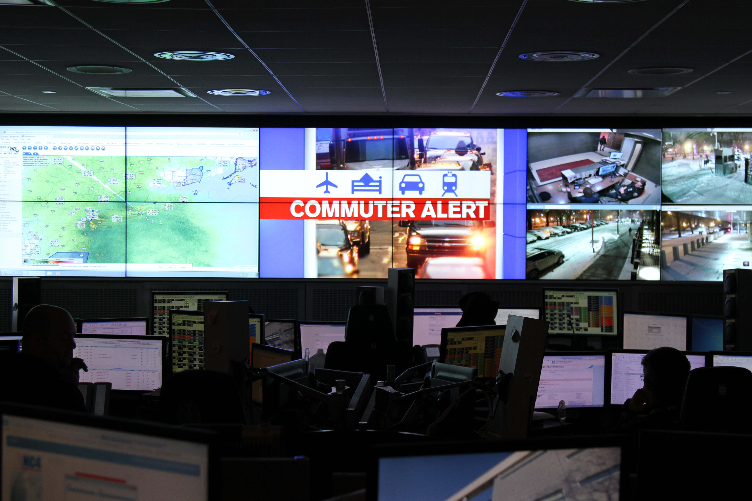
Expanding Impacts
Monday, June 30, 9:00 AM
The MTA is now reporting that several train lines are impacted by signal light outages at Penn Station causing major delays and limited train service:
  Expect mass transit disruptions on the A, C, D, E, F, M, 1, 2 & 3 train service in Manhattan in both directions.
The power outage is also impacting traffic signals, causing extensive traffic delays in the area of Midtown Manhattan in both directions.
Considerations:
Is the organization prepared to deal with staffing deficits related to commuting challenges?

Slide 8
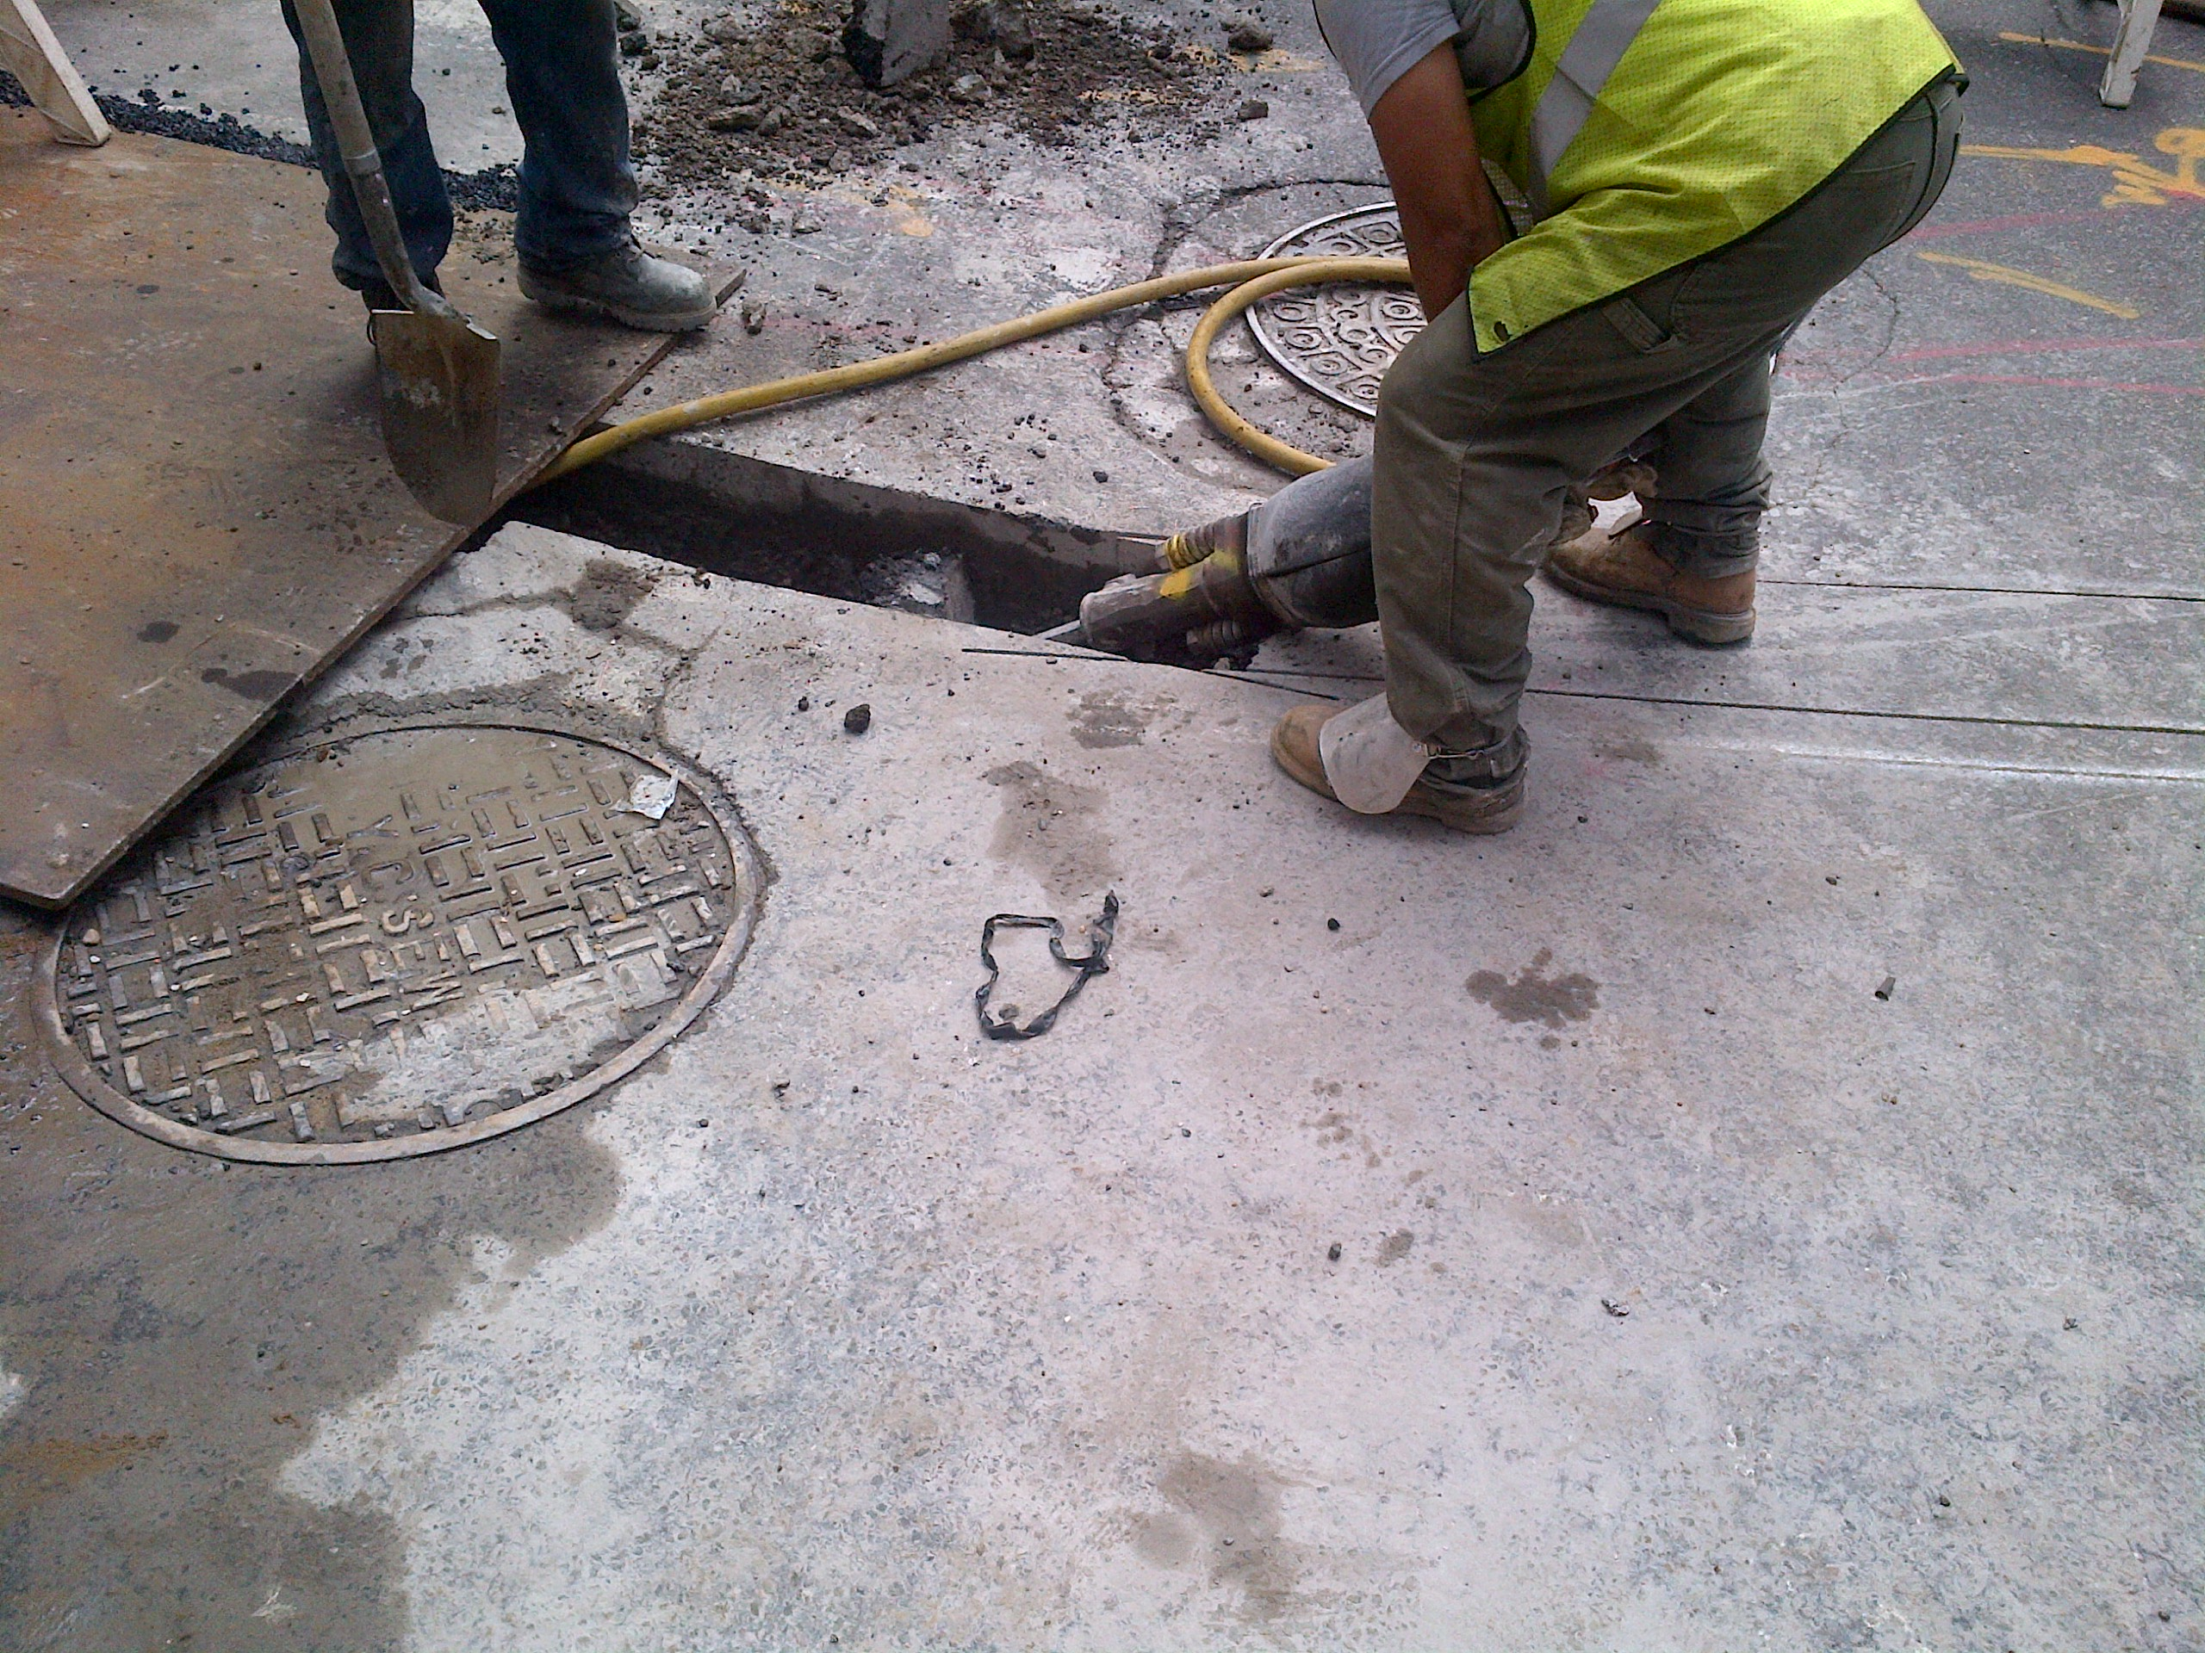
Outage Update
Monday, June 30, 11:00 AM
During a midmorning press conference, Con Edison announces that they have located the source of the outage and are currently working on repairs. Estimated time of restoration to the west side of Manhattan is 8 hours.
Considerations:
What contingency plans are in place if the power outage continues overnight? Another 24-36 hours?

Slide 9
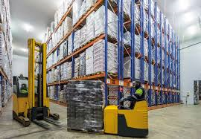
Growing Concerns
Monday, June 30, 12:30 PM
The Facilities Manager reports their concern about a delivery of products expected this afternoon that require refrigeration.
The HR Manager reports that several staff are requesting to leave early due to commuting challenges.
Considerations:
What are the organization’s concerns at this point?
Will the organization’s supply chain be disrupted in any way? If so, how?

Slide 10
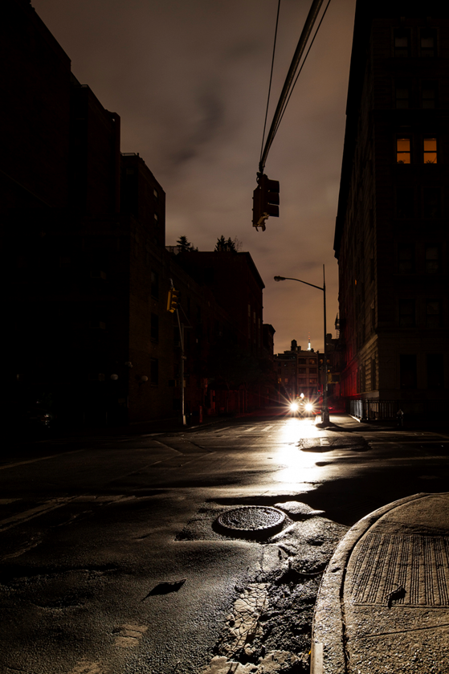
IN the dark?
AFFECTED by an outage?
Report it at www.coned.com/ReportOutage or call 1-800-75-CONED (26633).
Do NOT use generators indoors.
Keep refrigerator and freezer doors closed to prevent food spoilage.
Check on your neighbors. If someone you know uses Life-Sustaining Equipment (LSE) and needs immediate assistance, dial 911.

Slide 11

Moving Forward
Tuesday, July 1, 5:00 AM
Power has been restored to the building, however…
Con Edison has disseminated alerts requesting customers to assist in relieving stress on the electric system by:
  Turning off non-essential electrical equipment
  Reducing or shutting down elevator service
  Switching to generator power prior to peak load periods
Considerations:
How will these requests affect the organization?
What are necessary preparations the organization must take for potential additional disruptions?

Slide 12
Thank you
For more information about the resources that NYC Emergency Management has available for organizations, please visit us at NYC.gov/emergencymanagement or email us at publicprivate@oem.nyc.gov.

