Slide 1
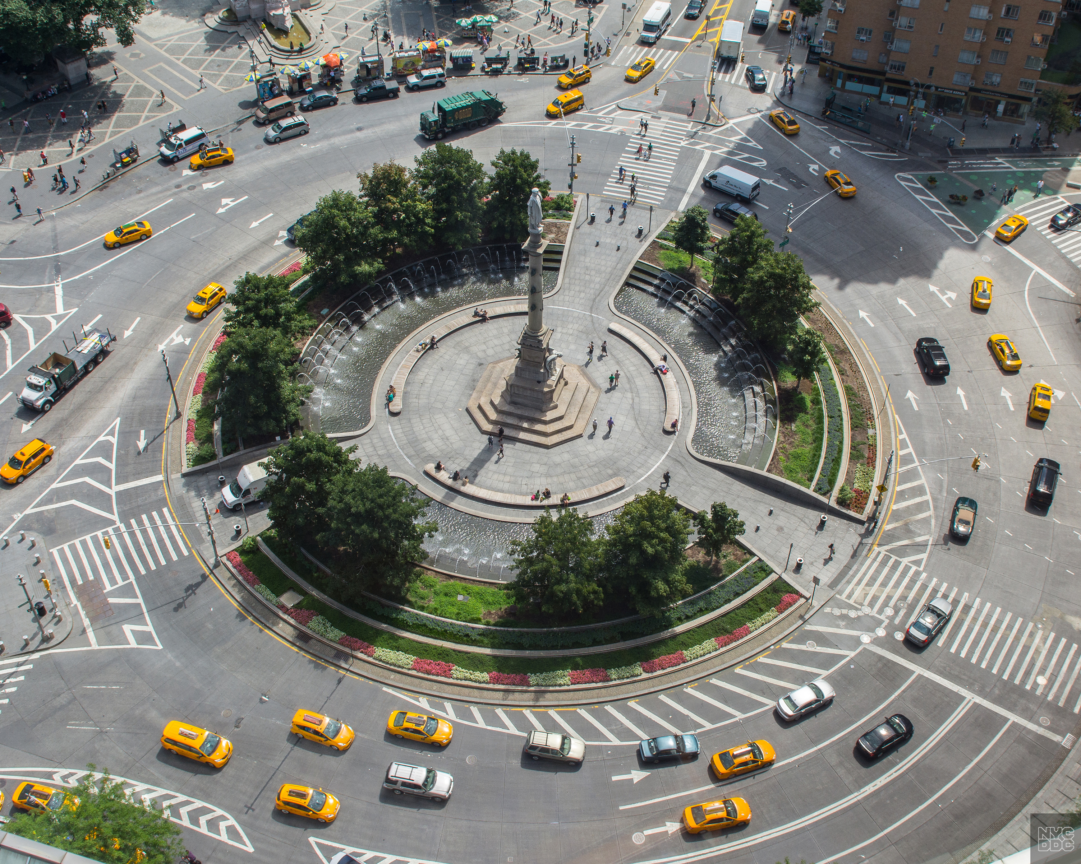
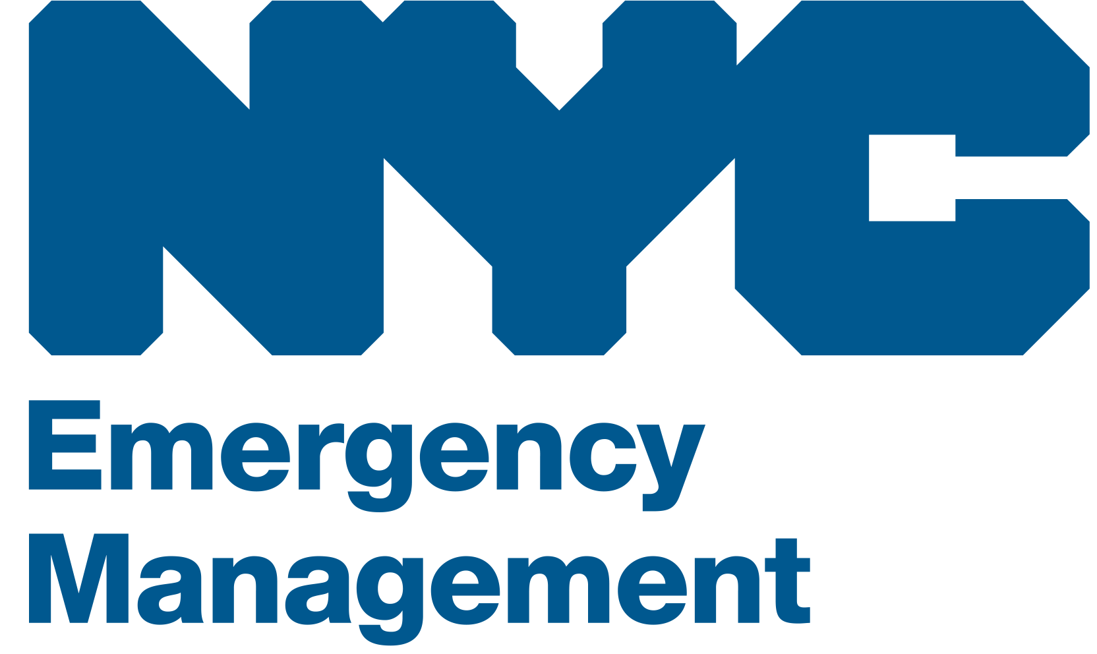
Tabletop exercise
[Date]
[Time]
[Company/Organization]
Disclaimer: These customizable exercise templates were created for the use of private sector organizations by New York City Emergency Management (NYCEM). NYCEM is not responsible for any changes made to exercise materials by participating organizations. The scenarios presented are fictional, and NYCEM cannot guarantee that the City agency actions depicted here will be the City’s response for similar incidents. For more information about the resources NYC Emergency Management have available, please visit us at NYC.gov/emergencymanagement or email us at publicprivate@oem.nyc.gov.

Slide 2
Ground Rules
Don’t fight the scenario! It is a tool to guide the discussion.
This exercise will be held in an open, low-stress, no-fault environment. Varying viewpoints, even disagreements, are expected.
Respond to the scenario using your knowledge of your organization’s current plans and capabilities.
Decisions are not precedent-setting and may not reflect your organization’s final position on a given issue. This exercise is an opportunity to discuss and present multiple options and possible solutions.
Issue identification is not as valuable as suggestions and recommended actions that could improve response efforts. Problem-solving efforts should be the focus.
The Parking Lot: A place to note ideas that can be discussed at a later time.

Slide 3
Background
Monday, November 8, 8:30 AM
A coastal storm originating in the Gulf Coast made landfall last night in Texas.
Early reports show that the storm had drastic impacts in Texas. This includes many oil wells being inundated with water and drills left temporarily inoperable.
A large proportion of NYC’s petroleum comes from the Gulf Coast. The impacts for the New York Metro Area are likely to be large.

Slide 4
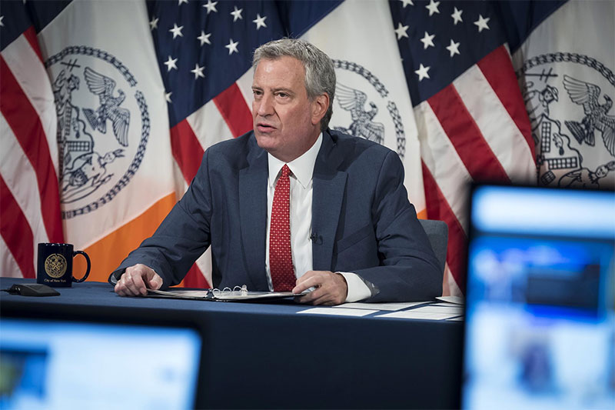
Press Briefing
Monday, November 8, 10:00 AM
The mayor announces that the coastal storm in Texas will likely lead to a fuel shortage for New Yorkers in the coming week. Petroleum products such as gas and heating oil will become scarce for an undetermined time. The public is urged to limit non-essential travel and to not panic buy for risk of making the situation worse.
Considerations
Does your organization rely on oil to heat the building?
What other utilities rely on this fuel for day-to-day operations?

Slide 5
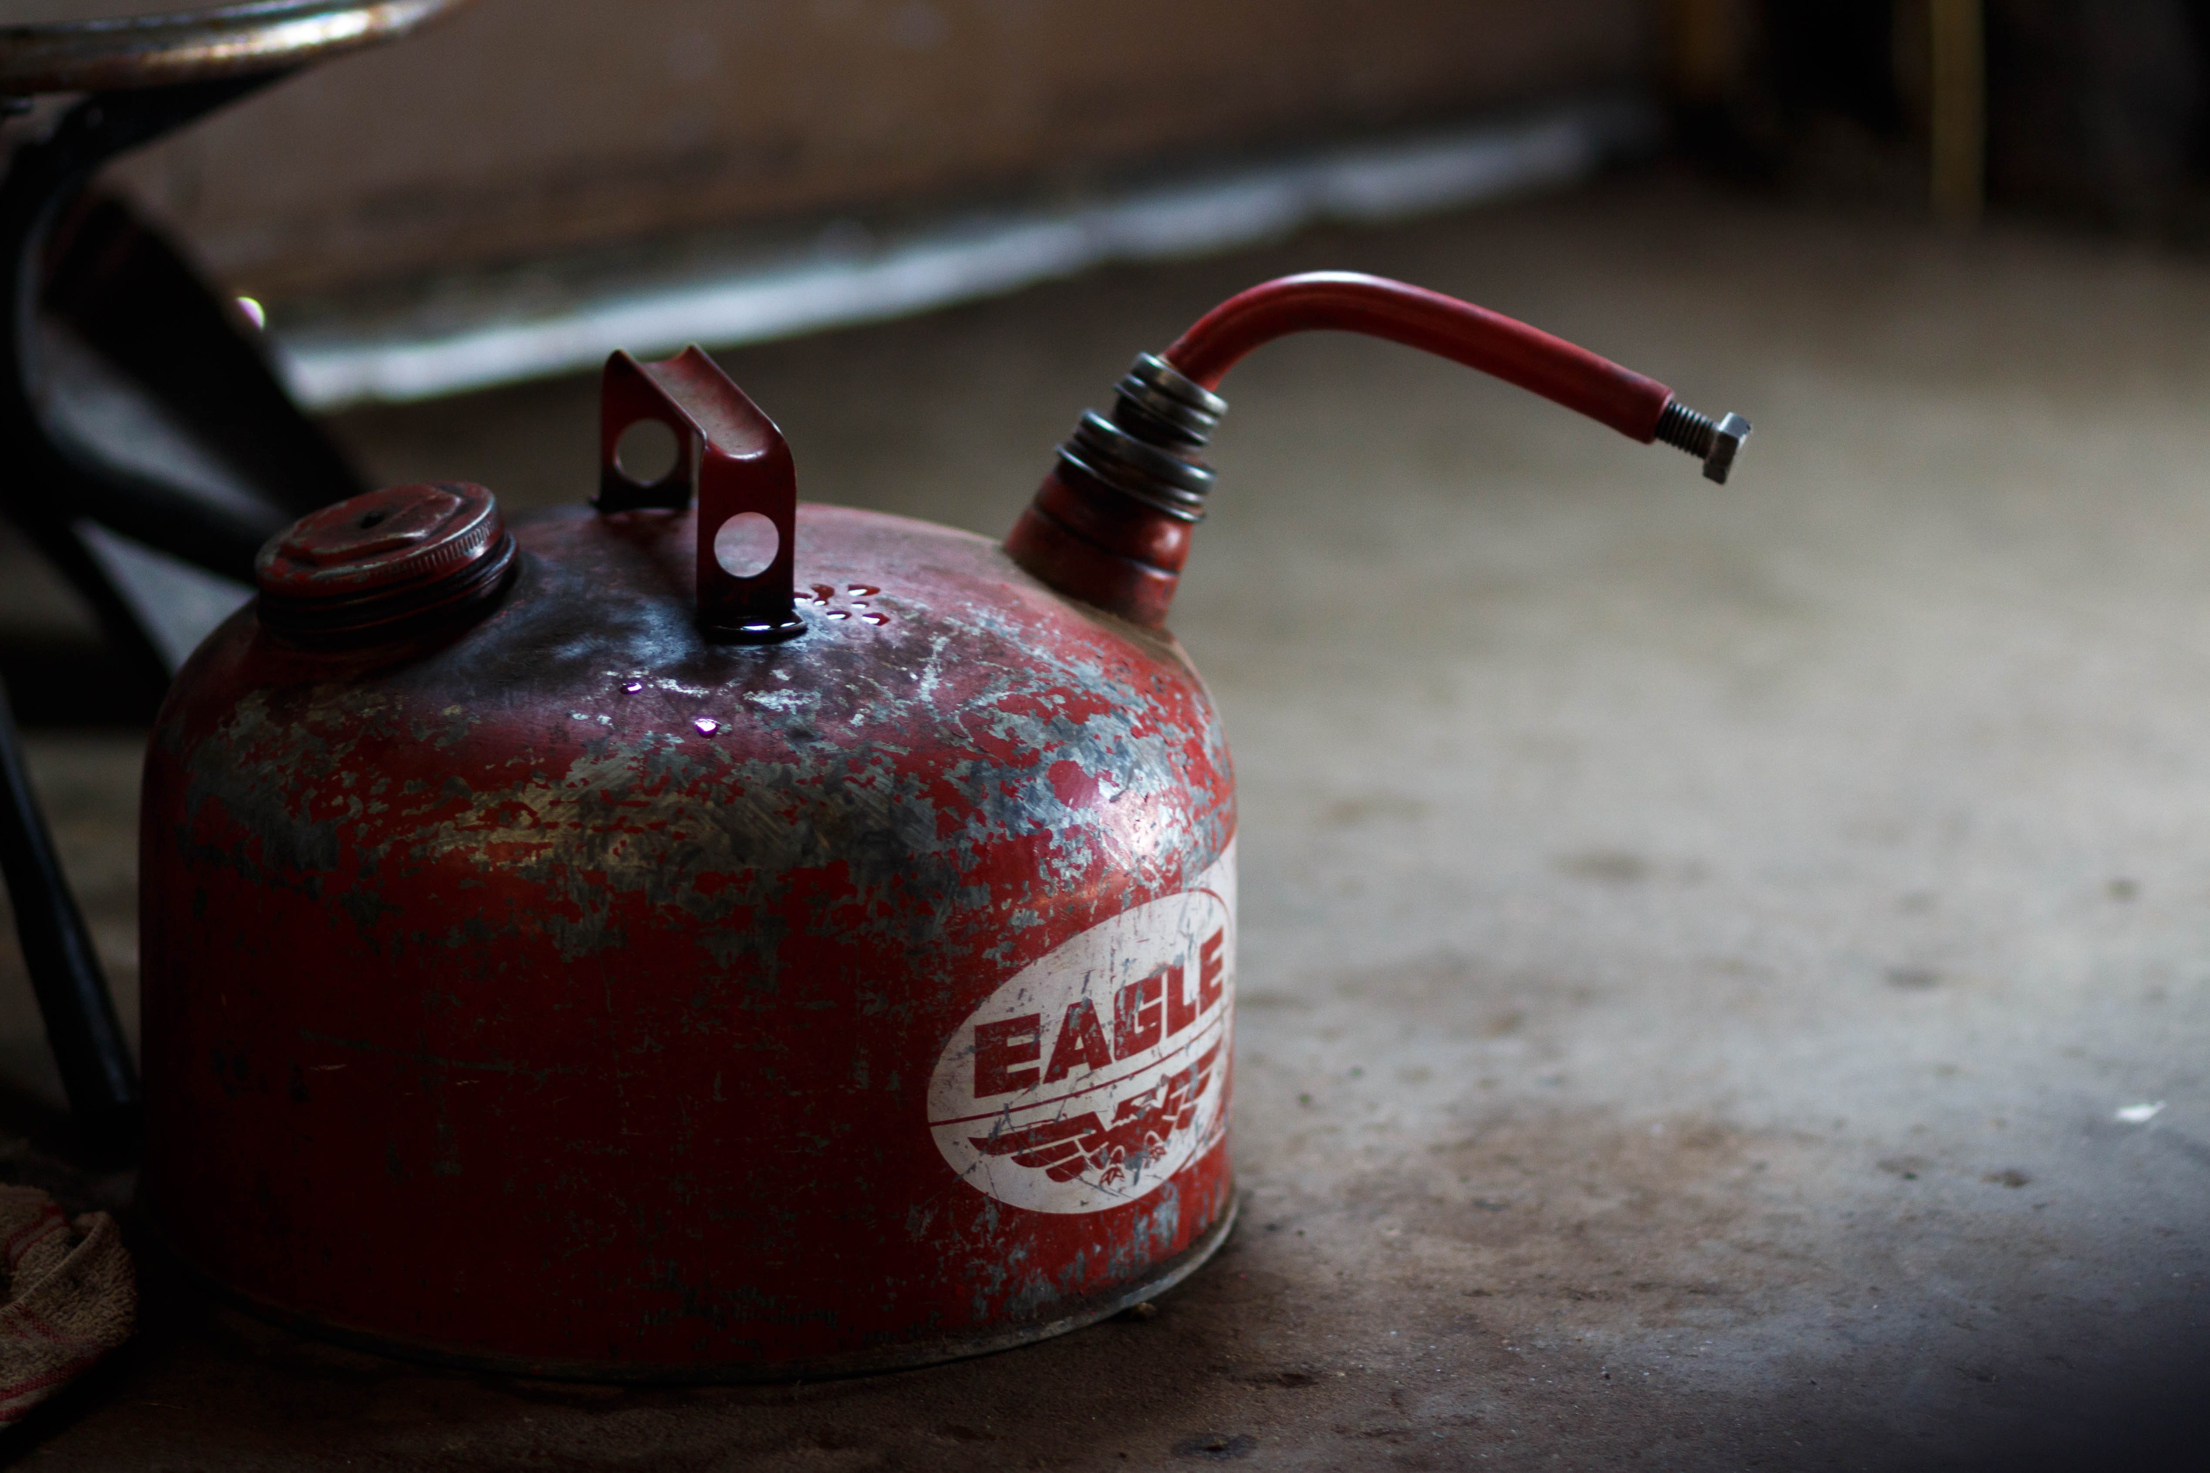
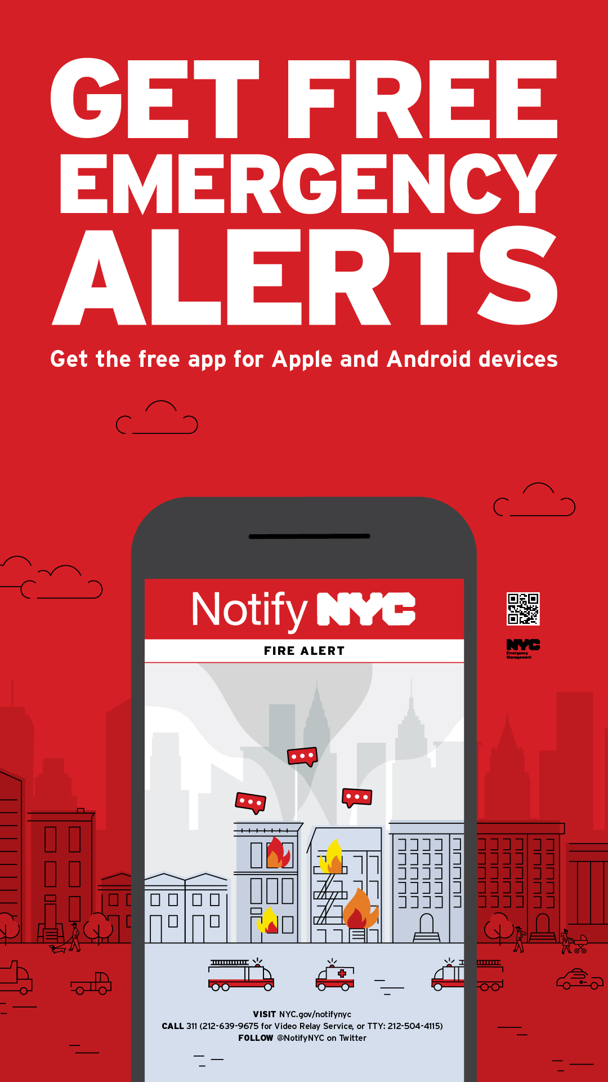
Are you ready?
PREPARE for a possible fuel shortage
Keep adequate supplies on hand at all times
Store fuel in a dry, sealed container away from flammable objects
Photo credit: Madelyn Woods
All New Yorkers should sign up for NotifyNYC to receive up-to-date emergency alerts via www.nyc.gov/notifynyc or follow@notifynyc.

Slide 6
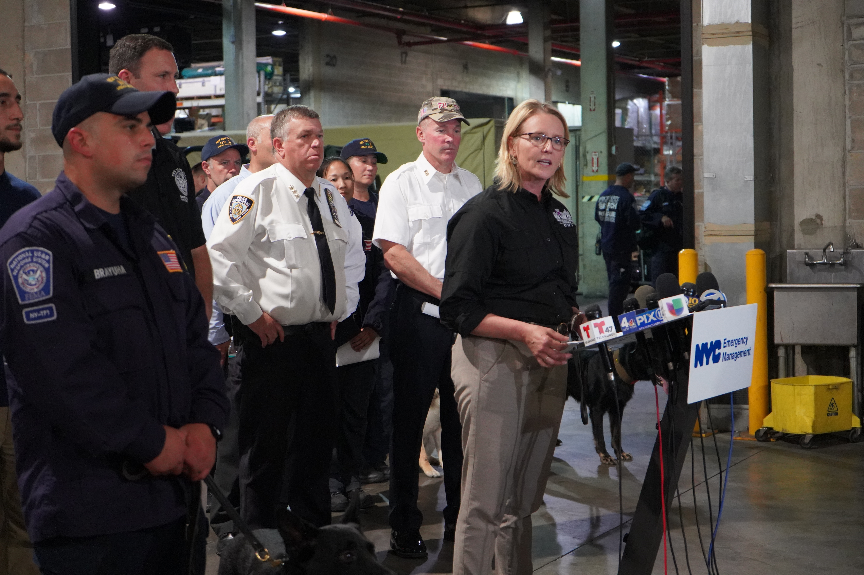
Supply Distribution Update
Tuesday, November 16, 10:00 AM
During a morning press conference, NYCEM announces that borough-based emergency fuel sites have been set up in all five boroughs. Priority will be given to emergency and city-owned vehicles due to the limited supply.
Considerations:
Is the organization prepared to deal with limited access to fuel locations?
Will staffing be an issue for your organization based on commuting challenges?

Slide 7
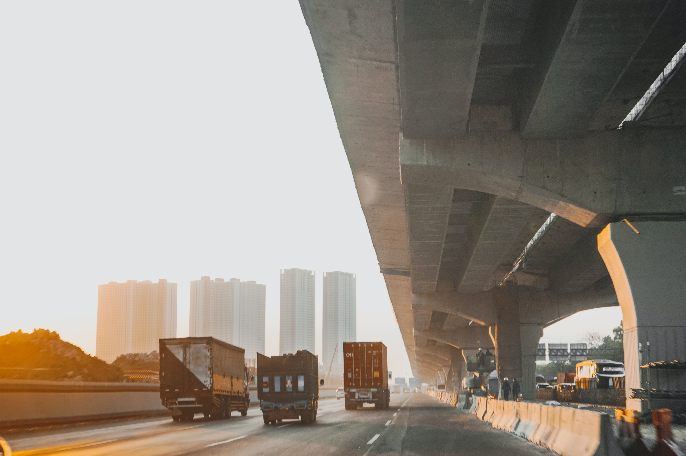
Growing Concerns
Tuesday, November 16, 2:00 PM
One of your vendors has contacted your organization to notify you that a shipment of supplies critical to your organization has been delayed as a result of the fuel shortage. The vendor has prioritized other organizations and won’t be able to deliver for several days.
Photo credit: Indira Tjokorda
Considerations
How is your organization prepared to respond to this?

Slide 8

Executive Order Announced
Thursday, November 18, 10:00 AM
The mayor announces an executive order for odd-even license plate alternate day fueling. Vehicles with a license plate ending in an even number may only receive fuel on even calendar days, while license plates ending in an odd number may only receive fuel on odd calendar days.
Considerations
How does this disrupt your employees’ ability to commute to work?
Are organization vehicles prepared for a fuel shortage?

Slide 9

Schools Stay Open
Thursday, November 18, 3:00 PM
The Department of Education announced that the fuel shortage will not impact school openings. Multiple employees from your organization expressed concern with dropping their children off at school. They believe they will not have sufficient fuel to travel to work and school.
Considerations
How does this disrupt day-to-day operations?

Slide 10
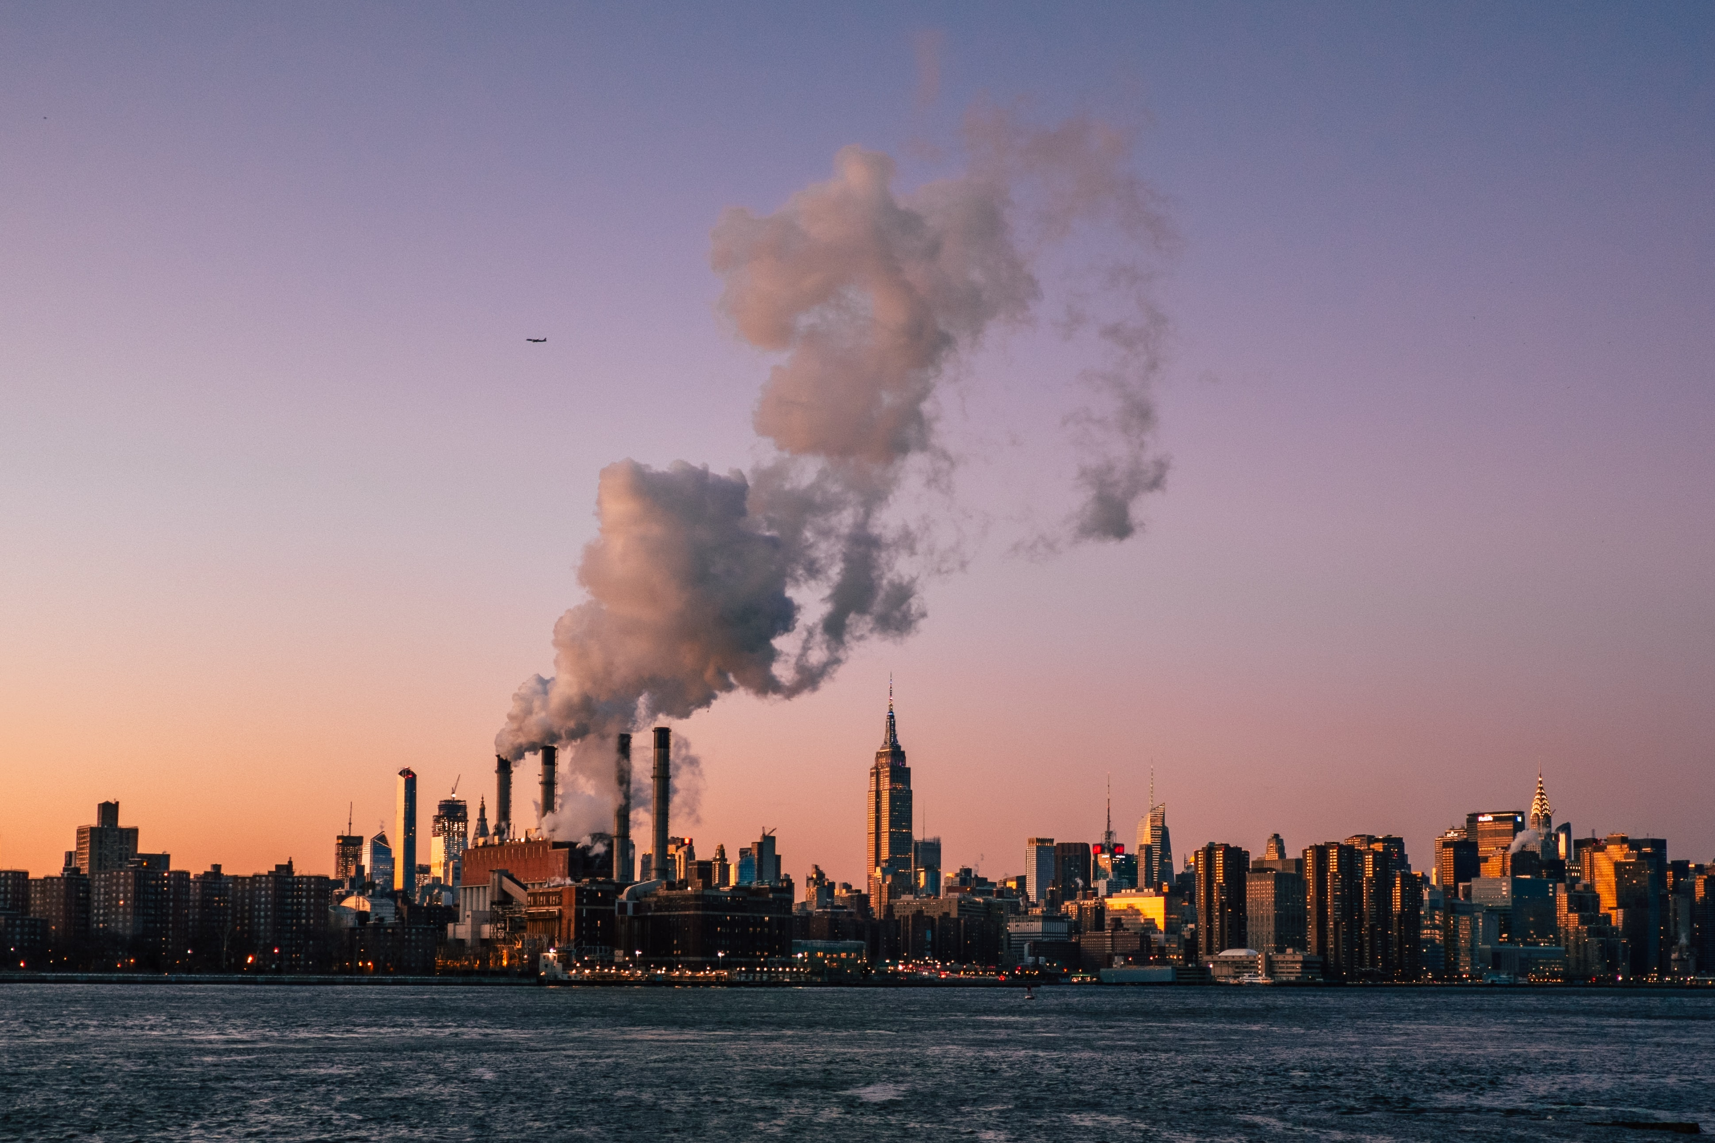
The Situation Improves
Tuesday, November 23, 9:00 AM
The fuel supply chain disruption has begun to ease as the response to the coastal storm has improved
The mayor has disseminated alerts requesting residents to continue limiting unnecessary travel in order to assist in relieving stress to the fuel supply chain
Photo credit: Matteo Catanese
Considerations:
Is the organization prepared to continue to have limited access to fuel?

Slide 11

Moving Forward
Friday, November 26, 12:00 PM
The supply of petroleum to New York has been fully restored and there is no longer anticipated disruptions
The odd-even license plate executive order has been lifted and the public is free to travel at their leisure
Delivery of goods is expected to be restored unhindered
Considerations:
How will the organization return to day-to-day operations?

Slide 12
Thank you
For more information about the resources that NYC Emergency Management has available for organizations, please visit us at NYC.gov/emergencymanagement or email us at publicprivate@oem.nyc.gov.

