Slide 1
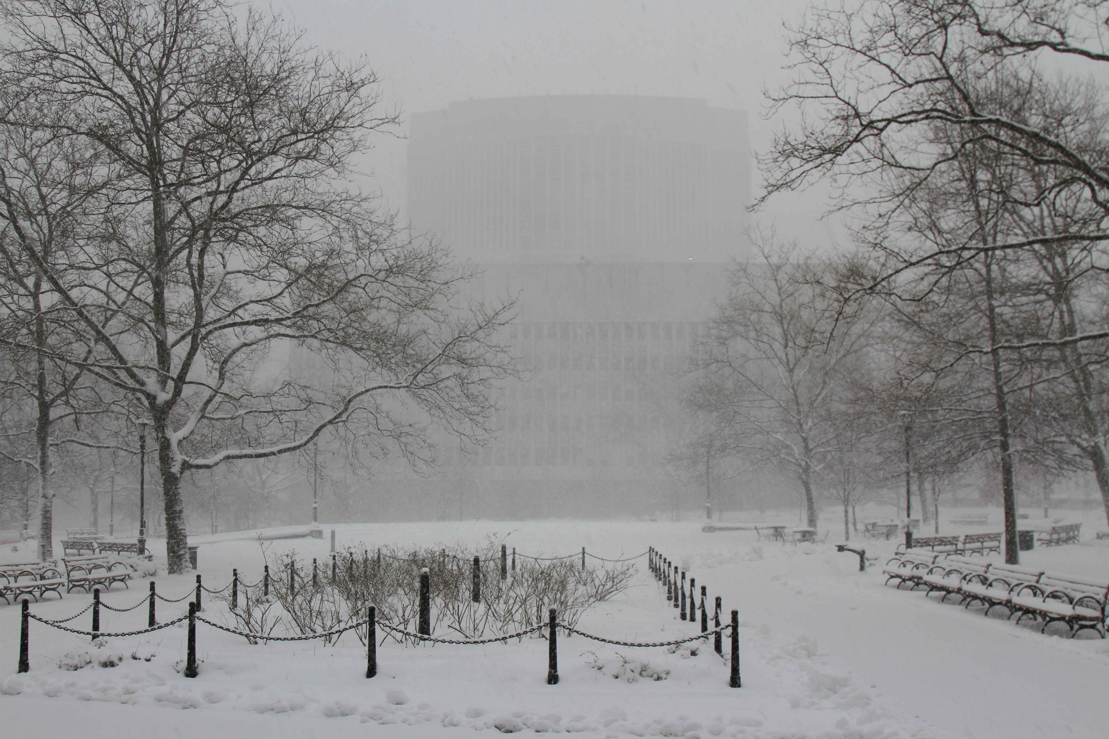
Tabletop exercise
Date
Time
Company/Organization
Disclaimer: These customizable exercise templates were created for the use of private sector organizations by New York City Emergency Management (NYCEM). NYCEM is not responsible for any changes made to exercise materials by participating organizations. The scenarios presented are fictional, and NYCEM cannot guarantee that the City agency actions depicted here will be the City’s response for similar incidents. For more information about the resources NYC Emergency Management has available, please visit us at NYC.gov/emergencymanagement or email us at publicprivate@oem.nyc.gov.

Slide 2
Ground Rules
Don’t fight the scenario! It is a tool to guide the discussion.
This exercise will be held in an open, low-stress, no-fault environment. Varying viewpoints, even disagreements, are expected.
Respond to the scenario using your knowledge of your organization’s current plans and capabilities.
Decisions are not precedent-setting and may not reflect your organization’s final position on a given issue. This exercise is an opportunity to discuss and present multiple options and possible solutions.
Issue identification is not as valuable as suggestions and recommended actions that could improve response efforts. Problem-solving efforts should be the focus.
The Parking Lot: A place to note ideas that can be discussed at a later time.

Slide 3
Background
Tuesday, December 11, 10:30 AM
The winter has been relatively mild, and holiday season is in full swing with more than usual city street congestion. Several of the organization’s employees are chatting about plans to complete their holiday shopping this week when someone warns of expected inclement weather in the coming days.
Sarah states, “the news is predicting up to 8 inches of snowfall starting tomorrow around 10:00pm.”
Dave replies, “Oh, it’s never as bad as they say.”

Slide 4
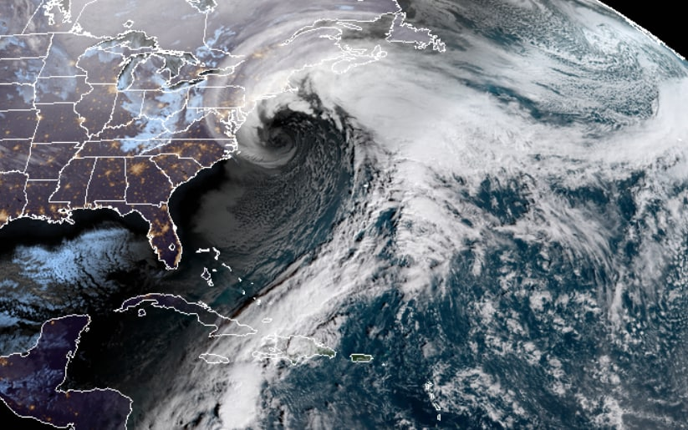
Reality Check
Tuesday, December 11, 4:00 PM
Local meteorologists are reporting that a nor’easter has formed off the East coast with the potential to affect the entire Northeast region over the next few days. The storm could bring more than 12 inches of snow to New York City.
Considerations:
What is the organization concerned about at this point?
Is there a designated process for coordinating the organization’s preparation?

Slide 5
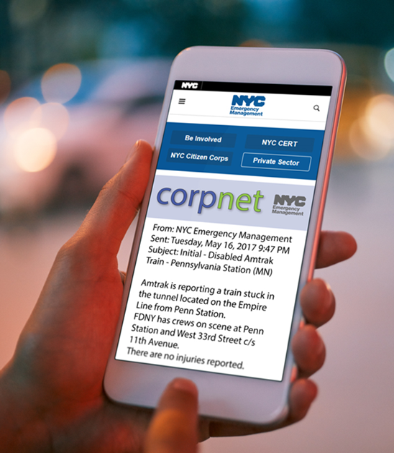
Winter Storm Watch
Tuesday, December 11, 4:00 PM
New York City Emergency Management messaging includes the following CorpNet notification:
Precipitation is expected to begin Wednesday night between 10-11 PM. Heaviest snow Thursday between 4 AM and 2 PM.
Snow totals – 10.0 - 12.0 inches (worst case 14.0 – 16.0 inches). Northern Manhattan and the Bronx could see higher amounts. 1.5 - 2.5 inches of snow per hour is possible during the heaviest period.
Snow starts to wind down Thursday evening between 6-7 PM and taper off at approximately 8 PM.
Total liquid equivalent: 1.25 inches
Current temperature: 38 degrees
Temps drop to the low-30s when the snow starts.
Temps will hover just below 31F throughout the snowstorm.

Slide 6
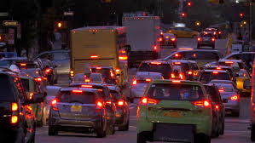
Logistical Challenges
Wednesday, December 12, 9:00 AM
The National Weather Service (NWS) has issued a Blizzard Warning for the NYC area with 80% confidence of blizzard conditions within 24 hours.
NYC Emergency Management issues a Hazardous Travel Advisory beginning at 8PM.
Considerations:
Does a contingency plan exist for vendor cancellations?
Which employees are considered essential to maintain critical functions?
Will they be equipped to shelter in place?

Slide 7
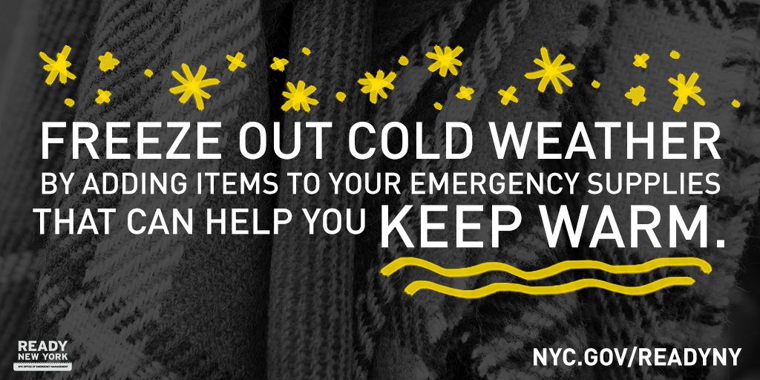
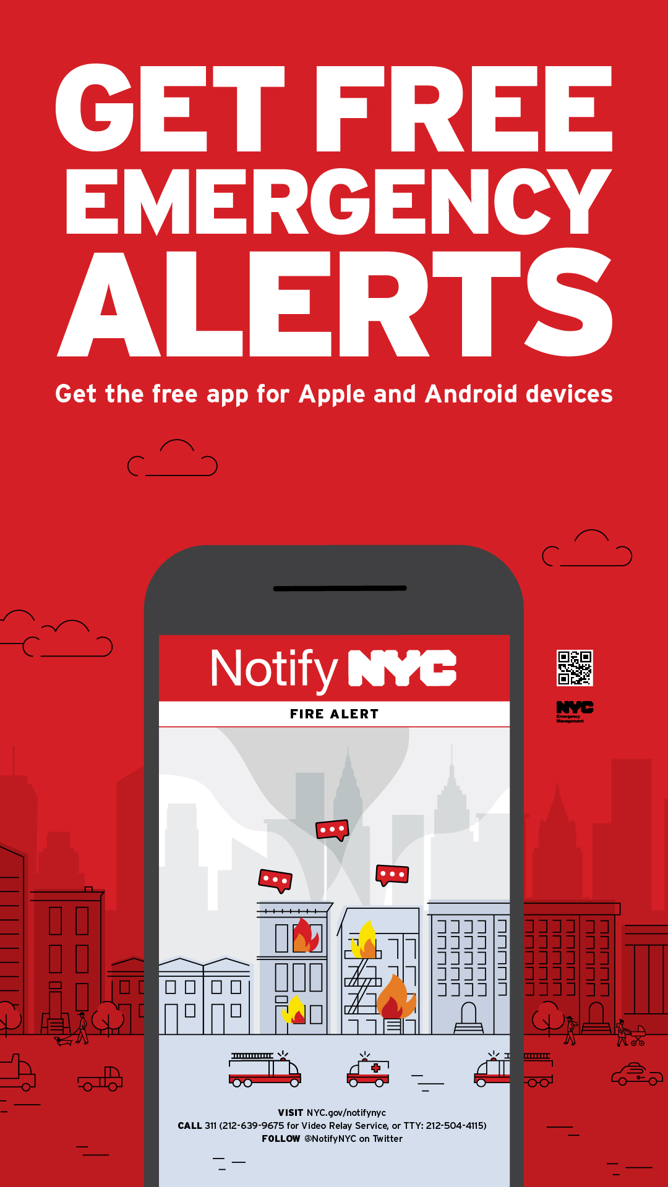
Are you ready?
Winterize your Go Bag by adding a blanket, warm socks, and gloves.
All New Yorkers should sign up for NotifyNYC to receive up-to-date emergency alerts directly from NYCEM’s 24/7 Watch Command.

Slide 8
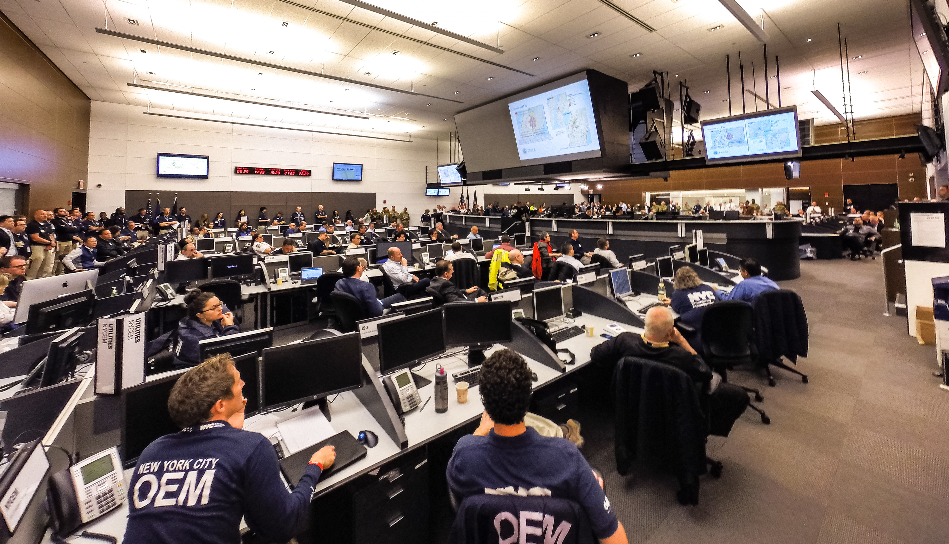
Weather Emergency Declaration
Wednesday, December 12, 6:00 PM
The Mayor’s Office has issued a Winter Weather Emergency Declaration from 10 PM Wednesday until midnight Thursday.
The Mayor urges residents to avoid all driving except in emergencies.
The City officially announces school closures for Thursday.
NYCEM Emergency Operations Center is activated.
MTA will be discontinuing bus and above-ground train services as of 2:00 AM.
CEAS Level A has been activated.
Considerations:
How does the organization stay informed with the most up-to-date alerts?
What impact will this have on your employees?

Slide 9
Nor’easter BEARS DOWN
Thursday, December 13, 9:00 AM
The city is currently experiencing heavy snow with blizzard conditions.
Snow began overnight, with 6 inches having fallen by 7 AM. Currently 9 inches of snow have been reported in Central Park.
There is a high confidence of expected snowfall up to 1.5 feet. There is currently a snowfall rate of 1 to 2 inches per hour, and snow is expected to continue until 8:00 PM tonight.
Significant travel impacts are already being seen around the city.
Bus terminals and airports have cancelled arrivals and departures until further notice.

Slide 10
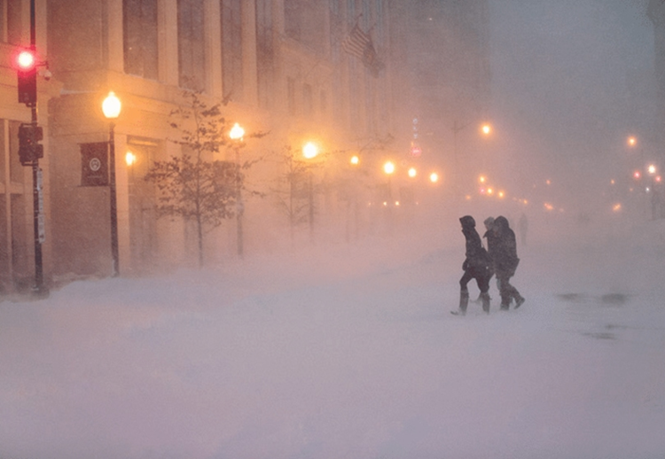
Arctic Impact
Thursday, December 13, 2:00 PM
The facilities manager calls with news that the accumulating ice and freezing temperatures caused a pipe to burst in the facility, leaving only minor water damage but requires a shutdown of all utilities. The building will now be without heat and hot water for at least two days.
Considerations:
Can your organization withstand a utility shutdown? For how long?
Does the organization have the capability to communicate with staff?

Slide 11

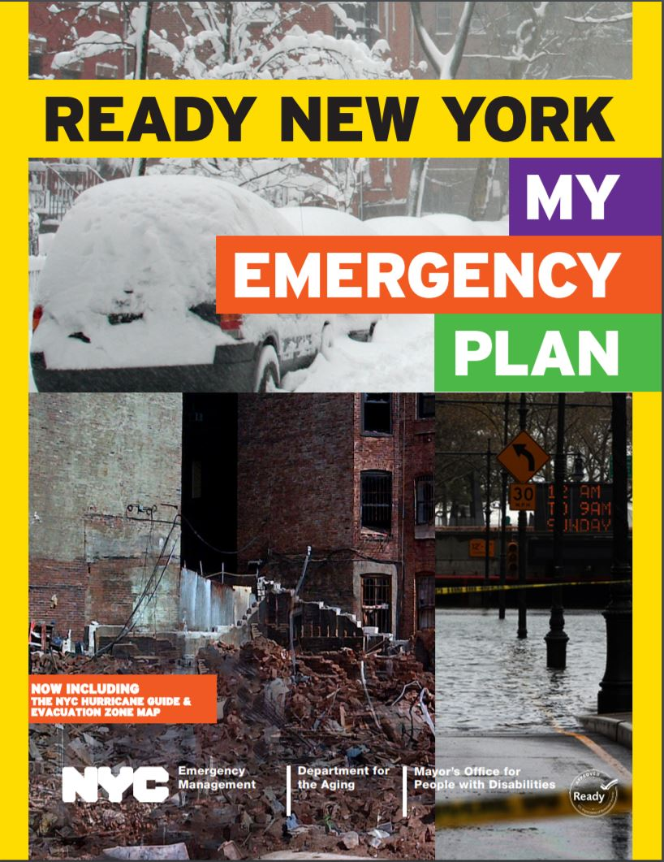
Winter safety tips
Stay safe when shoveling snow, stretch beforehand, and avoid overexertion.
Install and check batteries in smoke and carbon monoxide detectors.
Use only portable heating equipment that is approved for indoor use.

Slide 12
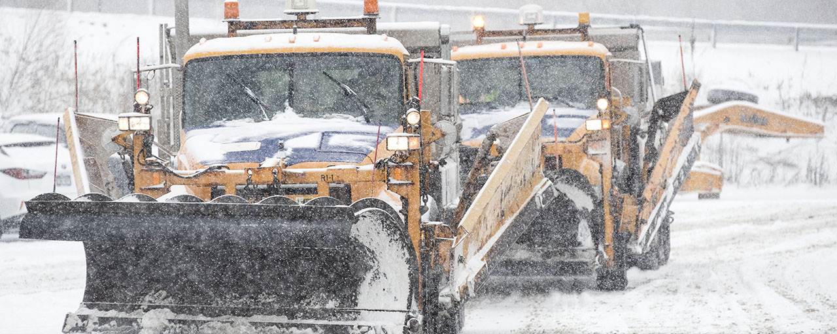
Citywide Concerns
Thursday, December 13, 5:30 PM
Several downed trees have been reported in the Bronx, blocking roadways and damaging homes.
Many residents in Staten Island and certain areas of Brooklyn and Queens are reporting power outages to 311, ConEdison, and PSE&G.
Due to sustained high winds (41 mph), there is a motorcycle, tractor trailer, and full trailer ban for the Verrazano Narrows Bridge.
NYC plow and salt trucks are continuing their operations.
Considerations:
Is the organization prepared to deal with ongoing staff tardiness and/or absenteeism due to commuting challenges?

Slide 13
Thank you
For more information about the resources that NYC Emergency Management has available for organizations, please visit us at NYC.gov/emergencymanagement or email us at publicprivate@oem.nyc.gov.

